Slide 1
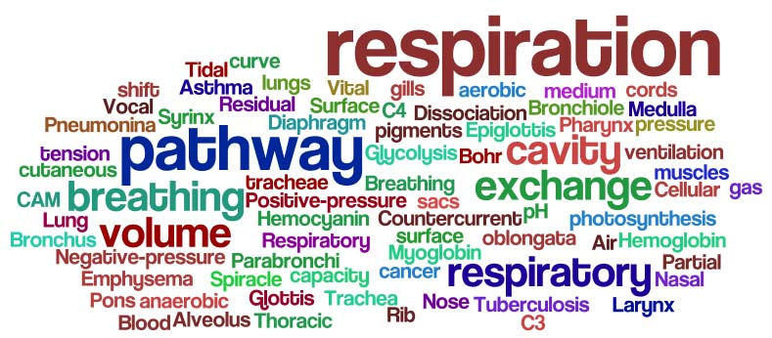
Chapter 10

Slide 2
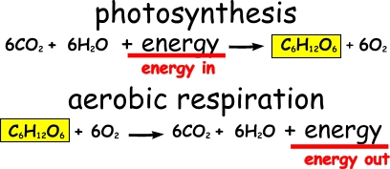

Slide 3
Respiration is the controlled release of energy (ATP) from food/glucose using enzymes.

Slide 4
Respiration occurs in every living cells & is controlled by enzymes.
The released energy is used to make ATP or released as heat.

Slide 5

2 Types of Respiration
Aerobic Respiration –
the release of energy from food in the
presence of oxygen
2. Anaerobic Respiration –
The release of energy from
food without requiring the
presence of oxygen

Slide 6
http://www.science-groove.org/Now/Glucose.mp3

Slide 7
Glucose -- ah, sugar sugar --
You are my favorite fuel
From the blood-borne substrate pool.
Glucose -- monosaccharide sugar --
You're sweeter than a woman's kiss
'Cause I need you for glycolysis.
I just can't believe the way my muscles take you in.
(For you, they'll open the door.)
All it takes is a little bit of insulin
(To upregulate GLUT4).
Ah, glucose -- ah, sugar sugar --
You help me make ATP
When my predators are chasing me.
Ah, glucose -- you're an aldehyde sugar,
And you're sweeter than a woman's kiss
'Cause I need you for glycolysis.
I just can't believe the way my muscles break you down.
(My glycogen is almost gone.)
A few more seconds and I'll be rigor mortis-bound.
(Acidosis done me wrong.)
Your sweet is turning sour, baby.
I'm losing all my power, baby.
I'm gonna make your muscles ache.
No, no, no!
I'm swimming in lactate, baby.
Yes, I'm swimming in lactate, baby.
Now I'm drowning in lactate, baby.
I'm gonna make your muscles ache.
No, no, no!
I'm drowning in lactate, baby.
Ah, glucose -- ah, sugar sugar --
I used you up and you left me flat;
Now I'll have to get my kicks from fat.
Oh, glucose, glucose, sugar, sugar,
The honeymoon is over now.

Slide 8
Learning Check 1
What is respiration?
What type of food is usually found in respiration?
Where is the energy stored in cells?
There are two types of respiration what are they?
What is the difference between each type?

Slide 9
Aerobic respiration:
is the complete breakdown of glucose
releases a large amount of energy
is represented by the balanced equation
C₆H₁₂O₆ + 6O₂ 6CO₂ + 6H₂O + Energy
Glucose + Oxygen Carbon dioxide + water + energy
Notes:
Most living things get energy from aerobic respiration and are called AEROBES
The energy stored in bonds in glucose is released and used to make ATP
When ATP breaks down it supplies energy for all the reactions in a cell such as movement of muscles, growth of new cells etc.

Slide 10
There are 2 Stages in aerobic respiration:
Stage 1
Stage 2

Slide 11
Stage 1
does not use oxygen (anaerobic)
Occurs in the cytoplasm of the cell
releases very little energy
splits 6C glucose into two 3-carbon molecules
C-C-C-C-C-C
C-C-C
C-C-C

Slide 12
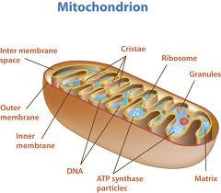
Stage 2
uses oxygen (aerobic)
Occurs in the mitochondria
releases a large amount of energy
converts the 3-carbon molecules to carbon dioxide and water
Notes:
Aerobic respiration is relatively efficient, 40% of the energy in glucose is used to make ATP
Any energy not used to produce ATP is lost as heat

Slide 13
Learning Check
How many stages are there in Aerobic respiration?
Outline what happens during the 1st stage in aerobic respiration.
Outline what happens during the 2nd stage in aerobic respiration
How efficient is aerobic respiration?

Slide 14
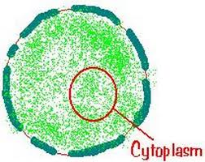
Anaerobic respiration
is also known as Fermentation
does not use oxygen
is a partial breakdown of glucose
releases a small amount of energy
Occurs in the cytosol - the cytoplasm without the organelles

Slide 15
Fermentation
2 types of fermentation:
Lactic Acid Fermentation
Alcohol Fermentation

Slide 16
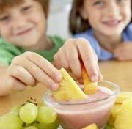
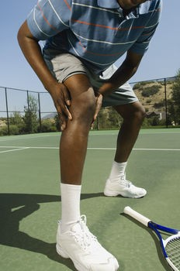
1. Lactic Acid Fermentation
This occurs in some anaerobic bacteria and in animal muscles when there is not enough oxygen
Glucose 2 Lactic Acid + small amount of energy

Slide 17
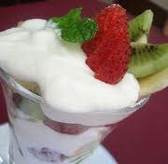
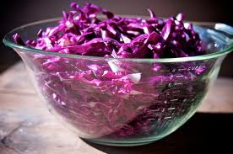
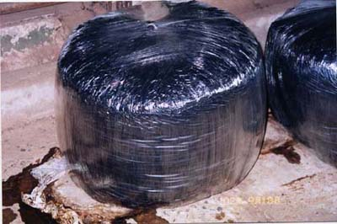
Lactic Acid Industrial Fermentation
In yoghurt production Lactic acid forms when bacteria cause milk to go sour,
when bacteria respire on cabbage to form Sauerkraut &
in silage production.

Slide 18
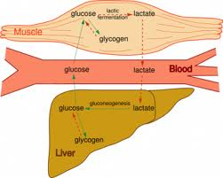
Lactic Acid Fermentation in animal cells
When we exercise and get out of breath not enough oxygen can reach our muscles and anaerobic respiration takes place in the muscle.
This forms lactic acid which
causes cramps, when you
rest the lactic acid is broken
down by the liver.

Slide 19
Learning Check
Does anaerobic respiration require oxygen?
What is glucose broken into?
Is there a lot or a little energy released by anaerobic respiration?
Why is anaerobic respiration described as being less efficient than aerobic respiration
What is fermentation?
There are two types of fermentation what are they?
Which type occurs in animal cells?

Slide 20
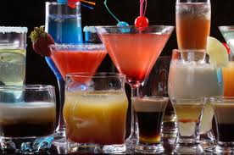
2. Alcohol Fermentation
Takes place in Bacteria and some fungi e.g. yeast and in plants when they are deprived of oxygen
Involves the partial breakdown of glucose
Glucose 2Ethanol + 2Carbon dioxide
+ small amount energy

Slide 21
Learning Check
What kind of organisms carry out alcohol fermentation?
Is glucose fully broken down?
What are the end products of alcohol fermentation?
How can yeast cells be immobilised?

Slide 22
Biotechnology
Biotechnology refers to the use of living things such as microorganisms - bacteria and yeast and enzymes, to carry our useful reactions in industry to carry out different anaerobic or fermentation reactions.

Slide 23
Microorganisms used in bioprocessing
Bacteria can be used to make yoghurts, antibiotics + enzymes
Yeasts can be used to make alcohol for beer and wine, carbon dioxide for baking
Fungi can produce antibiotics and citric acid
Bacteria and fungi may be attached to sand and gravel and then decompose the waste in the treatment of sewage

Slide 24
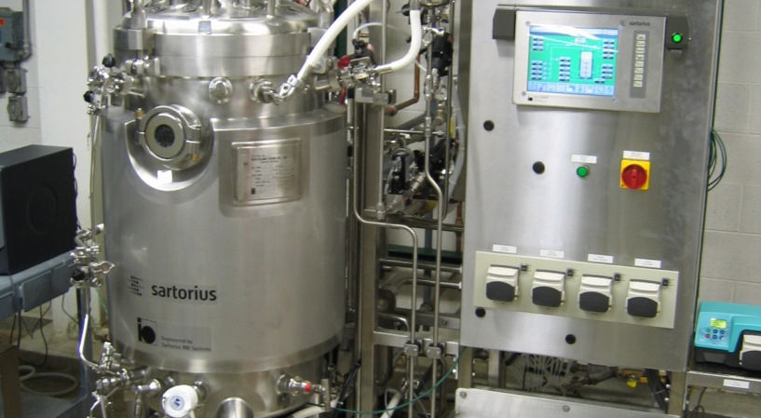
The production of substances by fermentation is an example of bioprocessing.
A bioreactor is a vessel in which bioprocessing takes place

Slide 25
Yeast cells can be immobilised in sodium alginate & placed in a sugar solution in a large bioreactor.
The yeast respires anaerobically to produce alcohol & carbon dioxide as waste products.
Yeast is used in baking, the carbon dioxide gas produced causes the bread to rise.

Slide 26
Immobilised cells are attached to each other or suspended in a gel.
The advantages of immobilised cells are:
they can be reused, resulting in cheaper production
the cells are not damaged by the process
the cells are easy to separate from the product

Slide 27
Learning Check
What is biotechnology?
What is a bioreactor?
Why are microorganisms sometimes immobilised?
How is immobilisation achieved?
Can you give some examples of uses of immobilised cells?
What are the advantages of immobilising cells?

Slide 28
Higher Level

Slide 29
Aerobic Respiration occurs in 2 stages
Stage 1 Glycolysis
Stage 2

Slide 30
Stage 1 Glycolysis
Takes place in the cytosol (the cytoplasm without the organelles) as enzymes are found here
Does not require oxygen
It only releases small amounts of energy
Is the same for both aerobic and anaerobic respiration

Slide 31
Glucose a 6 carbon sugar is split into two molecules of pyruvic acid 3C
with the release of a small amount of energy which is used to make 2 ATPs molecules

Slide 32
Learning Check
What is the first stage of respiration called?
Where does this stage take place?
Why does it take place here?
Does this stage require oxygen?
Does it release much energy?
Does it occur in aerobic respiration, anaerobic respiration or both?
What is the 6-carbon sugar broken into?

Slide 33
If oxygen is not present then pyruvic acid is converted to:
lactic acid in lactic acid fermentation, takes place in some bacteria and mammal muscle
ethanol and carbon dioxide in alcohol fermentation, takes place in some bacteria and yeast

Slide 34
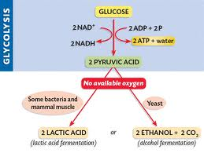

Slide 35
Anaerobic respiration
is represented by the word equations:
Glucose 2 lactic acid + some energy
Glucose 2 ethanol + 2 carbon +some dioxide energy

Slide 36
Stage 2
If oxygen is present stage 2 proceeds in the mitochondrion as the necessary enzymes are found here
This stage requires and uses oxygen
It releases a large amount of energy
Pyruvic acid is broken down during the
Krebs cycle reactions and the
electron transport system.

Slide 37
Learning Check
Where does the second stage take place?
Why does it take place here?
Does this stage require oxygen?
Does it release much energy?
Does it occur in aerobic respiration, anaerobic respiration or both?
What is the 3-carbon sugar broken into?

Slide 38
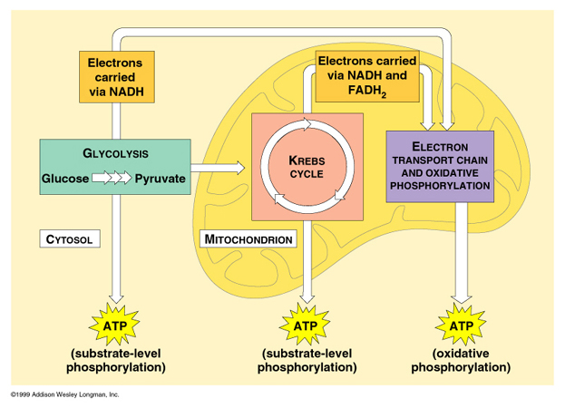

Slide 39
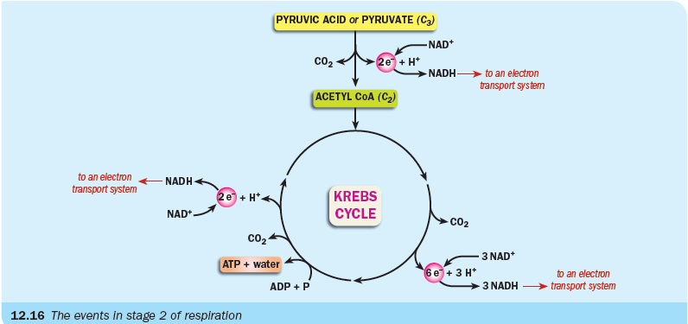
In Krebs cycle:
Pyruvic acid 3C loses a Carbon atom to become acetyl CoA 2C
acetyl CoA goes through a cycle of reactions and is converted to carbon dioxide and hydrogen
high-energy electrons and protons (H+) are released to form several NADHs
ADP is converted to ATP

Slide 40
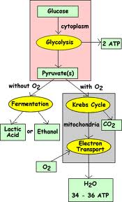

Slide 41
In the electron transport systems located on the inner membrane of the mitochondrion:
NADH releases high-energy electrons
these electrons pass from molecule to molecule along the system
releasing energy as they pass along
which is used to form ATP
finally, electrons combine with oxygen and hydrogen to form water

Slide 43
Learning Check
What is the 3-carbon sugar broken into?
What is acetyl CoA converted into?
What are released to form several NADHs?
What is ADP converted into?
Where is the electron transport systems located?
What does NADH release?
What does the releasing energy form?
What do the electrons combine with to form water?

Slide 44
Aerobic respiration
involves both stage 1 - anaerobic, low energy release
and stage 2 - aerobic, high energy release
Anaerobic respiration
only involves stage 1 and is a low-energy release process

Slide 45
Differences between Aerobic and Anaerobic Respiration
 | Aerobic | Anaerobic
Location | Cytoplasm and Lumen and Cristae of mitochondria | Cytoplasm
Oxygen Requirements | Uses O₂ | Does not use O₂
End Products | CO₂ + H₂O | Ethanol +CO₂ _{or} Lactic acid
Energy Produced | Lots of energy (38 ATP) | Little energy (2 ATP)

Slide 46
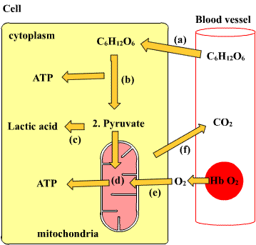

Slide 47
To prepare alcohol:
mix glucose and water
boil the solution
add yeast
cover with oil
leave in a warm place

Slide 48
To show the production of alcohol:
add acidified potassium dichromate
warm in hot water
if the colour turns from orange
to green
then alcohol is present
Or
To show the production of ethanol:
add potassium iodide
add sodium hypochlorite
if the colour changes from brown-orange
to pale yellow,
ethanol is present

