Slide 1
Chapter 14
Genetics and Evolution

Slide 2
Lesson Objectives
At the end of this lesson you should be able to
Define the terms:
Species
Heredity
A gene
Gene expression
alleles

Slide 3
Species
A group of organisms that can interbreed and produce fertile offspring.
Humans
Cats
Oak Trees

Slide 4
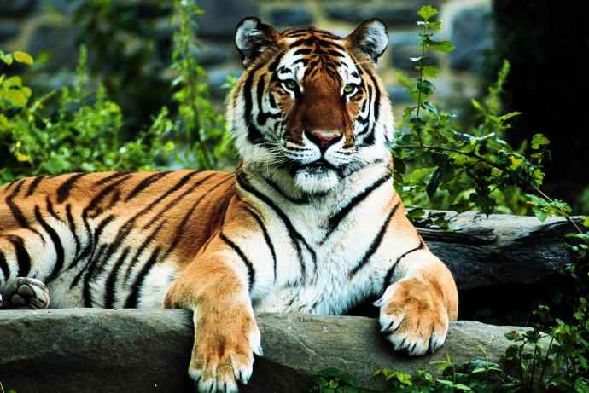
Tiger – a member of the cat family

Slide 5
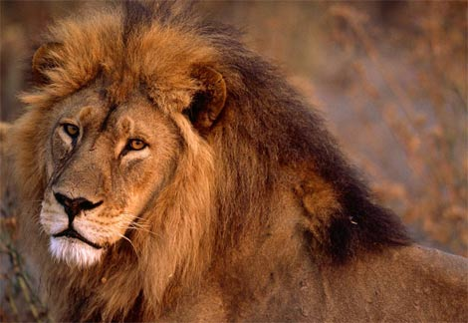
Lion – a member of the cat family

Slide 6
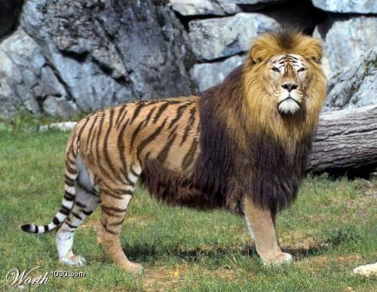
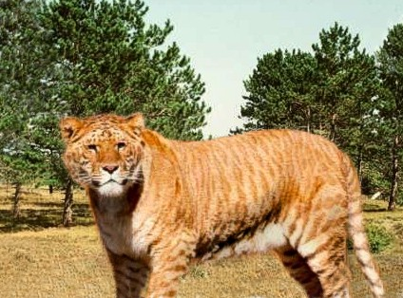
Liger = Male Tiger + Female Lion

Slide 7
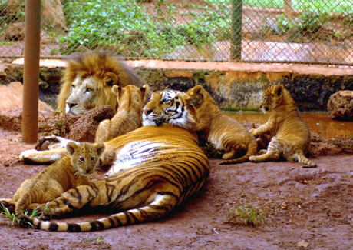
Liger Family in Chinese Zoo

Slide 8
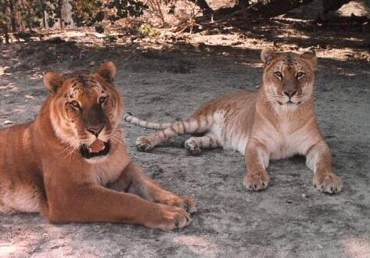
Tigon = Male tiger + Female Lion
Males are sterile but female are fertile – so not a new species

Slide 9
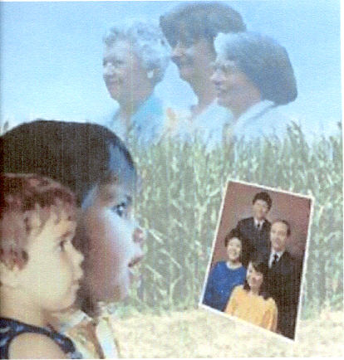
Heredity
(or genetic inheritance) is the study of the inheritance of characteristics from one generation to the next.
Notes:
Heredity is the transmission of characteristics such as eye colour, shape of nose in animals, colour of petal, type of venation in plants from parents to offspring.
However every animal & plant is the product of both heredity and their environment.
For example, a cow might have inherited a trait for yielding large quantities of milk. The mere possession of that trait is not enough to yield milk. The cow must also get the necessary food and nutrients from the environment to make that trait work and yield the milk. Thus there is a definite relationship between heredity and the environment. Each is equally important.

Slide 10
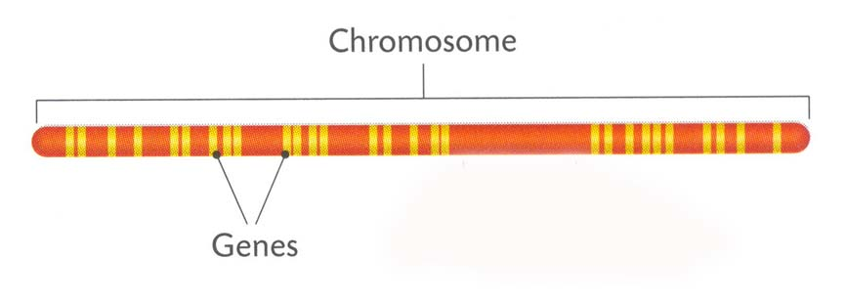
Chromosomes
Notes:
Chromosomes contain a number of genes arranged along the DNA of the chromosome

Slide 11
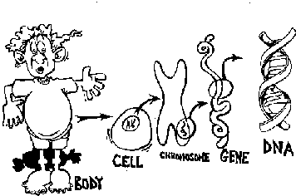
Recall that genes are located on chromosomes which are located in the nucleus
image from http://regentsprep.org/Regents/biology/units/heredity/dna.cfm

Slide 12
Chromosomes
Thread like structures
Contains 60% DNA
Contains 40% Protein
Contains Genetic Information
Occur in pairs
Found in the nucleus of all cells

Slide 13
Genes
A gene is a length of DNA that codes for a specific protein
It is the unit of inheritance
It is found on a chromosome
It contains instructions to make a particular protein
It directly influences the characteristics of an organism
Notes:
Genes only comprise about 3% of the DNA in human cells.
The rest of the DNA is said to be non-coding.

Slide 14
Genes & Characteristics
Characteristics are controlled by genes.
For example everyone has genes which determines hair colour.
But not everyone has the same version of those genes.
So there is more than one type of gene for hair colour that you could have.

Slide 15
Gene Expression
Is the process of changing the information in a gene into a protein.
Not all genes are expressed
  E.g. The gene for Tallness
  Organism is small – Why?
  Maybe due to poor nutrition
18 thinks to know about Genetics
Notes:
18 Things You Should Know About Genetics is an animated film that presents fundamental background information about genetics, as well as offering some quirky but interesting facts about DNA, genes and genetics. It was created to be an upbeat, fun educational short film to initiate and draw interest to this sometimes daunting and seemingly complex subject matter.

Slide 16
Characteristics
Characteristics =
heredity + environment
Notes:
Characteristics arise from the interaction of genes and their environment.

Slide 17
Alleles
Are the alternative forms of the same genes.

Slide 18
You usually have two "homologous" chromosomes - two copies of the same chromosome. They're the same chromosome as in "two copies of Chromosome 5" but they're not exactly the same as each other, they've got the same genes on them but for example a gene may be slightly different on one of the chromosomes.
So let's take Gene X and Chromosome 5. Gene X is located on Chromosome 5. You've got two copies of Chromosome 5, so that means two copies of Gene X. These two copies of the gene are called "alleles". They might be the same as each other, or they might be slightly different from each other, but they are both still Gene X and so are called alleles. Gene X on one Chromosome 5 is an allele of Gene X on the other Chromosome 5.

Slide 19
Homologous Chromosomes
eye color locus
B = brown eyes
eye color locus
b = blue eyes
This person would have brown eyes (Bb)
Paternal
Maternal

Slide 20
Learning Check 1
Define the following terms:
Species
Heredity
A gene
Gene expression
Alleles

Slide 21
Outline of Fertilisation
Gametes join together by fertilisation
Form a diploid zygote
This develops into an embryo
Eventually into a new individual
New individual resembles both parents – but is not identical to either

Slide 22
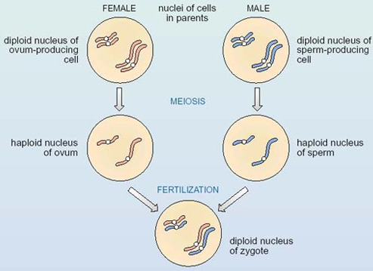

Slide 23
What are Gametes?
Reproductive / Sex Cells
Formed by meiosis
Contain single sets of chromosomes - haploid
Capable of fusion to form zygote - diploid
Zygote contains genetic information of both gametes

Slide 24
Meiosis - eye color
B
B
sperm
B
Bb
haploid (n)
b
b
diploid (2n)
b
meiosis I
meiosis II

Slide 25
Learning Check 2
What are reproductive cells called?
Where are they found?
Are they haploid or diploid cells?
How are they formed?
What is a zygote?

Slide 26

DNA
Deoxyribonucleic Acid

Slide 27
Lesson Objectives
At the end of this lesson you should be able to
Outline the simple structure of DNA
Name the four bases and the base pairs in DNA
Distinguish between coding and non coding structures
Define triplet base code
Outline the structure of RNA
Name the bases in RNA
Discuss the replication of DNA

Slide 28
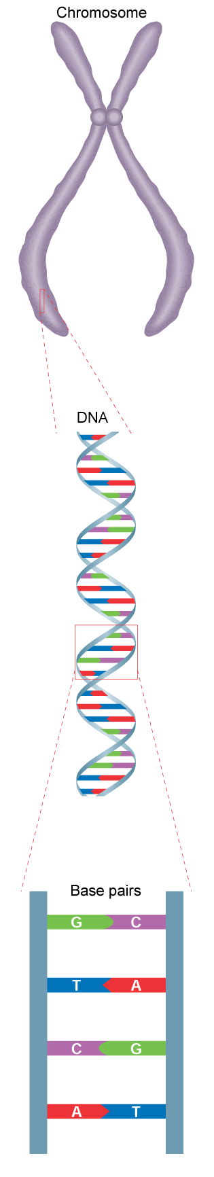
DNA

Slide 29
What is DNA
Two parallel strands
Linked to each other by pairs of complementary bases
Made up of units called nucleotides
Notes:
Is a long, double-stranded molecule.
Carries and passes on genetic information

Slide 30
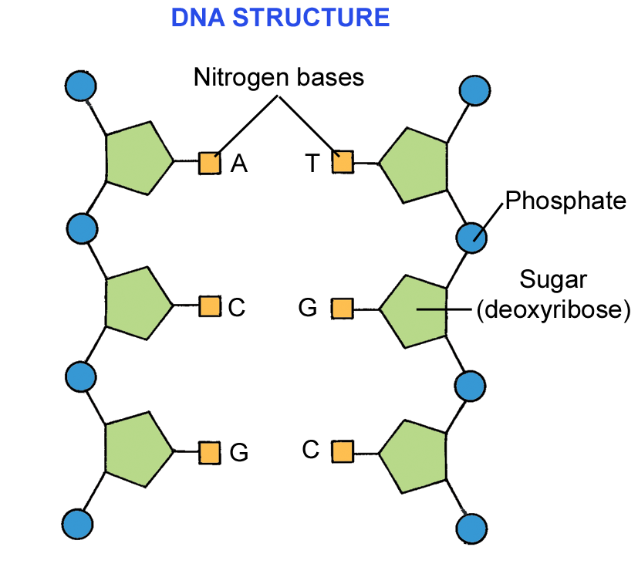
Nucleotides
Consist of:
A phosphate group
A sugar – deoxyribose &
4 nitrogen containing bases

Slide 31
The 4 Nitrogen containing Bases
    Adenine (A)
    Thymine (T)
    Cytosine (C)
  Guanine (G)

Slide 32
The Base Pair Rule
Adenine can only join to Thymine
A T
Guanine can only join to Cytosine
G C
What are genes?
Notes:
Find out about the basics of cells, chromosomes, and the genes contained in your DNA.

Slide 33
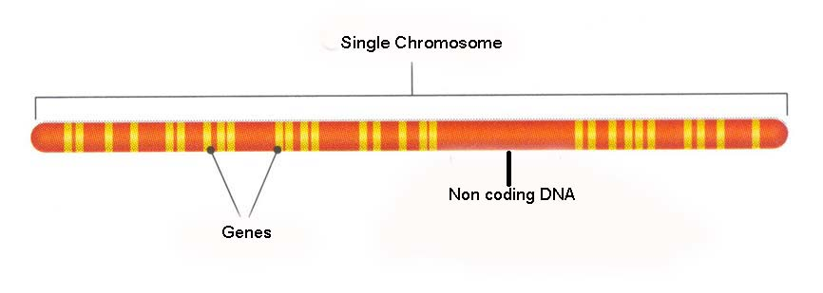
Non Coding & coding DNA
97% of DNA does not consist of genes.
This DNA is said be non-coding / junk DNA / Interons
The 3% of DNA that contains information to code for protein synthesis is called exons.

Slide 34
Building DNA
Drap & Drop DNA Model making
DNA Information
DNA, Fantastic! Mr. W's DNA Rap
Mr. Lee - Genetics rap
GENEticS / Jeans rap song

Slide 35
Learning Check 3
What does DNA stand for?
Name the four bases in DNA
Which base complements Adenine?
Which base compliments Guanine?

Slide 36
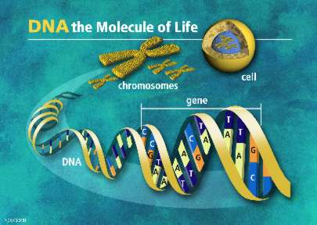
DNA PROFILING

Slide 37
Lesson Objectives
At the end of this lesson you should be able to:
Discuss the stages involved in DNA profiling
Define the process of DNA profiling
Give two uses of DNA profiling
Define and give a use for genetic screening

Slide 38
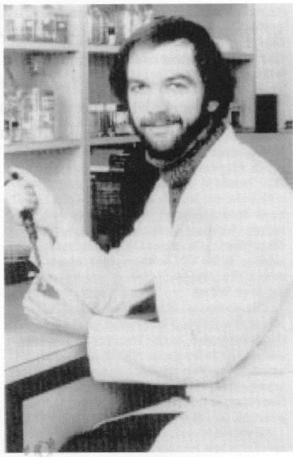
DNA PROFILING
1980 - American researchers discovered non-coding regions of DNA
1984 - Professor Alec Jeffries developed the process of DNA profiling
1987 - First conviction based on DNA evidence
Notes:
Like several other significant discoveries in biotechnology genetic fingerprinting was discovered by scientists who were searching for something else. However, unlike many other advances in modern genetics DNA profiling has already had a major effect on the lives of thousands of ordinary people throughout the world. In 1984 Prof Alec Jeffreys of the University of Leicester in England was studying the gene for myoglobin ,a protein that stores oxygen in the muscle. He found that part of the gene did not carry instructions for the manufacture of myoglobin ( non coding DNA sequence) Instead, this bit of DNA consisted of an unusual sequence of bases repeated several times.Jeffreys realised these apparantly useless,harmless pieces of DNA could act as genetic markers for the myoglobin gene – helpful in tracking down its location on a particular chromosome. To his surprise Jefferys found that the sequence of non coding DNA from the myoglobin gene occurred in many different places throughout the human chromosome . Further investigation showed that each of the variable regions shared a common sequence of about 16 base pairs. The number of times this sequence occurred was apparantly unique to each individual . Prof. Jefferys was quick to realise that the technique could be used to establish with accuracy the identity and relatedness of individuals
Legal history – made in Nov 1984 when a Bristol man was sentenced to 8 yrs in jail for rape. First conviction based on evidence using the revolutionary tnew technique known as DNA fingerprinting ( matched blood with semen stains on the clothes of his victim)

Slide 39
Principle of DNA Profiling
All human chromosomes have sections of DNA with no known functions
These sections have short base sequences
These sequences repeat over and over
They are inherited from parents
Their length and position are unique to each person

Slide 40
DNA PROFILING
A DNA profile or genetic fingerprint involves a process of making a pattern of bands from an individual’s DNA, for comparison.
Used in forensics & paternity suits.
Notes:
DNA profiles can be used to:
establish whether biological tissue at a crime scene matches or does not match a suspect
determine whether a person is or is not the parent of a child

Slide 41
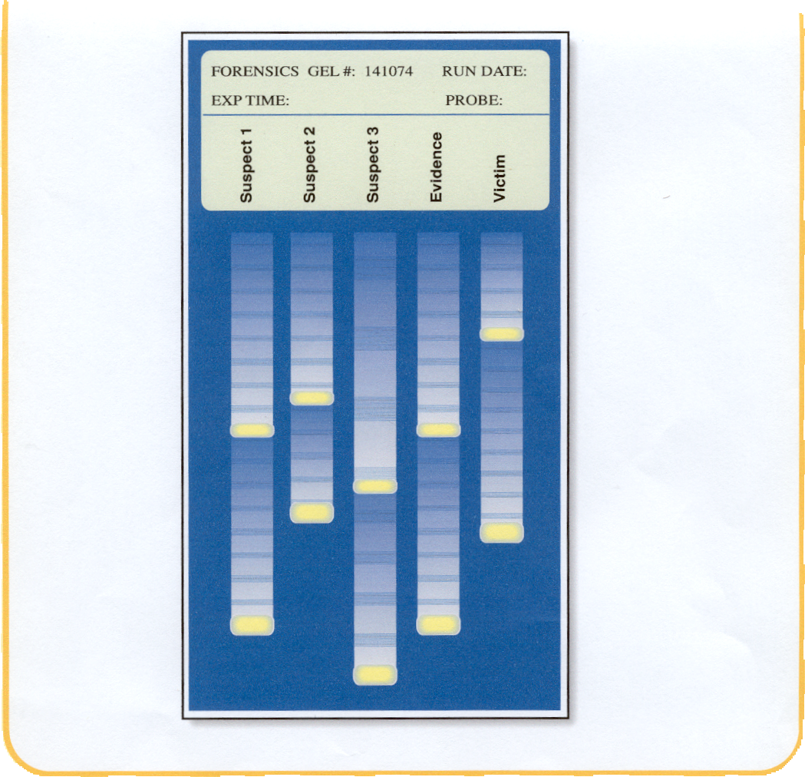
FORENSIC SCIENCE

Slide 42
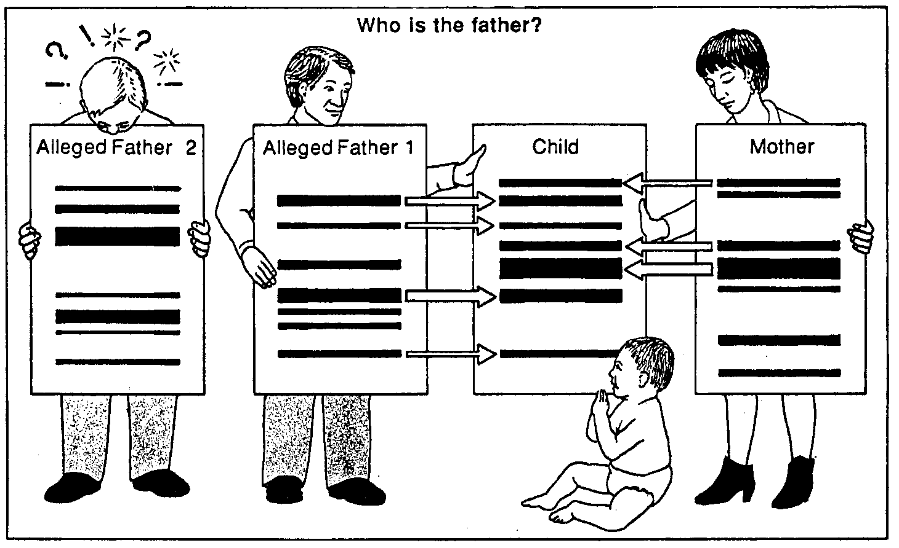
FAMILY RELATIONSHIPS
Notes:
Used in analysis of family relationships in disputed paternity and immigration cases.DNA profiling has also proved valuable in sea & air accidents when victims are beyond recognition.

Slide 43
STAGES INVOLVED
Cells broken down to release DNA
DNA strands cut into fragments using Restriction enzymes
Fragments separated by size.
Pattern of fragments analysed

Slide 44
To isolate DNA from onion cells:
grind up onion tissue in a salt/detergent mixture (to clump DNA and break down cell membranes)
filter the mixture (to remove cell parts); proteins and DNA form the filtrate
add protease enzyme to the filtrate (to remove the protein)
add ice-cold ethanol (to precipitate the insoluble DNA)

Slide 45
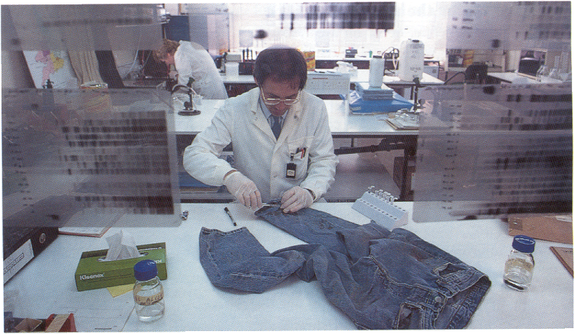
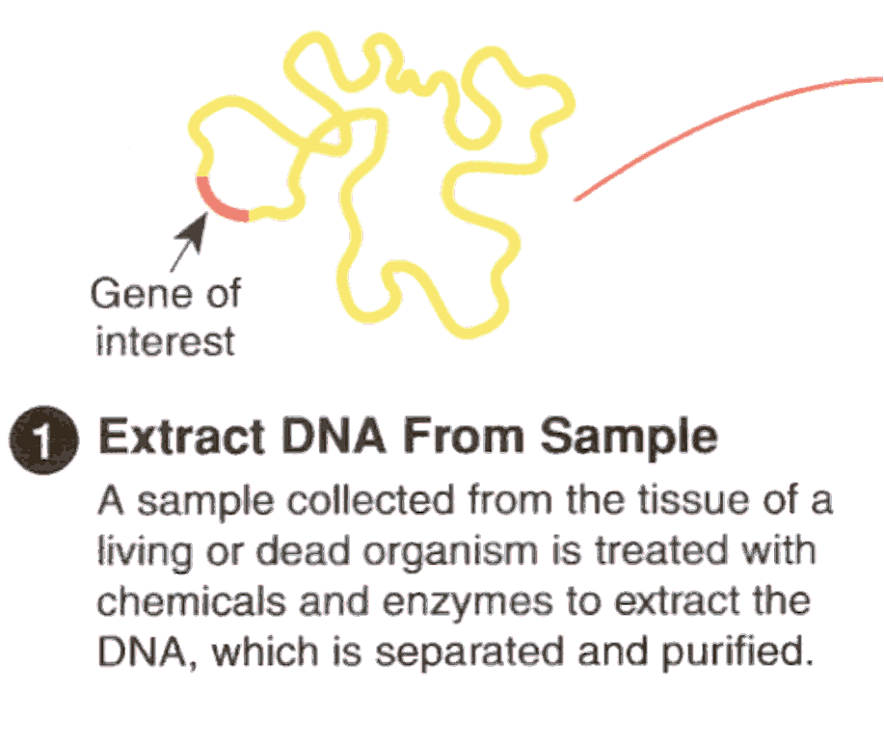
1. DNA EXTRACTION

Slide 46
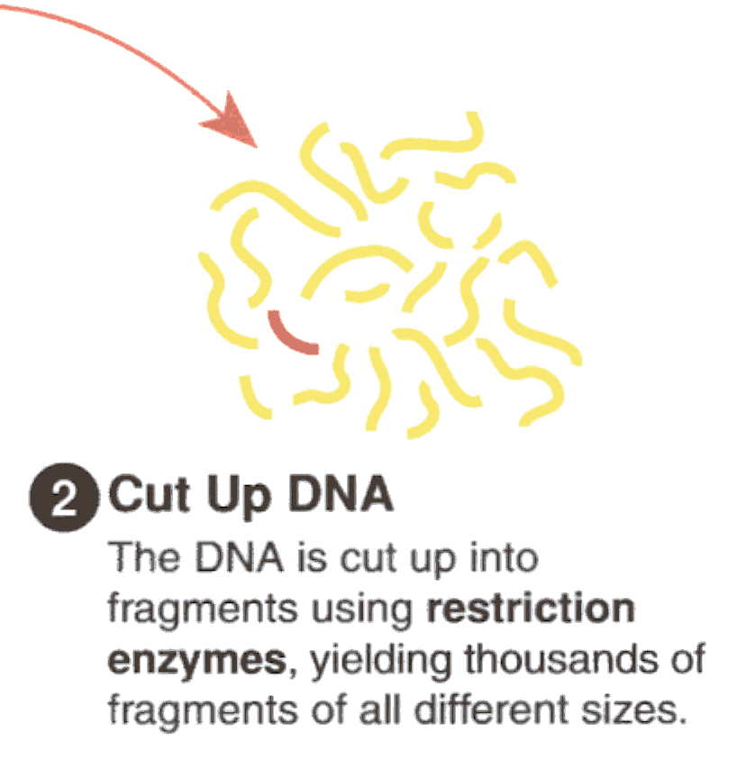
2. DNA CUTTING
The DNA is cut up into fragments using restriction enzymes
This gives lots of fragments
The fragments are different sizes.
Notes:
The samples containing the restriction fragments produced in step 2
are pipetted into individual wells in an agarose gel immersed in an alkaline buffer ( in an electrophoresis tank). Electrophoresis is started.

Slide 47
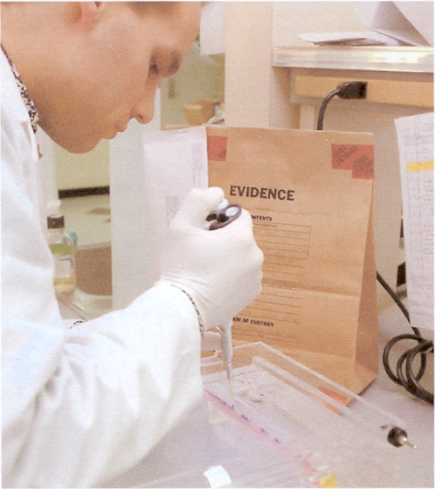
3. FRAGMENT SEPARATION
Samples containing the fragments are placed into individual wells in a gel using a pipette.
This is known as electrophoresis.

Slide 48
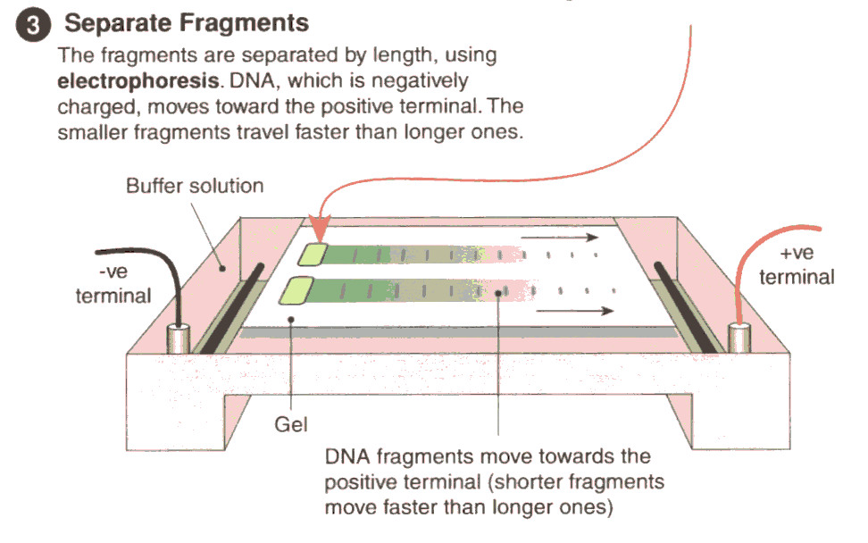
ELECTROPHORESIS
Fragments separated by length
DNA (negatively charged)
Moves towards +ve terminal
Shorter fragments move faster

Slide 49
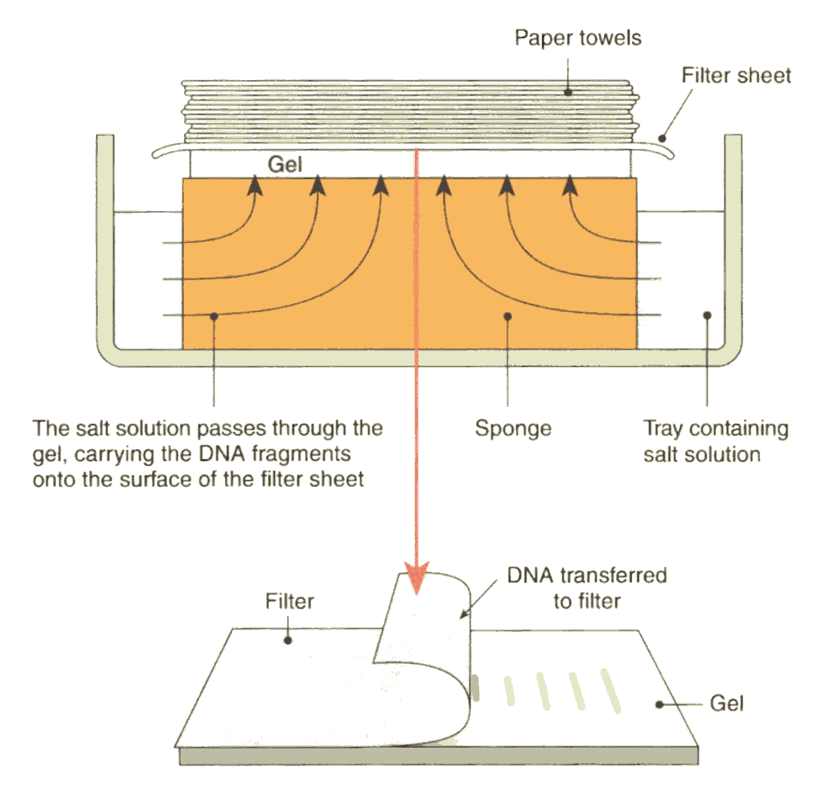
4. DNA TRANSFER
DNA split into single strands using alkaline solution
DNA fragments transferred from gel to filter paper or nylon membrane
Gel, with filter paper attached, is removed & separated

Slide 50
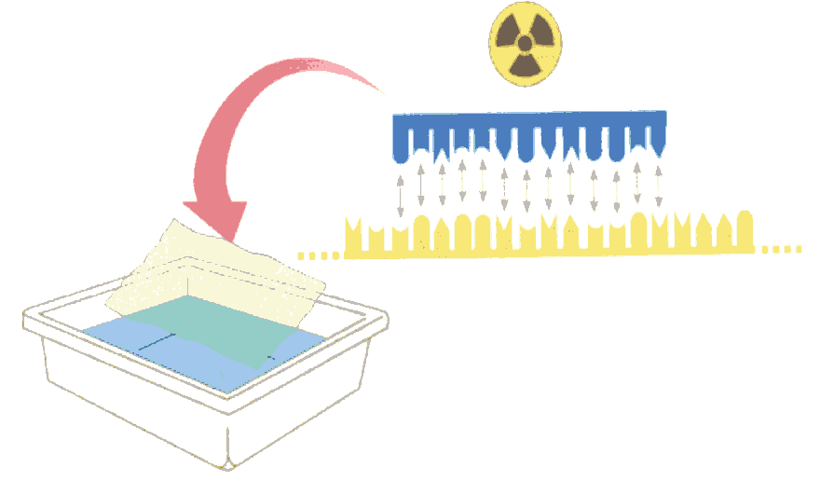
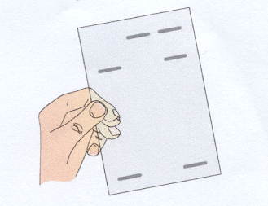
5. ANALYSIS
Radioactive probe in solution binds to DNA
Revealing a pattern of bands
X-ray film

Slide 51
Animation of Electrophoresis
Sort and measure DNA strands by running your own gel electrophoresis experiment.
CAN DNA DEMAND A VERDICT?

Slide 52
Genetic Screening or DNA screening & Applications
Test for the presence or absence of gene(s)
Check for genetic disorders e.g. cystic fibrosis
Notes:
Genetic or DNA screening means that a person’s DNA can be tested to show the presence of normal or altered genes (which may cause disease).
Build up of mucus in the lungs & intestines.

Slide 53
Screening Tests
Antenatal serum screening for Down Syndrome
Antenatal carrier screening for Sickle Cell Anaemia
Predictive testing for hereditary cancers
Predictive testing for cystic fibrosis
Newborn screening for cystic fibrosis and hypothyroidism.

Slide 54
COMMON CONCERNS
Quality of sample
Mistakes and inaccuracy
Interpretation
Privacy
Evidence from criminal investigations
Who should use DNA fingerprinting
Cost effective
Ethical problems
Notes:
Forensic samples odf DNA are rarely pure. Typically bloodstains on clothing or furniture will be contaminated with all sorts of other material. DNA from fungi,bacteria can be present and show up in a fingerprint. DNA decays rapidly and so some of the DNA sites attacked by restriction enzymes may be lost or or cause them to cut in wrong places. Other contaminants may attach to the DNA fragments and weigh them down and shift bands to an unpredictable extent
Human beings collect,register and store the samples and therefore there is the possibility of human error. Accuracy has been challanged because segments rather than complete DNA strands are fingerprinted and so a fingerprint may not be unique. Often tests carried out in private laboratories that may not follow uniform testing standards and quality control
(£) Band on electrophoresis gels are sometimes indistinct and can result in interpretation being a matter of opinion
If certain behaviours family relationships or physical characteristics are shown to have genetic roots a DNA database could offer the opportunity for discrimination
When DNA fing. Is used in a criminal investigation should the authorities be allowed to keep DNA records or samples from those people not proven guilty or those who are proven guilty.
What org. might want to use and be prepared to pay for DNA Fing.
The distribution of allele frequencies in various VNTR loci can vary among different ethnic groups

Slide 55
Learning Check 4
What are the stages involved in DNA profiling
Define the process of DNA profiling
Give two uses of DNA profiling
Define and give a use for genetic screening

Slide 56
Creating DNA Fingerprint simulation
http://www.pbs.org/wgbh/nova/sheppard/lab01.html

Slide 57
DNA Replication
DNA makes exact copies of itself.
  The DNA strands unwind & separate.
  Separation of the 2 nucleotide chains by enzymes - that break the Hydrogen bonds between the complimentary bases.
  Video on DNA Replication
Notes:
The process of copying DNA in a cell
Each chain serves as a template for a new nucleotide chain.

Slide 58
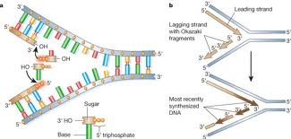
  The exposed bases link up with complementary bases found in the surroundings.
  Hydrogen bonds join the new chain to the original chain between the base pairs.

Slide 59
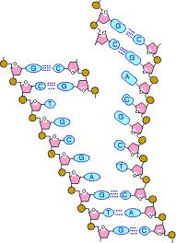
When replication is completed, 2 new exact copies of the original DNA molecule are produced. Each new strand being half new DNA and half old DNA
The cell is ready to undergo cell division.
Notes:
Each new DNA molecule has I new and I original nucleotide chain.

Slide 60
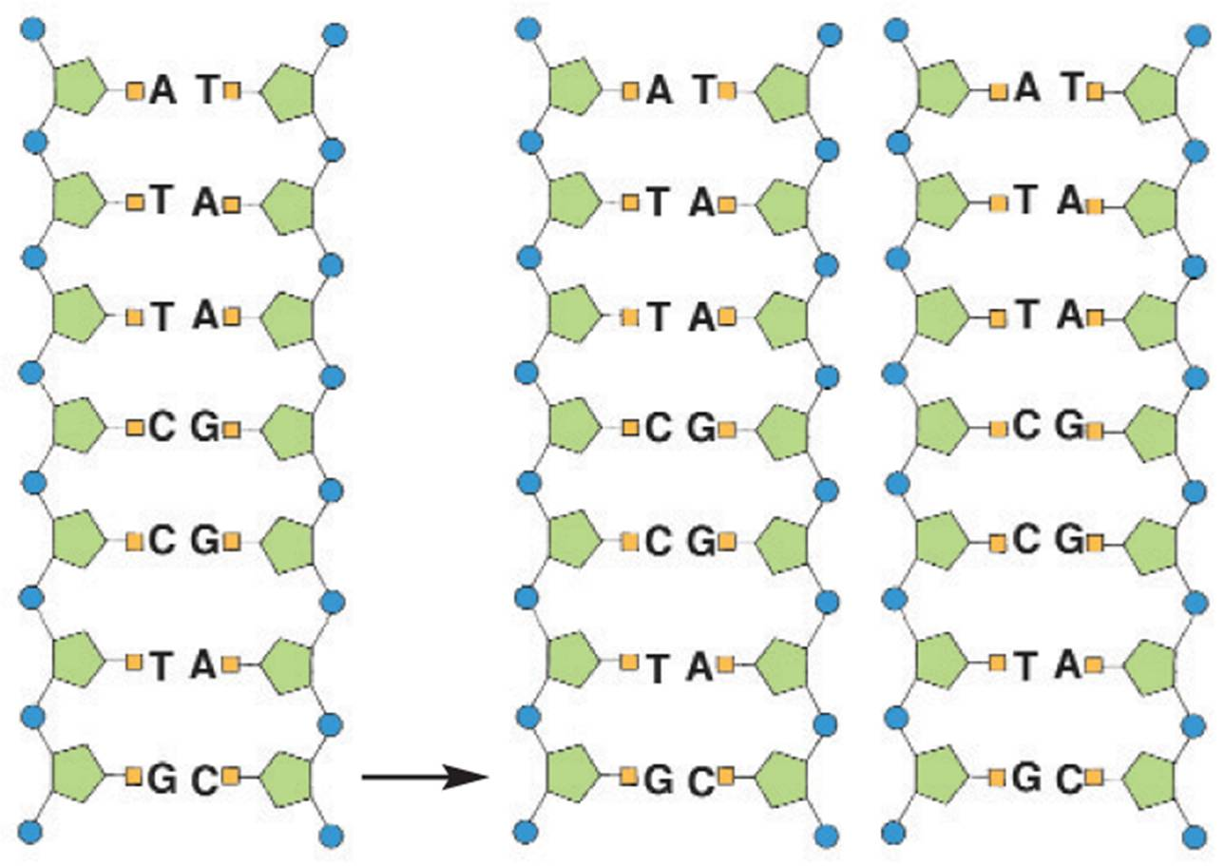
DNA Replication

Slide 61
Accuracy and Repair
High degree of accuracy – only 1 error / 10,000 paired nucleotides.
Mutation: a change in the nucleotide sequence. Even one may have serious effects in new cells.
DNA can be damaged by a variety of agents including chemicals and ultraviolet (UV) radiation from the sun.
Repair enzymes continually recognize and repair errors.

Slide 62
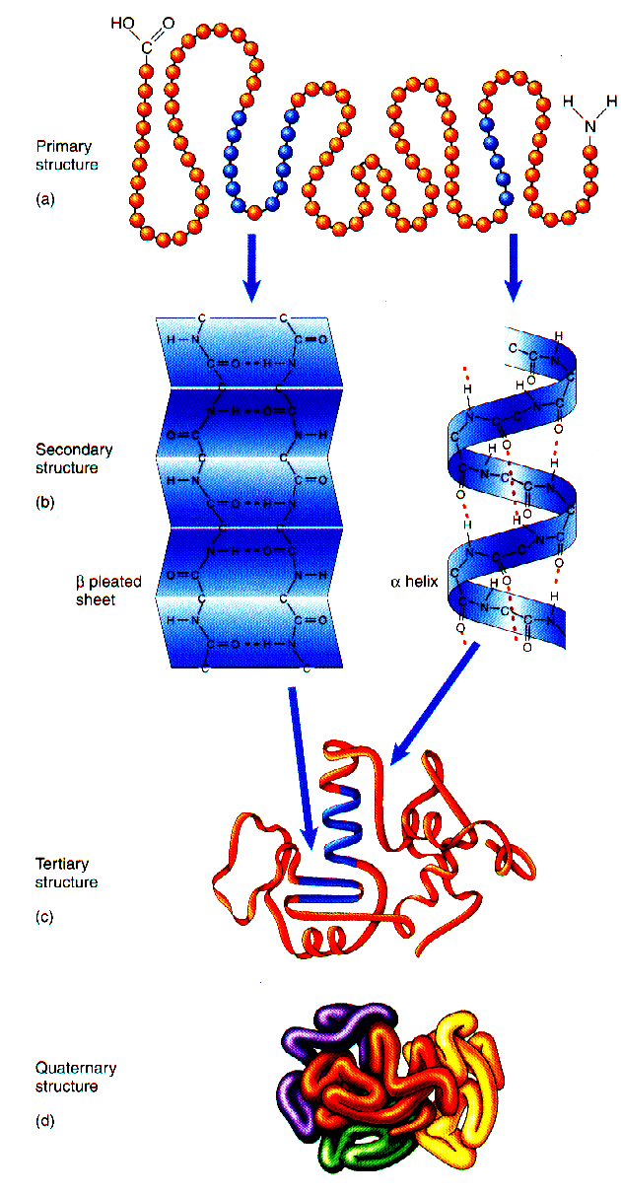
PROTEIN SYNTHESIS

Slide 63
Lesson Objectives
At the end of this lesson you should be able to
Outline the steps in protein synthesis
Understand that a strand of DNA is copied by transcription
Understand the role of mRNA
Know the function of a ribosome in protein synthesis
Understand the process of translation that leads to the formation of a new protein
Know that the shape of a protein determines its function

Slide 64
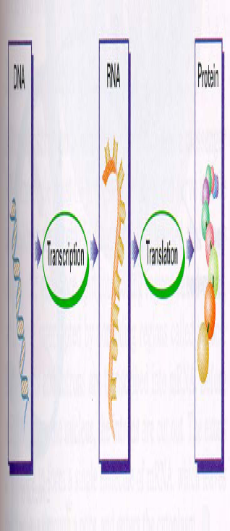
Protein Synthesis
3 stages:
Transcription
RNA processing
Translation
Remember: DNA → RNA → Protein

Slide 65
Firstly enzymes in the nucleus begin to unwind the DNA double helix & break the bonds between its base pairs.
The DNA uncoils and unzips.
One of the DNA chains, called the template, is used for transcription.

Slide 66
1. Transcription
The process by which the information from DNA is transferred to mRNA.
An enzyme RNA polymerase joins the exposed DNA bases with RNA bases in the nucleus to form mRNA.
DNA
RNA Polymerase
mRNA

Slide 67
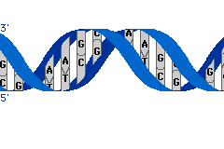

Slide 68
Animation on Protein synthesis
Protein Synthesis video

Slide 69
2. RNA Processing
Nuclear
membrane
DNA
Transcription
Eukaryotic Cell
RNA Processing
mRNA
Ribosome
Translation
Protein

Slide 70
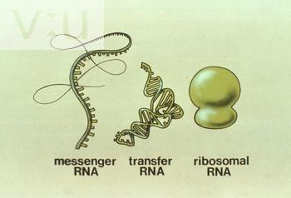
2. RNA Processing
The process by which the information from DNA is transferred to RNA.
There are three types of RNA:
mRNA – messanger RNA
rRNA – ribosomal RNA
tRNA – transfer RNA

Slide 71
The mRNA molecule leaves the nucleus via nuclear pores and travels to the ribosome, carrying the information for a specific protein.
Each mRNA carries a codon / 3 bases / triplet code (sequence of three bases) that codes for a specific amino acid.
codon
A U G G G C U U A A A G C A G U G C A C G U U
mRNA molecule

Slide 72
3. Translation
The production of proteins from information according to the mRNA
mRNA enters a ribosome in the cytoplasm
ribosomes are composed of rRNA – ribosomal RNA and proteins.
rRNA binds mRNA to the ribosome
tRNA –transfer RNA, has a triplet of bases at one end & an amino acid at the other end.
tRNA binds with the complementary codons on the mRNA.
Notes:
Cell produces a protein
–Occurs at the ribosome in the cytoplasm where the cell keeps its supply of tRNA
Tools of translation (in addition to mRNA)
– tRNA
– Ribosomes (rRNA)

Slide 73
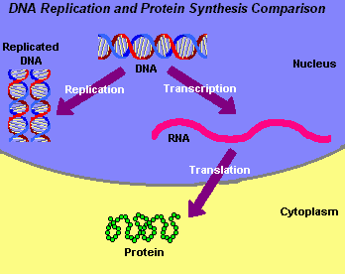

Slide 74
the amino acids attached to the tRNA are assembled in the sequence determined by the with the codons on the mRNA.
the amino acids bond to each other to form a protein.
The protein folds into shape.
aa5
aa4
aa3
aa2
aa199
aa1
aa200

Slide 75
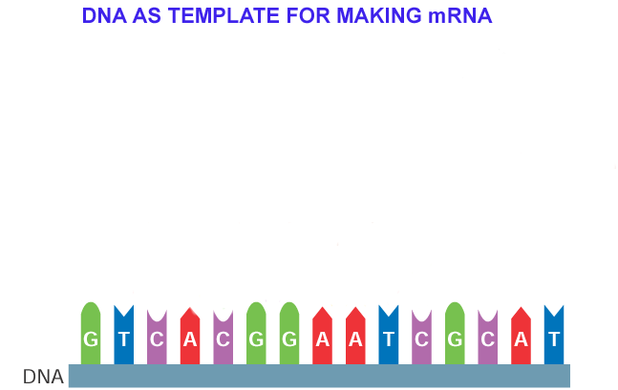
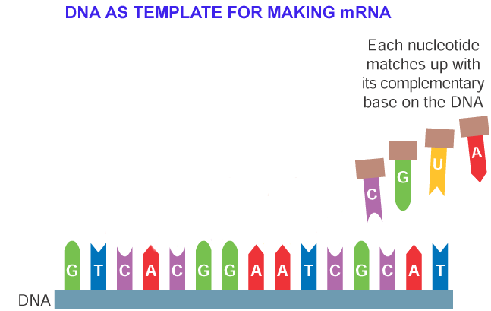
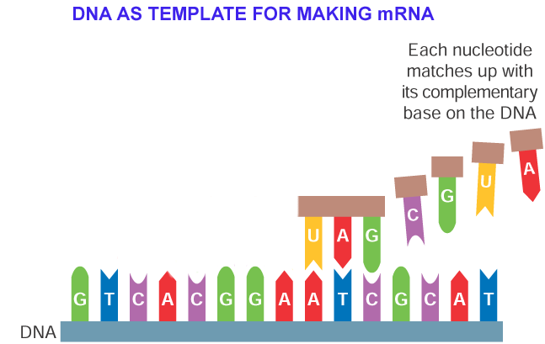
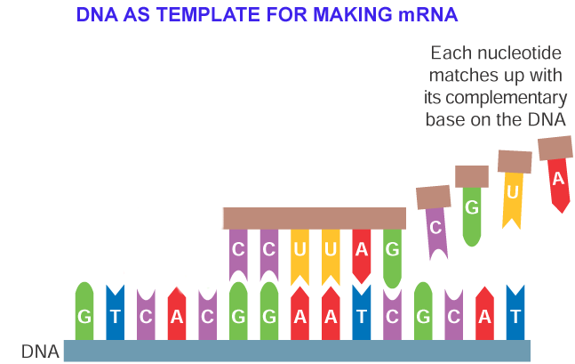
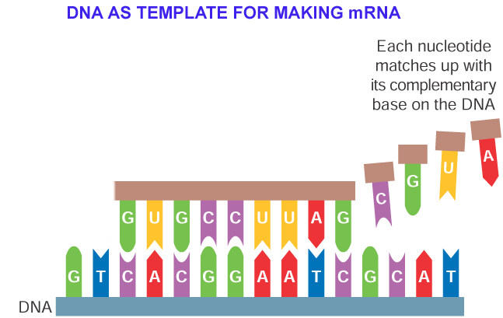
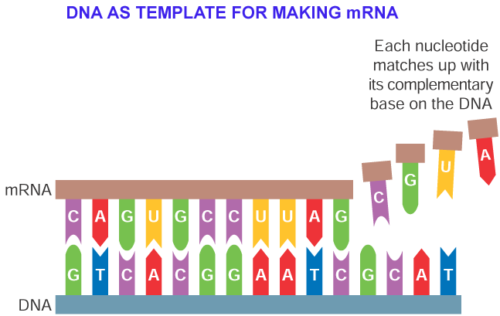
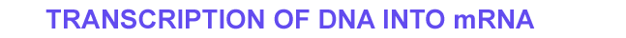

Slide 76
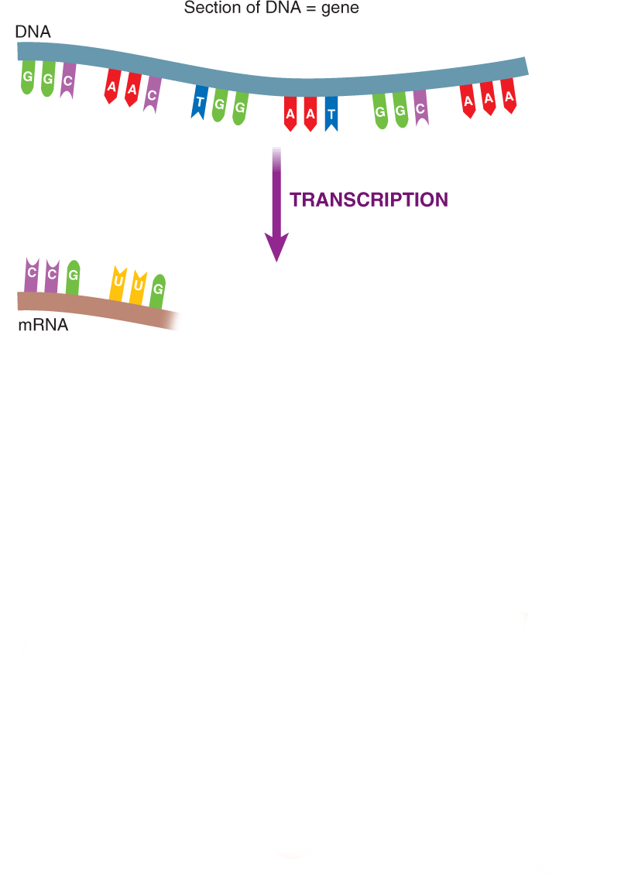
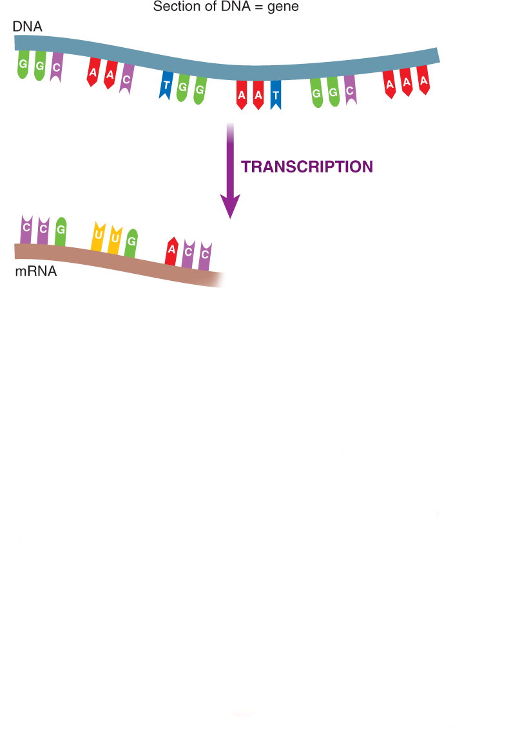
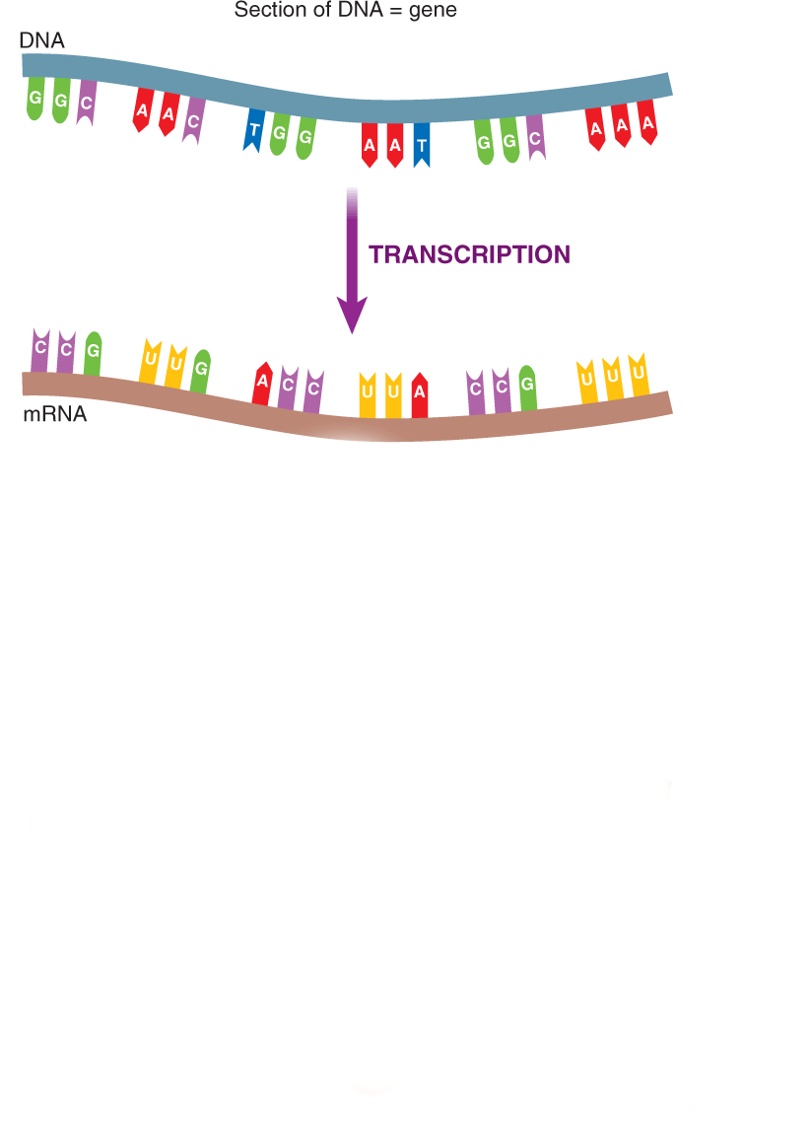
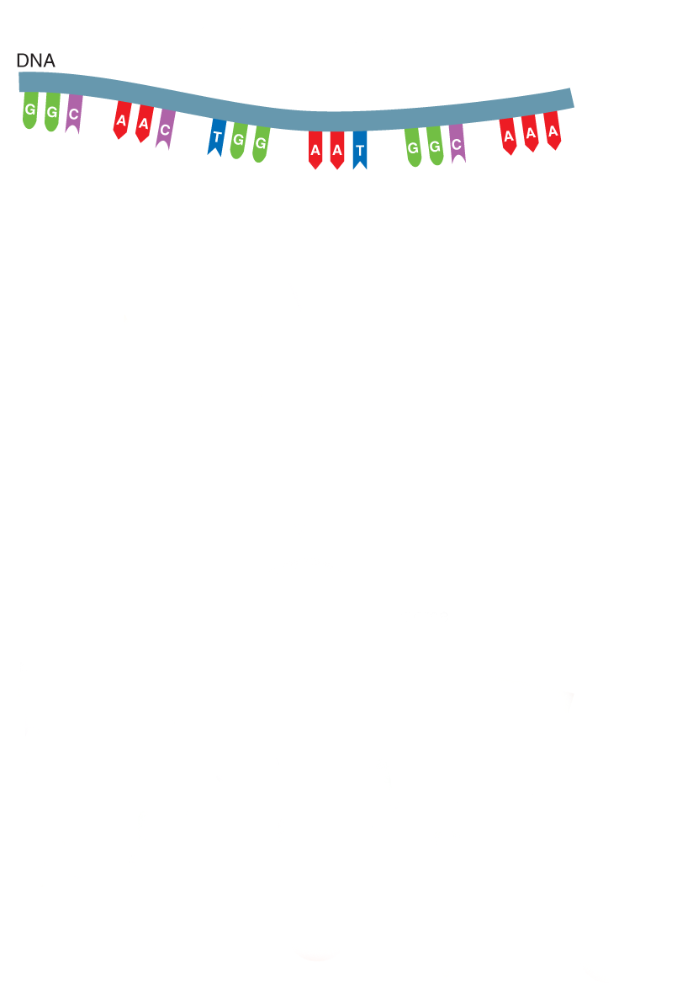
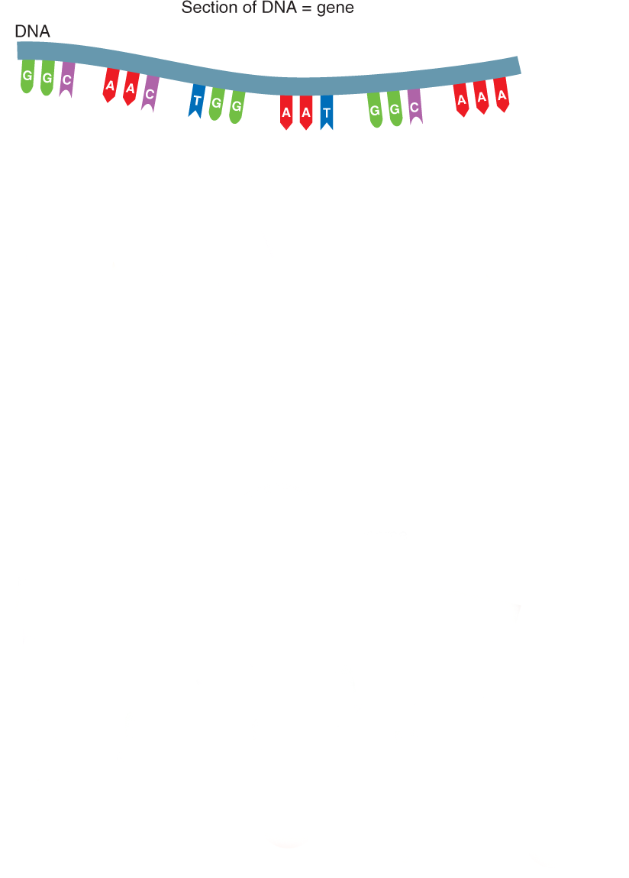
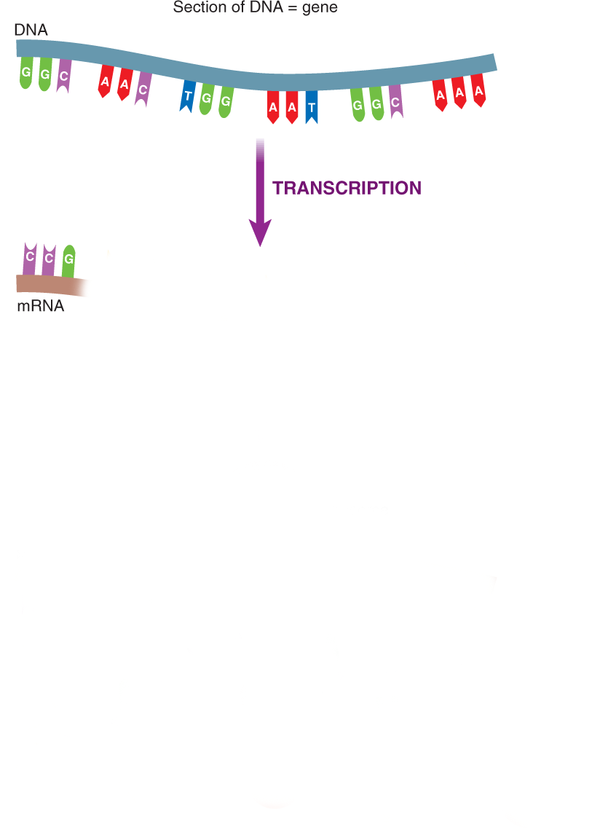
PROTEIN SYNTHESIS

Slide 77
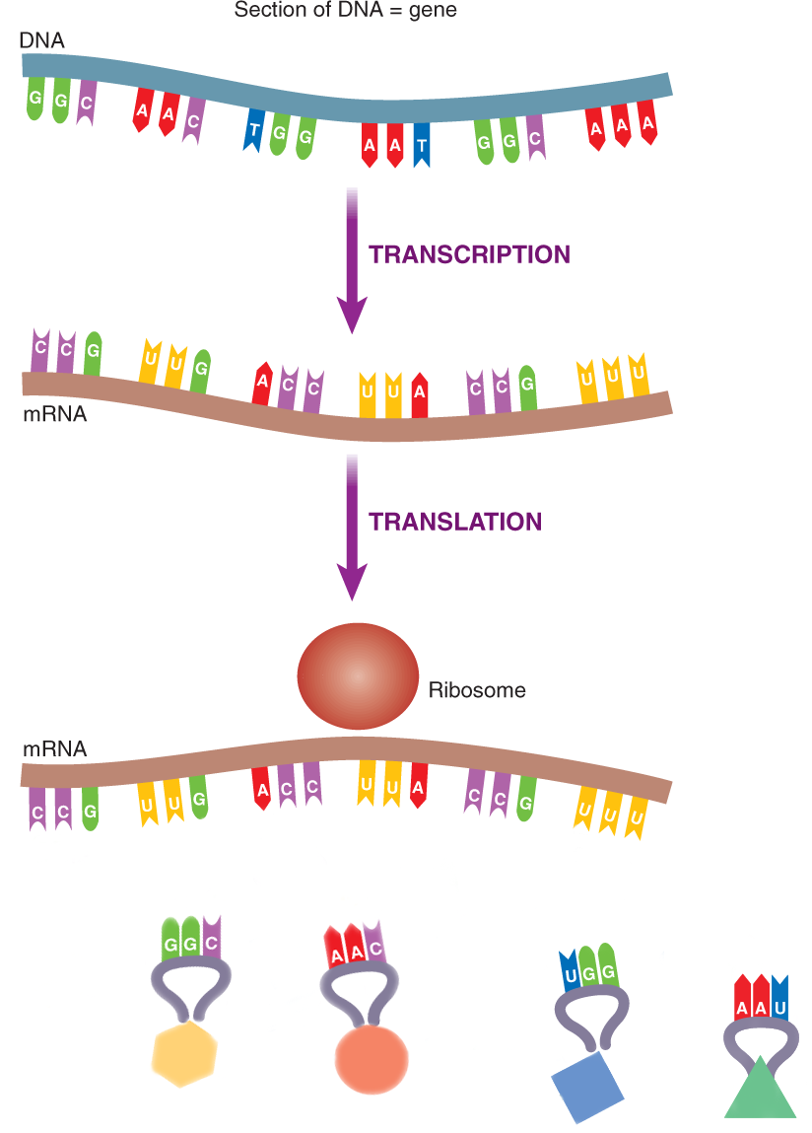
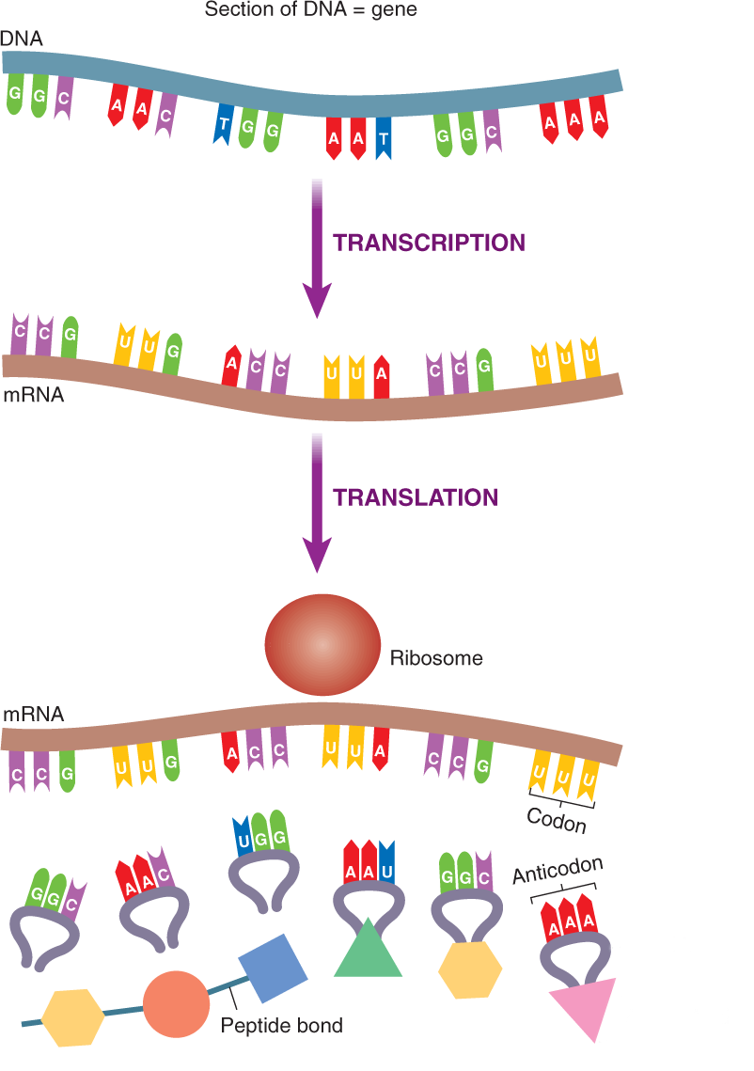
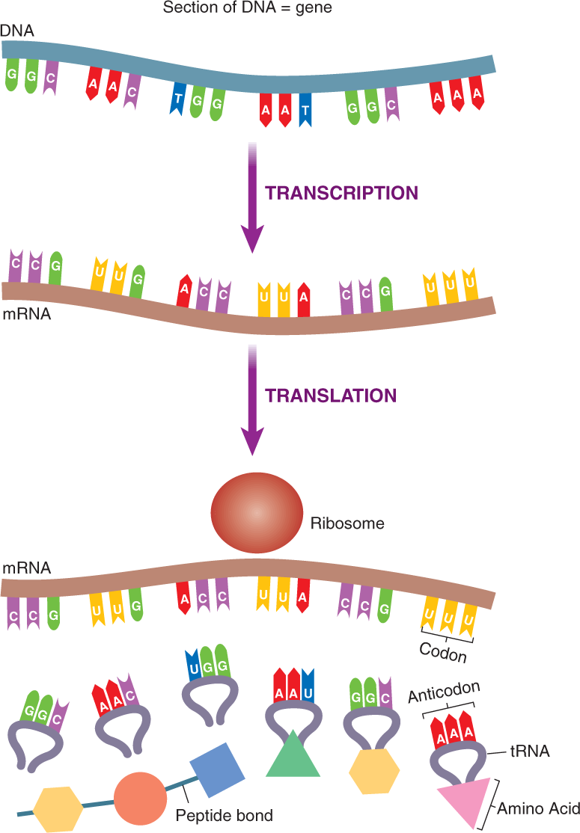
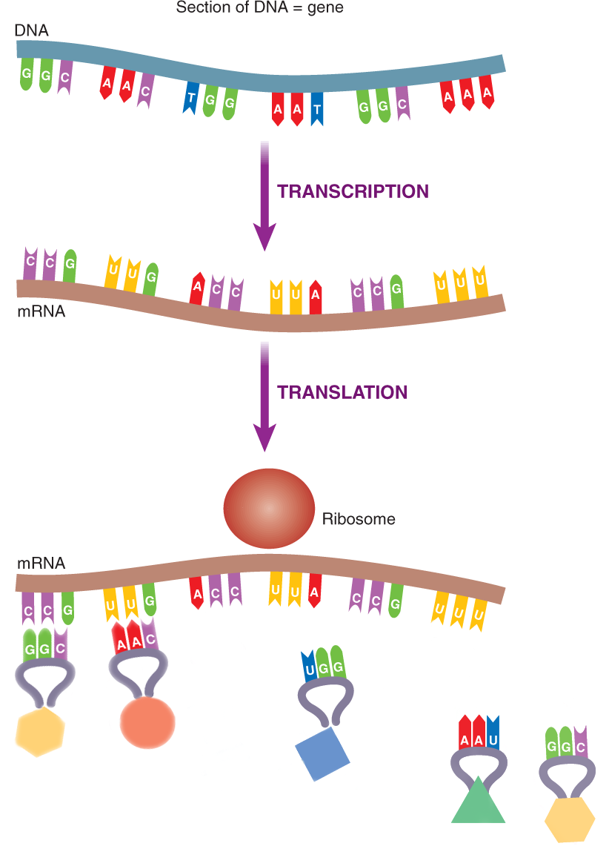







Slide 78


Slide 79
Translation Animation

Slide 80

The Importance of Proteins
The amount and kind of proteins that are produced in a cell determine the structure and function of the cell.
Proteins carry out the genetic instructions encoded in an organism’s DNA

Slide 81

RNA- Ribonucleic acid
is composed of 3 parts
Ribose: smaller sugar than deoxyribose of DNA
Phosphate
4 Nitrogenous Bases A,G,U,C.
Uracil instead of thymine
RNA is a single stranded and
thus smaller & able
to leave the nucleus of the cell.

Slide 82


Slide 83
Types of RNA
Messenger RNA (mRNA) | Consists of RNA nucleotides in the form of a single uncoiled chain. | mRNA carries genetic info from DNA in the nucleus to the cytosol
Transfer RNA (tRNA) | Consists of a single chain of about 80 RNA nucleotides folded into a hairpin shape 45 varieties | binds to a specific amino acid and brings it over to the ribosome
Ribosomal RNA (rRNA) | Most abundant form of RNA Consists of RNA nucleotides in a globular form. | Joins with proteins to form ribosomes – the site of protein synthesis

Slide 84
  This is a molecule of messenger RNA.
  It was made in the nucleus by transcription from a DNA molecule.
codon
A U G G G C U U A A A G C A G U G C A C G U U
mRNA molecule

Slide 85
A ribosome attaches to the mRNA molecule.
ribosome
A U G G G C U U A A A G C A G U G C A C G U U

Slide 86
Amino acid
A transfer RNA molecule arrives
It brings an amino acid to the first three bases (codon) on the mRNA.
The three unpaired bases (anticodon) on the tRNA link up with the codon.
tRNA molecule
anticodon
U A C
A U G G G C U U A A A G C A G U G C A C G U U

Slide 87
Another tRNA molecule comes into place, bringing a second amino acid.
Its anticodon links up with the second codon on the mRNA.
U A C
C C G
A U G G G C U U A A A G C A G U G C A C G U U

Slide 88
Another tRNA molecule brings the next amino acid into place.
C C G
A A U
A U G G G C U U A A A G C A G U G C A C G U U

Slide 89
A peptide bond joins the second and third amino acids to form a polypeptide chain.
C C G
C C G
A U G G G C U U A A A G C A G U G C A C G U U

Slide 90
The process continues.
The polypeptide chain gets longer.
This continues until a termination (stop) codon is reached.
The polypeptide is then complete.
A C G
G U C
A U G G G C U U A A A G C A G U G C A C G U U

Slide 91


Slide 92
GENE FUNCTION

Slide 93

Alleles are different forms of the same gene.
A dominant allele stops another allele from working.
A recessive gene does not work in the presence of a dominant allele

Slide 94
Homozygous means two alleles are the same e.g. TT – tall plants
Heterozygous means two alleles are different e.g. Tt - tall pea plants
Homozygous recessive (tt – small plants)

Slide 95
Genotype means genetic make-up.
Phenotype means physical make-up or appearance.
The phenotype is formed by the action of the environment on the genotype.
Progeny means the offspring of a cross.
F1 means the first filial generation, i.e. the first generation of offspring.

Slide 96
Homologous Chromosomes
eye color locus
B = brown eyes
eye color locus
b = blue eyes
This person would have brown eyes (Bb)
Paternal
Maternal

Slide 97


Human Traits

Slide 98

Homozygous genotypes
phenotype
genotype

Slide 99

Heterozygous genotype
phenotype
genotype

Slide 100

phenotype
Heterozygous Brown x Heterozygous Brown
genotype
genotype
phenotype ? ? ? ?

Slide 101

phenotype
Homozygous Brown x Homozygous Blue
genotype
genotype
phenotype ?

Slide 102

phenotype
Heterozygous Brown x Homozygous Blue
genotype
genotype
phenotype ? ?

Slide 103
Punnett square
A Punnett square is used to show the possible combinations of gametes.

Slide 104











How to lay out genetics crosses 1

Slide 105












How to lay out genetics crosses 2

Slide 106
Codominance or Incomplete dominance
In Codominance or Incomplete dominance neither allele is dominant and both are expressed in the heterozygous condition.
The heterozygous condition can produce an intermediate phenotype / different phenotype to the parents.

Slide 107
Incomplete Dominance
Example: snapdragons (flower)
red (RR) x white (rr)
RR = red flower
rr = white flower
R
R
r
r

Slide 108
Incomplete Dominance
R
R
r
produces the
F₁ generation
Rr
Rr
r
Rr
Rr
All Rr = pink
(heterozygous pink)

Slide 109













Slide 110
















Slide 111
Sex Determination

Slide 112
Autosomes are chromosomes that do not determine sexuality.
The sex chromosomes are the X and the shorter Y chromosomes.
In humans:
XX = female
XY = male

Slide 113

Female Karyotype

Slide 114

Male Karyotype

Slide 115
Meiosis
In females each eggs will have only one type of chromosome – X.
In males the X and Y chromosomes separate and go into different sperm cells:
½ the sperm carry the X and the other half carry the Y.
The Y chromosome has the main sex-determining gene on it.

Slide 116


















Slide 117
Learning Check
How many pairs of chromosomes does a human somatic cell have?
Which pair of chromosomes determines the sex of the offspring?
If you are male what does chromosome pair number 23 look like?
If you are female what does chromosome pair number 23 look like?

Slide 118
Variations and Mutations

Slide 119
Lesson Objectives
At the end of this lesson you should be able to:
Define variation and mutation
List the causes of variations and mutations
List the types of mutations
Discuss the causes for and effects of increased mutation rates

Slide 120

Variation in the foods that we eat

Slide 121
Variation means differences.
Acquired variation is learned during life.
Inherited variation is caused by:
Sexual reproduction - the independent assortment of chromosomes when gametes are being formed
Mutations
how inheritance of genes are determined

Slide 122
A mutation is a change in the amount or structure of DNA.
Mutations may produce:
new alleles
beneficial phenotypes
no noticeable effect (i.e. no change in phenotype)
benign tumours (relatively harmless
malignant tumours (cancer)
genetic defects in the offspring.

Slide 123
Fact
When your parents cells undergo meiosis to produce sperm/egg cells
8 million different combinations of their chromosomes are possible
Every zygote is a 1 in 64,000,000,000,000 combination of chromosomes!
This leads to great variation in species
Meiosis Square Dance

Slide 124

Fusion of gametes
Sperm and egg cell fuse to form a zygote.
The combination of chromosomes leads to great variation in species

Slide 125










Whose Child?

Slide 126
Whose Child?

Slide 127
Learning Check
What happens during meiosis?
What does meiosis lead to?
What are the causes of variation?
Why are offspring not identical to their parents?

Slide 128

Mutations
Rare, occur randomly and usually harmful
Permanent Changes in:
Genes or
Chromosomes

Slide 129
1. Gene Mutations
A gene (or point) mutation is a tiny change in a single gene (often it only involves a single incorrect base).
Produce Proteins that may not function normally.
Can be passed on to next generation via gametes.
E.g. Sickle cell anaemia.
Notes:
Genes that are damaged or copied incorrectly.

Slide 130

2. Chromosome Mutations
Is caused by a large change in the
structure or
the number of one or more chromosomes.
E.g. Down’s syndrome is caused by three number 21 chromosomes.

Slide 131

Downs syndrome

Slide 132
Causes of Mutations
some types of Radiation from a radioactive material or from X-rays can cause the DNA molecule to alters e.g. Chernobyl
Some chemicals e.g. in cigarette smoke causes mutations associated with cancer.

Slide 133


Slide 134

Dying for a Suntan
Sunlight contains UV radiation (the component that causes a suntan).
This can cause an abnormal cross link in DNA to form between certain adjacent bases.
In most normal cases the cells can repair this damage, but sometimes a mutation can occur
Unprotected exposure to UV radiation by the human skin can lead to skin cancer and extensive skin tumors.

Slide 135

Genetic engineering/ recombinant DNA technology
Genetic engineering is the artificial manipulation or alteration of genes.
It allows genes from different species to be combined.

Slide 136


Slide 137

Genetically modified organisms (GMOs) are living things whose DNA has been altered artificially.
Transgenic organisms contain genes from another species.

Slide 139

The most common cloning vector is a plasmid - a small circle of DNA found in bacteria.
Plasmid Cloning 1

Slide 140
The process of genetic engineering using bacteria usually involves most of the following steps:
isolation of a chromosome (containing the target gene) and a plasmid
cutting the chromosome and plasmids with a restriction enzyme
ligation (or joining) of the target gene into the plasmid

Slide 141
transformation of bacterial cells, i.e. getting bacterial cells to take up plasmids
cloning or reproducing identical copies of the new genetically engineered bacterium
expression or production of the required protein by the bacteria with the recombinant DNA
Stuff From The Future - What is the Future of Genetic Modification?

Slide 142
Applications of genetic engineering
Plants - genetic modification allowed the tomato to delay ripening after picking.
Animals - Haemophilliacs suffer from a defective gene that fails to produce Factor V111, an important agent involved in blood clotting. Sheep DNA were insert with the human gene to produce it so that they produce the protein in their milk
Humans - inserting the gene for human insulin into a bacterium which then produces human insulin for use by diabetics
Genetic Engineering - Insulin

Slide 143
Evolution
The Theory of Natural Selection and the Survival of the Fittest
Facts Of Evolution: Good Design, Bad Design

Slide 144
Lesson Objectives
At the end of this lesson you should be able to
Define evolution
Outline the Darwin and Wallace Theory of natural selection
Discuss the evidence of evolution from either fossil, comparative anatomy or the study of embryos.

Slide 145

Homer Simpson Evolution

Slide 146


Evolution

Slide 147


Lamarck

Slide 148

Evolution is
the changes in a species / organisms over a long time
leads to the emergence of new species from older species
brought about by Natural selection in response to a change in the environment.

Slide 149



Charles Darwin

Slide 150

Charles Darwin and his route on HMS Beagle

Slide 151



Darwin’s Finches

Slide 152

How did evolution theory develop.

Slide 153

What did Darwin say?
NATURAL SELECTION
Individuals differ
Offspring resemble their parents
More offspring are produced than can possibly survive to reproduce
There is a struggle for existence and some are better adapted and so survive to reproduce

Slide 154
Darwin And Wallace
Darwin presented the theory of evolution by natural selection in 1858
Much of Darwin’s work was done on the Galapagos islands
Darwin proposed a mechanism for evolution by natural selection
Alfred Wallace working in Borneo also proposed the same theory

Slide 155


Alfred Wallace

Slide 156
The Mechanism of Evolution
Species have a high reproductive rate producing large numbers of offspring, but pop. numbers remain constant.
There is a high death rate among offspring.
This is due to competition for resources e.g. food, mates etc.
Variations / differences occur within a species so that some individuals are better suited then others.

Slide 157

Darwin's ideas on the struggle for survival and natural selection

Slide 158
5. The best adapted individuals live longer and have more offspring then those less well adapted.
6. The offspring inherit the favourable variations from their parents.
7. The poorly adapted ones die out.
8. As the environment changes new adaptations emerge.
Mechanisms Of Evolution: How Does Variety Arise?

Slide 159



Slide 160
evolution/how-did-evol-theory-develop/galapagos-mockingbirds

Slide 161
tree-of-life/interactive-tree
Highway Of Life: From Mammals To Primates

Slide 162
Conclusions drawn by Darwin
There is a struggle for existence
- competition will occur
Natural Selection
- only the fittest will survive

Slide 163
what-is-evolution/the-theory
This morph shows a transition from a warbler finch (Certhidea olivacea) to a large tree finch (Camarhynchus psittacula). The warbler finch is believed to be closest to the ancestral form and the large tree finch to be quite an advanced form.

Slide 164
Evidence for evolution
Comparative anatomy
Comparative embryology
Comparative genetics

Slide 165


Comparative anatomy
A homologous structure - Pentadactyl limb

Slide 166
One source of evidence of evolution is comparative anatomy & the pentadactyl limb.
Comparative anatomy is the study of similarities and differences in the anatomy of organisms.
Notes:
A common example of comparative anatomy is the similar bone structures in forelimbs of cats, whales, bats, and humans. All of these appendages consist of the same basic parts; yet, they serve completely different functions. The skeletal parts which form a structure used for swimming, such as a fin, would not be ideal to form a wing, which is better-suited for flight. One explanation for the forelimbs' similar composition is descent with modification.
Through random mutations and natural selection anatomical structures gradually became better-adapted to the every organism's respective habitat.[1] Two major concepts of comparative anatomy are:
Homologous structures - structures (body parts/anatomy) which are similar in different species because the species have common descent. They may or may not perform the same function. An example is the forelimb structure shared by cats and whales.
Analogous structures - structures similar in different organisms because they evolved in a similar environment, rather than were inherited from a recent common ancestor. They usually serve the same or similar purposes. An example is the streamlined torpedo body shape of porpoises and sharks. So even though they evolved from different ancestors, porpoises and sharks developed analogous structures as a result of their evolution in the same aquatic environment.
The pattern of limb bones called pentadactyl limb is an example of homologous structures
The pentadactyl limb is common to humans, other mammals (although whales and dolphins have lost their hind limbs), birds, dinosaurs, and other reptiles and amphibians.

Slide 167


Slide 168
There is a similar bone structure found in the forelimbs of cats, whales, bats, and humans yet, they serve completely different functions. The skeletal parts which form a structure used for swimming, such as a fin, would not be ideal to form a wing, which is better-suited for flight.
One explanation for the forelimbs' similar composition is descent with modification.
Notes:
A common example of comparative anatomy is the similar bone structures in forelimbs of cats, whales, bats, and humans. All of these appendages consist of the same basic parts; yet, they serve completely different functions. The skeletal parts which form a structure used for swimming, such as a fin, would not be ideal to form a wing, which is better-suited for flight. One explanation for the forelimbs' similar composition is descent with modification.
Through random mutations and natural selection anatomical structures gradually became better-adapted to the every organism's respective habitat.[1] Two major concepts of comparative anatomy are:
Homologous structures - structures (body parts/anatomy) which are similar in different species because the species have common descent. They may or may not perform the same function. An example is the forelimb structure shared by cats and whales.
Analogous structures - structures similar in different organisms because they evolved in a similar environment, rather than were inherited from a recent common ancestor. They usually serve the same or similar purposes. An example is the streamlined torpedo body shape of porpoises and sharks. So even though they evolved from different ancestors, porpoises and sharks developed analogous structures as a result of their evolution in the same aquatic environment.
The pattern of limb bones called pentadactyl limb is an example of homologous structures
The pentadactyl limb is common to humans, other mammals (although whales and dolphins have lost their hind limbs), birds, dinosaurs, and other reptiles and amphibians.

Slide 169

Comparative embryology

Slide 170

Comparitive genetics
Compare proteins
Compare DNA bases
Haemoglobin

Slide 171

Mammal evolutionary tree

