Slide 1
Chapter 15
DNA & RNA

Slide 2
Lesson Objectives
At the end of this lesson you should be able to
Define the terms:
Heredity
A gene
Gene expression

Slide 3
Heredity
or genetic inheritance, is the passing on of features from parents to offspring by means of genes e.g. hair colour

Slide 4
Genes
A gene is a section of DNA that codes for a specific protein
It is the unit of inheritance
It is found on a chromosome
It contains instructions to make a particular protein e.g. an enzyme
It directly influences the characteristics of an organism
Notes:
Genes only comprise about 3% of the DNA in human cells.
The rest of the DNA is said to be non-coding.

Slide 5
Gene Expression
Gene expression is the way in which a gene works to produce a protein.
Not all genes are expressed
Characteristics arise from the interaction of genes and their environment.
  E.g. The gene for Tallness
  Organism is small – Why?
  Maybe due to poor nutrition
18 thinks to know about Genetics
Notes:
18 Things You Should Know About Genetics is an animated film that presents fundamental background information about genetics, as well as offering some quirky but interesting facts about DNA, genes and genetics. It was created to be an upbeat, fun educational short film to initiate and draw interest to this sometimes daunting and seemingly complex subject matter.

Slide 6
Characteristics
Characteristics =
heredity + environment
Notes:
Characteristics arise from the interaction of genes and their environment.

Slide 7
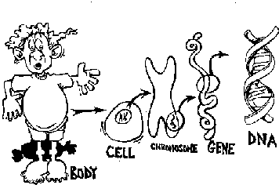
Recall that genes are located on chromosomes which are located in the nucleus
image from http://regentsprep.org/Regents/biology/units/heredity/dna.cfm

Slide 8
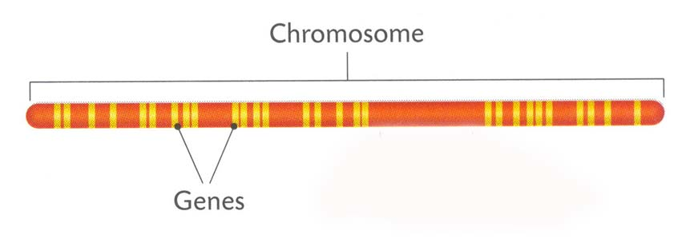
Chromosomes
Notes:
Chromosomes contain a number of genes arranged along the DNA of the chromosome
Chromosomes
are made of DNA and protein.
Genes only comprise about 3% of the DNA in human cells.
The rest of the DNA is said to be non-coding.

Slide 9
Chromosomes
Thread like structures
Contains 60% DNA
Contains 40% Protein
Contains Genetic Information
Occur in pairs
Found in the nucleus of all cells

Slide 10
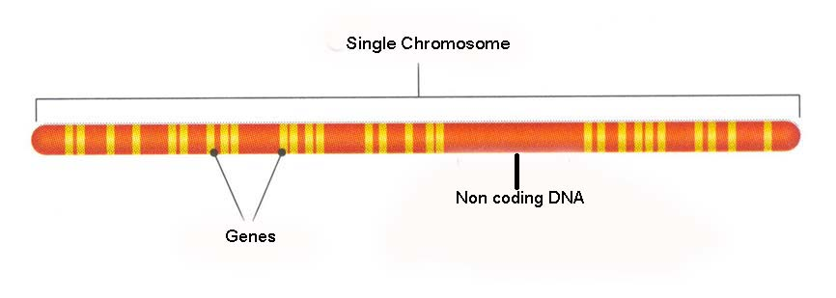
Non Coding & coding DNA
97% of DNA does not consist of genes.
This DNA is said be non-coding / junk DNA / Interons
The 3% of DNA that contains information to code for protein synthesis is called exons.
Notes:
Most of the DNA in a chromosome does not code for any amino acids.
Some of this non-coding DNA is found between the genes and some is found in the genes.

Slide 12

DNA
Deoxyribonucleic Acid

Slide 13
Lesson Objectives
At the end of this lesson you should be able to
Outline the simple structure of DNA
Name the four bases and the base pairs in DNA
Distinguish between coding and non coding structures
Define triplet base code
Outline the structure of RNA
Name the bases in RNA
Discuss the replication of DNA

Slide 14
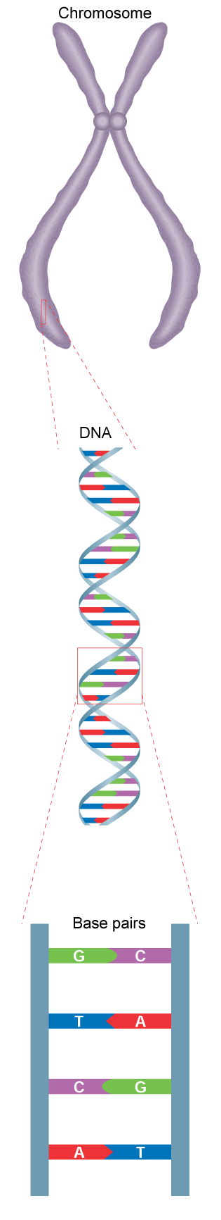
DNA

Slide 15
What is DNA
A long, double-stranded molecule.
Two parallel strands
Linked to each other by pairs of complementary bases
Made up of units called nucleotides
Notes:
Carries and passes on genetic information

Slide 16
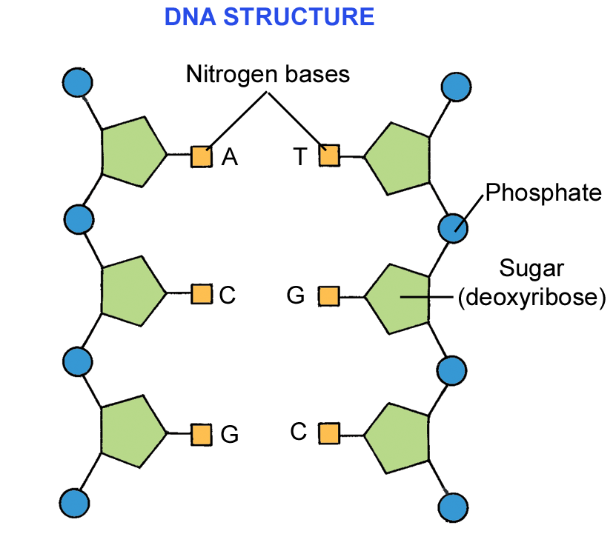
Nucleotides
Consist of:
A phosphate group
A sugar – deoxyribose &
4 nitrogen containing bases

Slide 17
The 4 Nitrogen containing Bases
    Adenine (A)
    Thymine (T)
    Cytosine (C)
  Guanine (G)

Slide 18
The Base Pair Rule
Adenine can only join to Thymine
A T
Guanine can only join to Cytosine
G C
  At The Giant’s Causeway
What are genes?
Notes:
Find out about the basics of cells, chromosomes, and the genes contained in your DNA.

Slide 19
Building DNA
Drap & Drop DNA Model making
DNA Information
DNA, Fantastic! Mr. W's DNA Rap
Mr. Lee - Genetics rap
GENEticS / Jeans rap song

Slide 20
Detailed structure of DNA
The detailed structure of DNA consists of:
nucleotides, which contain phosphate, deoxyribose sugar and a base.
The four bases are:
        the purines adenine (A) and guanine (G)
        the pyridimines thymine (T) and cytosine (C)
        The nucleotide or base pairs, i.e. A=T or G≡C, join together due to hydrogen bonding
        A double helix, the phosphates and sugars form the sides of the molecule and the base pairs are like rungs inside the double helix

Slide 22
Learning Check 3
What does DNA stand for?
Name the four bases in DNA
Which base complements Adenine?
Which base compliments Guanine?

Slide 23
The genetic code
The genetic code consists of a sequence of three DNA (or RNA) bases repeated many times.
Each group of three bases is the code for an amino acid.
A sequence of bases that produce a protein is called a gene.

Slide 24
DNA Replication
DNA makes exact copies of itself.
This occurs in the nucleus during Interphase
Notes:
The process of copying DNA in a cell
Each chain serves as a template for a new nucleotide chain.

Slide 25
Mechanism for DNA Replication
  The DNA strands unwind & separate.
  Separation of the 2 nucleotide chains by enzymes - that break the Hydrogen bonds between the complimentary bases.
  Video on DNA Replication
Notes:
The process of copying DNA in a cell
Each chain serves as a template for a new nucleotide chain.

Slide 26
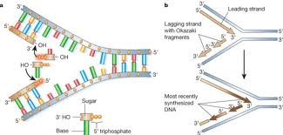
  The exposed bases link up with complementary bases found in the surroundings.
  Hydrogen bonds join the new chain to the original chain between the base pairs.

Slide 27
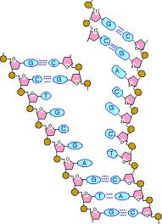
When replication is completed, 2 new exact copies of the original DNA molecule are produced. Each new strand being half new DNA and half old DNA
The cell is ready to undergo cell division.
Notes:
Each new DNA molecule has I new and I original nucleotide chain.

Slide 28
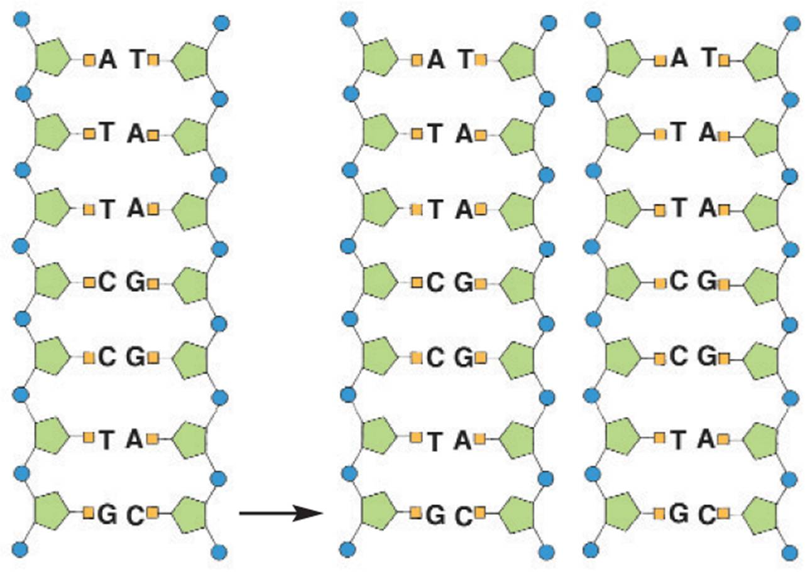
DNA Replication

Slide 29
Accuracy and Repair
High degree of accuracy – only 1 error / 10,000 paired nucleotides.
Mutation: a change in the nucleotide sequence. Even one may have serious effects in new cells.
DNA can be damaged by a variety of agents including chemicals and ultraviolet (UV) radiation from the sun.
Repair enzymes continually recognize and repair errors.

Slide 30
DNA Profiling

Slide 31
Lesson Objectives
At the end of this lesson you should be able to:
Discuss the stages involved in DNA profiling
Define the process of DNA profiling
Give two uses of DNA profiling
Define and give a use for genetic screening

Slide 32
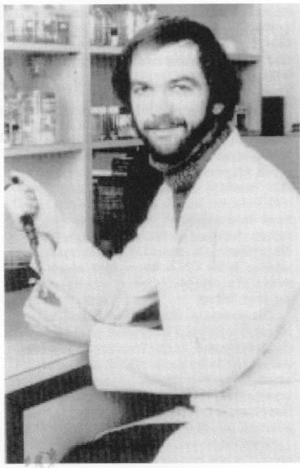
DNA PROFILING
1980 - American researchers discovered non-coding regions of DNA
1984 - Professor Alec Jeffries developed the process of DNA profiling
1987 - First conviction based on DNA evidence
Notes:
Like several other significant discoveries in biotechnology genetic fingerprinting was discovered by scientists who were searching for something else. However, unlike many other advances in modern genetics DNA profiling has already had a major effect on the lives of thousands of ordinary people throughout the world. In 1984 Prof Alec Jeffreys of the University of Leicester in England was studying the gene for myoglobin ,a protein that stores oxygen in the muscle. He found that part of the gene did not carry instructions for the manufacture of myoglobin ( non coding DNA sequence) Instead, this bit of DNA consisted of an unusual sequence of bases repeated several times.Jeffreys realised these apparantly useless,harmless pieces of DNA could act as genetic markers for the myoglobin gene – helpful in tracking down its location on a particular chromosome. To his surprise Jefferys found that the sequence of non coding DNA from the myoglobin gene occurred in many different places throughout the human chromosome . Further investigation showed that each of the variable regions shared a common sequence of about 16 base pairs. The number of times this sequence occurred was apparantly unique to each individual . Prof. Jefferys was quick to realise that the technique could be used to establish with accuracy the identity and relatedness of individuals
Legal history – made in Nov 1984 when a Bristol man was sentenced to 8 yrs in jail for rape. First conviction based on evidence using the revolutionary tnew technique known as DNA fingerprinting ( matched blood with semen stains on the clothes of his victim)

Slide 33
DNA PROFILING
A DNA profile or genetic fingerprint involves a process of making a pattern of bands from an individual’s DNA, for comparison.
These bands can distinguish one person’s DNA from another person’s.

Slide 35
STAGES INVOLVED
Cells broken down to release DNA
DNA strands cut into fragments using Restriction enzymes
Fragments separated by size.
Pattern of fragments analysed

Slide 36
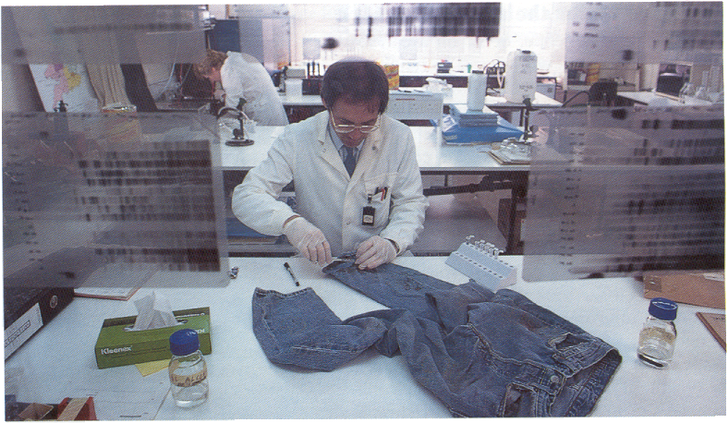
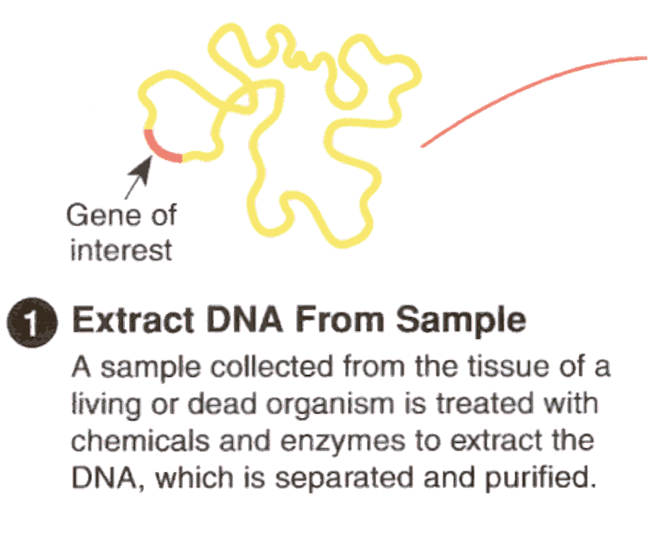
1. DNA EXTRACTION

Slide 37
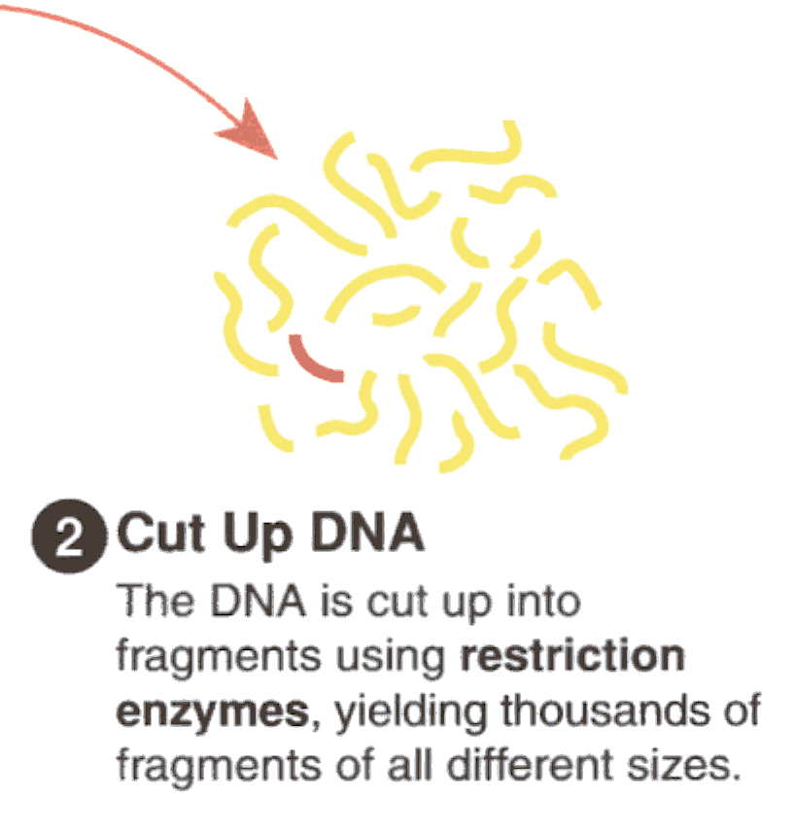
2. DNA CUTTING
The DNA is cut up into fragments using restriction enzymes
This gives lots of fragments
The fragments are different sizes.
Notes:
The samples containing the restriction fragments produced in step 2
are pipetted into individual wells in an agarose gel immersed in an alkaline buffer ( in an electrophoresis tank). Electrophoresis is started.

Slide 38
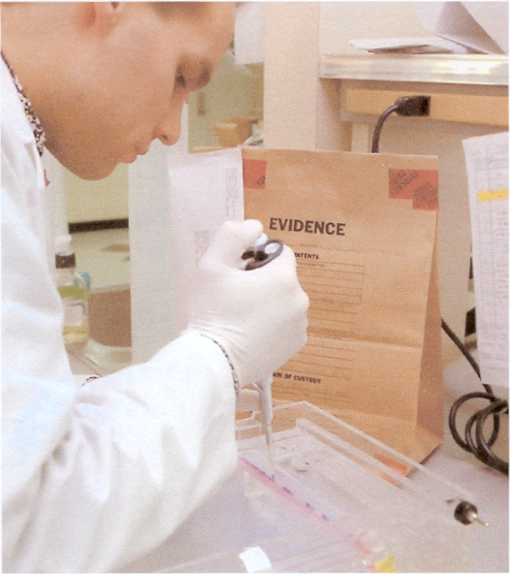
3. FRAGMENT SEPARATION
Samples containing the fragments are placed into individual wells in a gel using a pipette.
This is known as electrophoresis.

Slide 39
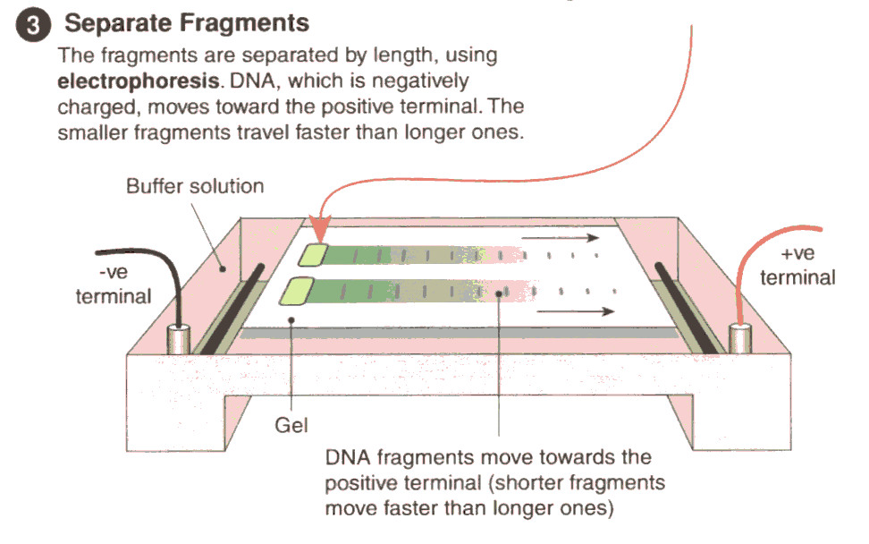
ELECTROPHORESIS
Fragments separated by length
DNA (negatively charged)
Moves towards +ve terminal
Shorter fragments move faster

Slide 40
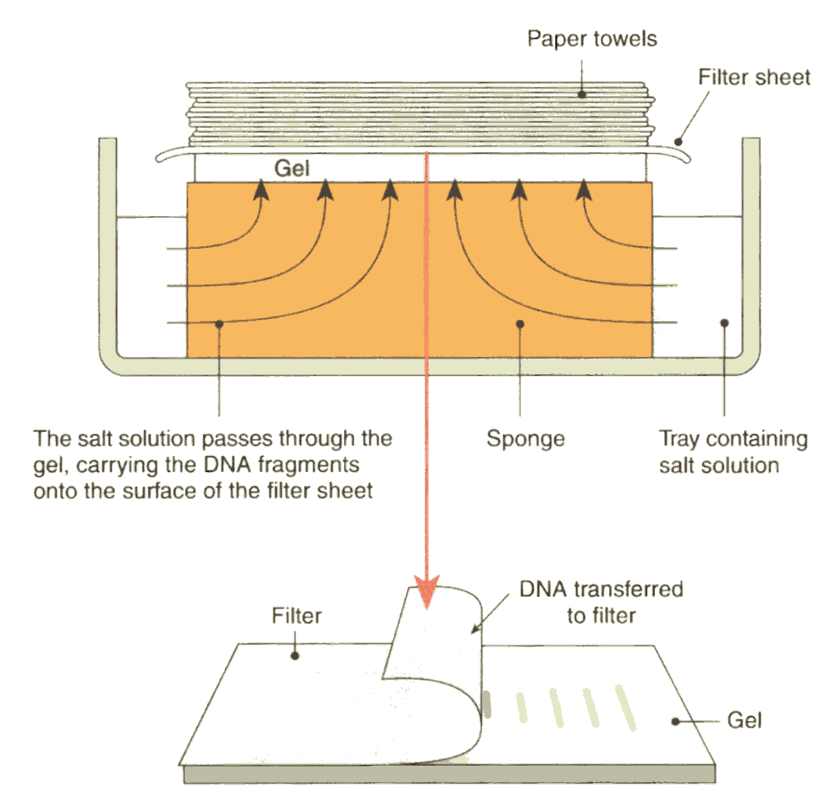
4. DNA TRANSFER
DNA split into single strands using alkaline solution
DNA fragments transferred from gel to filter paper or nylon membrane
Gel, with filter paper attached, is removed & separated

Slide 41
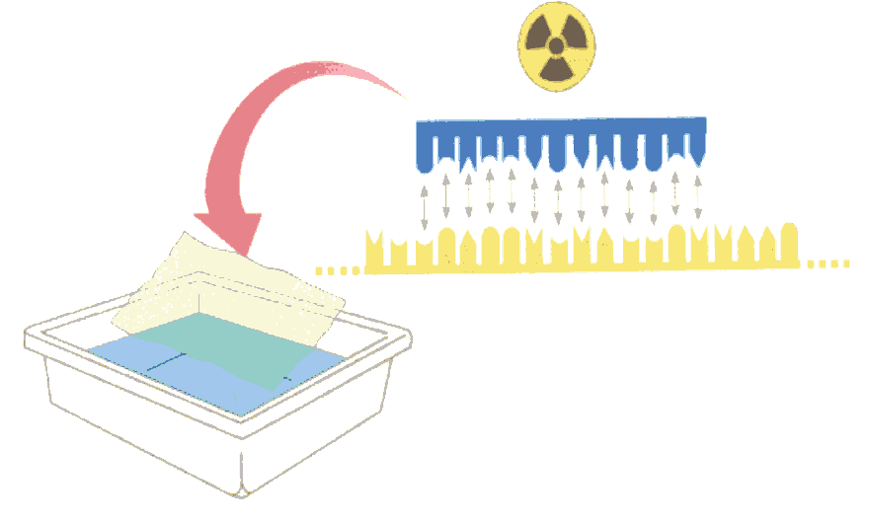
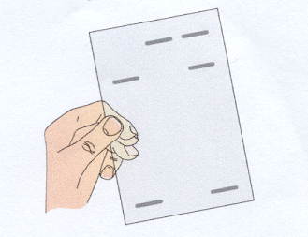
5. ANALYSIS
Radioactive probe in solution binds to DNA
Revealing a pattern of bands
X-ray film

Slide 42
Animation of Electrophoresis
Sort and measure DNA strands by running your own gel electrophoresis experiment.
CAN DNA DEMAND A VERDICT?

Slide 43
Applications of DNA profiles
DNA profiles can be used to:
establish whether biological tissue at a crime scene matches or does not match a suspect
determine whether a person is or is not the parent of a child

Slide 44
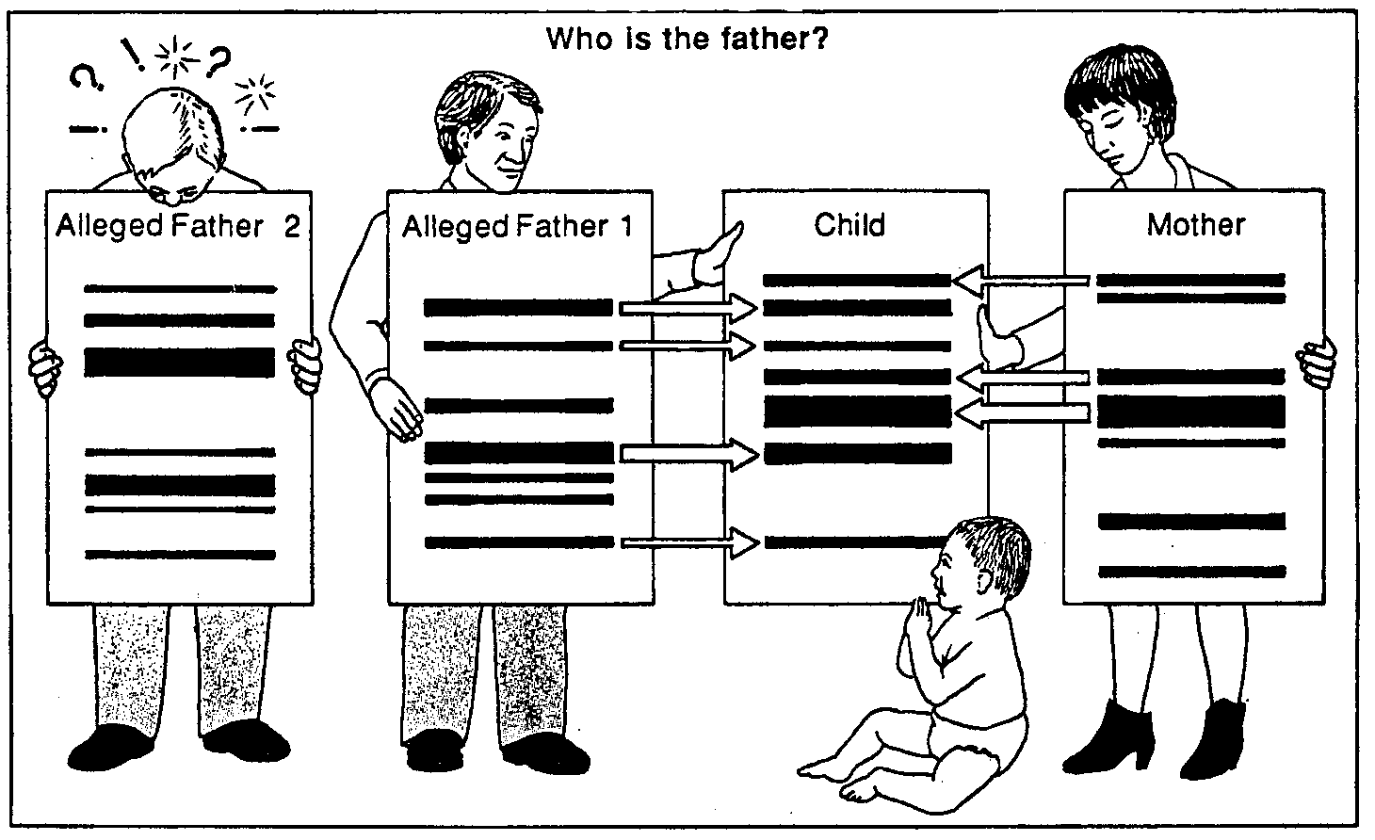
FAMILY RELATIONSHIPS
Notes:
Used in analysis of family relationships in disputed paternity and immigration cases.DNA profiling has also proved valuable in sea & air accidents when victims are beyond recognition.

Slide 45
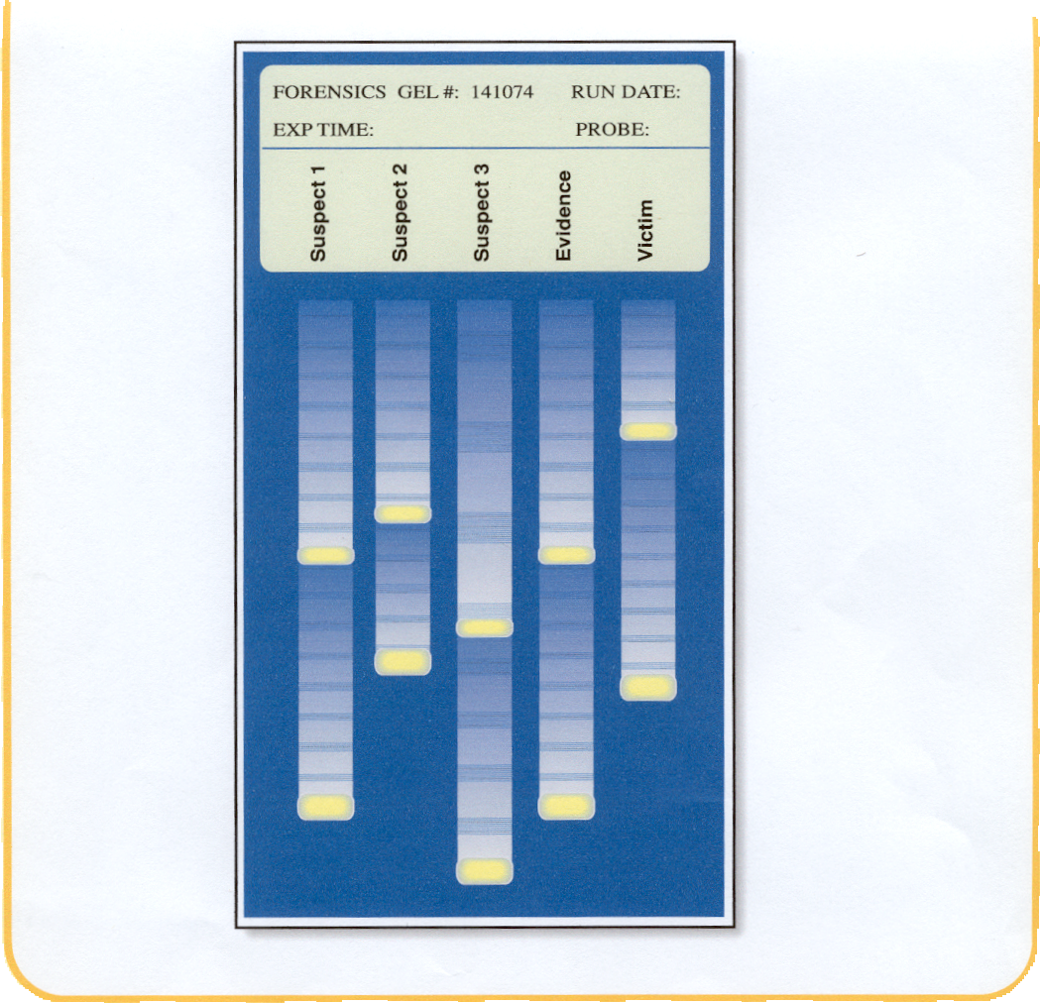
FORENSIC SCIENCE

Slide 46
Genetic Screening
Genetic or DNA screening means that a person’s DNA can be tested to
show the presence of normal or altered genes, which may cause genetic diseases e.g. cystic fibrosis.
Notes:
Genetic or DNA screening means that a person’s DNA can be tested to show the presence of normal or altered genes (which may cause disease).
Build up of mucus in the lungs & intestines.

Slide 47
Screening Tests
Antenatal serum screening for Down Syndrome
Antenatal carrier screening for Sickle Cell Anaemia
Predictive testing for hereditary cancers
Predictive testing for cystic fibrosis
Newborn screening for cystic fibrosis and hypothyroidism.

Slide 48
COMMON CONCERNS
Quality of sample
Mistakes and inaccuracy
Interpretation
Privacy
Evidence from criminal investigations
Who should use DNA fingerprinting
Cost effective
Ethical problems
Notes:
Forensic samples odf DNA are rarely pure. Typically bloodstains on clothing or furniture will be contaminated with all sorts of other material. DNA from fungi,bacteria can be present and show up in a fingerprint. DNA decays rapidly and so some of the DNA sites attacked by restriction enzymes may be lost or or cause them to cut in wrong places. Other contaminants may attach to the DNA fragments and weigh them down and shift bands to an unpredictable extent
Human beings collect,register and store the samples and therefore there is the possibility of human error. Accuracy has been challanged because segments rather than complete DNA strands are fingerprinted and so a fingerprint may not be unique. Often tests carried out in private laboratories that may not follow uniform testing standards and quality control
(£) Band on electrophoresis gels are sometimes indistinct and can result in interpretation being a matter of opinion
If certain behaviours family relationships or physical characteristics are shown to have genetic roots a DNA database could offer the opportunity for discrimination
When DNA fing. Is used in a criminal investigation should the authorities be allowed to keep DNA records or samples from those people not proven guilty or those who are proven guilty.
What org. might want to use and be prepared to pay for DNA Fing.
The distribution of allele frequencies in various VNTR loci can vary among different ethnic groups

Slide 49
Learning Check 4
What are the stages involved in DNA profiling
Define the process of DNA profiling
Give two uses of DNA profiling
Define and give a use for genetic screening

Slide 50
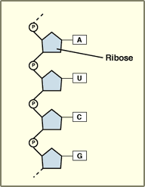
RNA- Ribonucleic acid
is composed of 3 parts
Ribose: smaller sugar than deoxyribose of DNA
Phosphate
4 Nitrogenous Bases A,G,U,C.
Uracil instead of thymine
RNA is a single stranded and
thus smaller & able
to leave the nucleus of the cell.

Slide 51
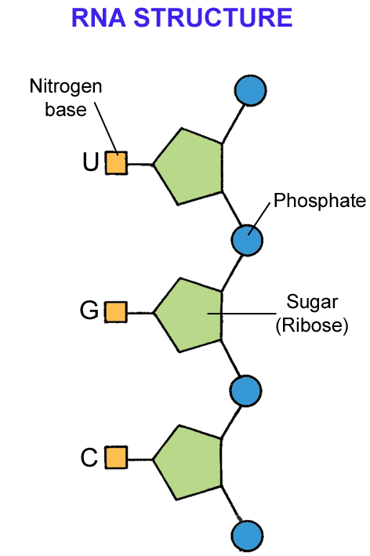

Slide 52
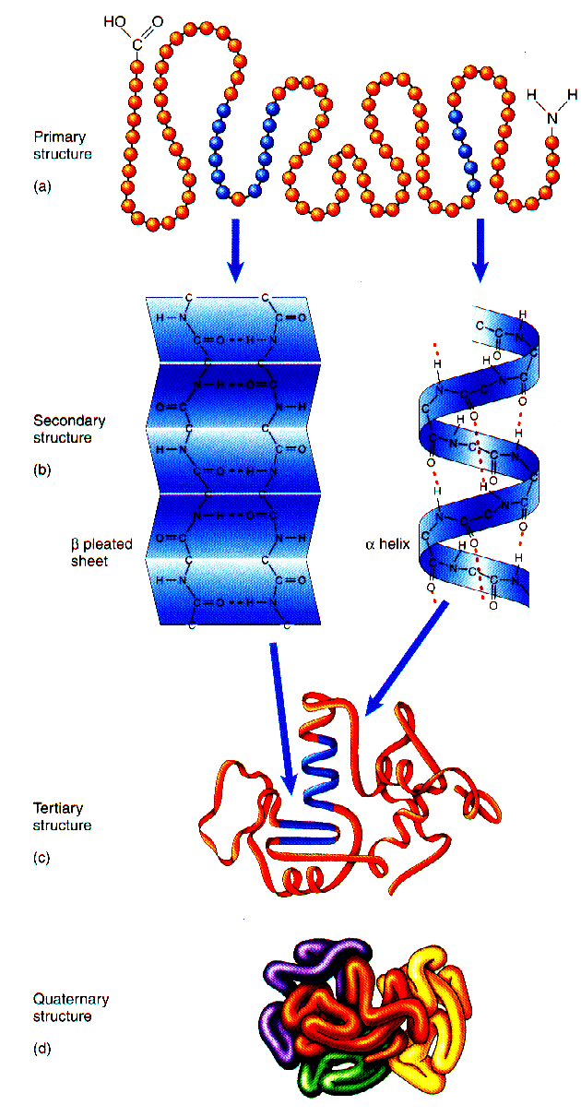
PROTEIN SYNTHESIS

Slide 53
Lesson Objectives
At the end of this lesson you should be able to
Outline the steps in protein synthesis
Understand that a strand of DNA is copied by transcription
Understand the role of mRNA
Know the function of a ribosome in protein synthesis
Understand the process of translation that leads to the formation of a new protein
Know that the shape of a protein determines its function

Slide 54
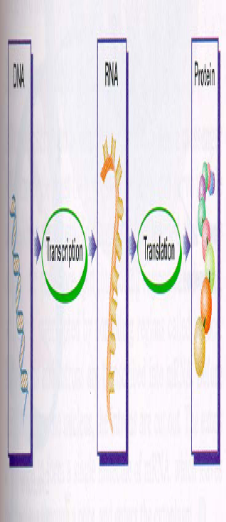
Protein Synthesis
3 stages:
Transcription
RNA processing
Translation
Remember: DNA → RNA → Protein

Slide 55
Firstly enzymes in the nucleus begin to unwind the DNA double helix & break the bonds between its base pairs.
The DNA uncoils and unzips.
One of the DNA chains, called the template, is used for transcription.

Slide 56
1. Transcription
The process by which the information from DNA is transferred to mRNA.
An enzyme RNA polymerase joins the exposed DNA bases with RNA bases in the nucleus to form mRNA.
DNA
RNA Polymerase
mRNA

Slide 57
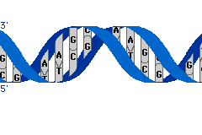

Slide 58
Animation on Protein synthesis
Protein Synthesis video

Slide 59
2. RNA Processing
Nuclear
membrane
DNA
Transcription
Eukaryotic Cell
RNA Processing
mRNA
Ribosome
Translation
Protein

Slide 60
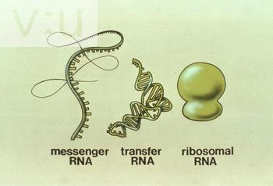
2. RNA Processing
The process by which the information from DNA is transferred to RNA.
There are three types of RNA:
mRNA – messanger RNA
rRNA – ribosomal RNA
tRNA – transfer RNA

Slide 61
The mRNA molecule leaves the nucleus via nuclear pores and travels to the ribosome, carrying the information for a specific protein.
Each mRNA carries a codon / 3 bases / triplet code (sequence of three bases) that codes for a specific amino acid.
codon
A U G G G C U U A A A G C A G U G C A C G U U
mRNA molecule

Slide 62
3. Translation
The production of proteins from information according to the mRNA
mRNA enters a ribosome in the cytoplasm
ribosomes are composed of rRNA – ribosomal RNA and proteins.
rRNA binds mRNA to the ribosome
tRNA –transfer RNA, has a triplet of bases at one end & an amino acid at the other end.
tRNA binds with the complementary codons on the mRNA.
Notes:
Cell produces a protein
–Occurs at the ribosome in the cytoplasm where the cell keeps its supply of tRNA
Tools of translation (in addition to mRNA)
– tRNA
– Ribosomes (rRNA)

Slide 63
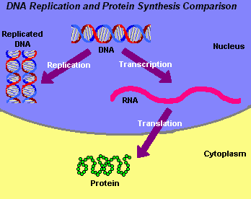

Slide 64
the amino acids attached to the tRNA are assembled in the sequence determined by the with the codons on the mRNA.
the amino acids bond to each other to form a protein.
The protein folds into shape.
aa5
aa4
aa3
aa2
aa199
aa1
aa200

Slide 65
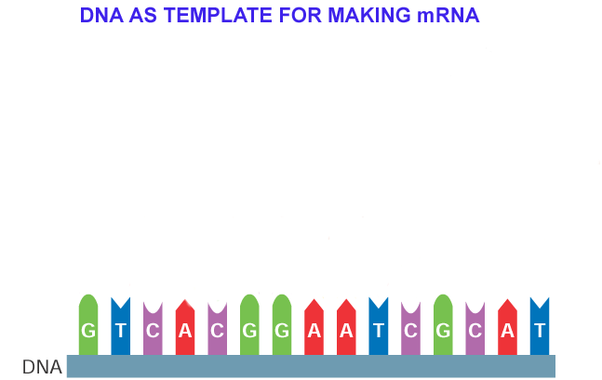
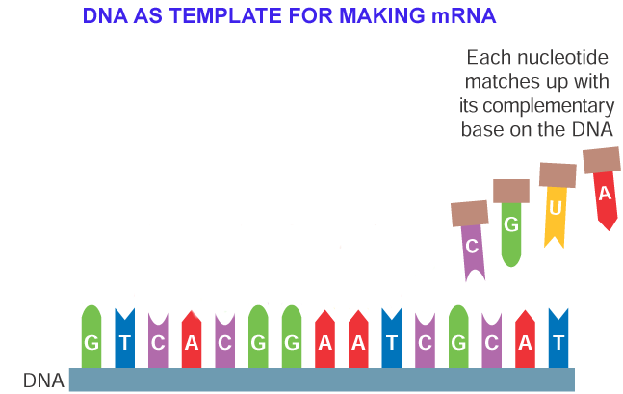
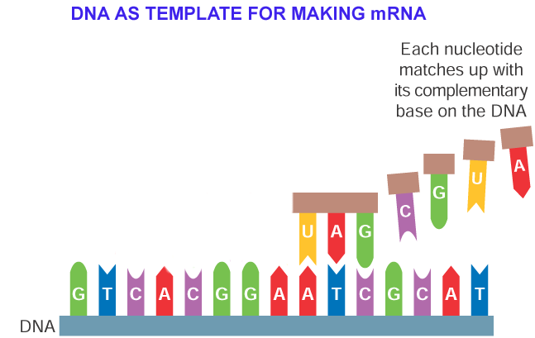
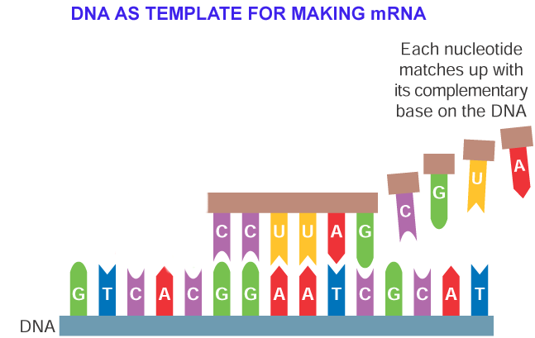
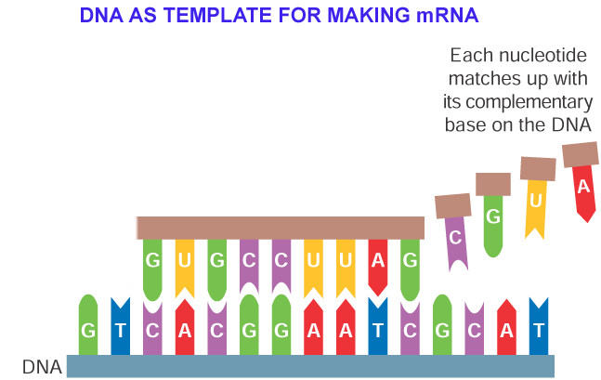
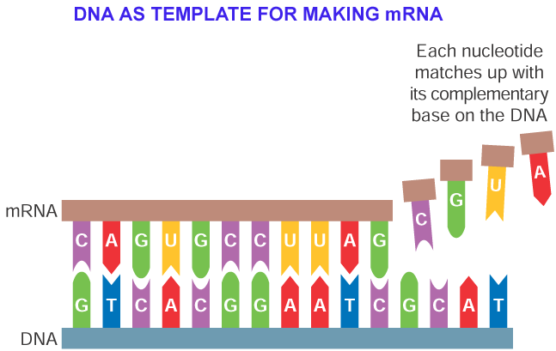
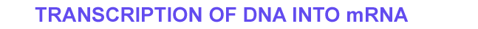

Slide 66
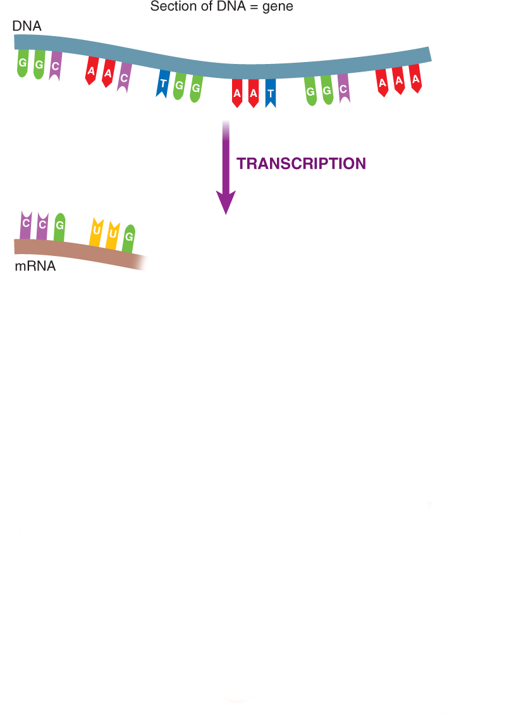
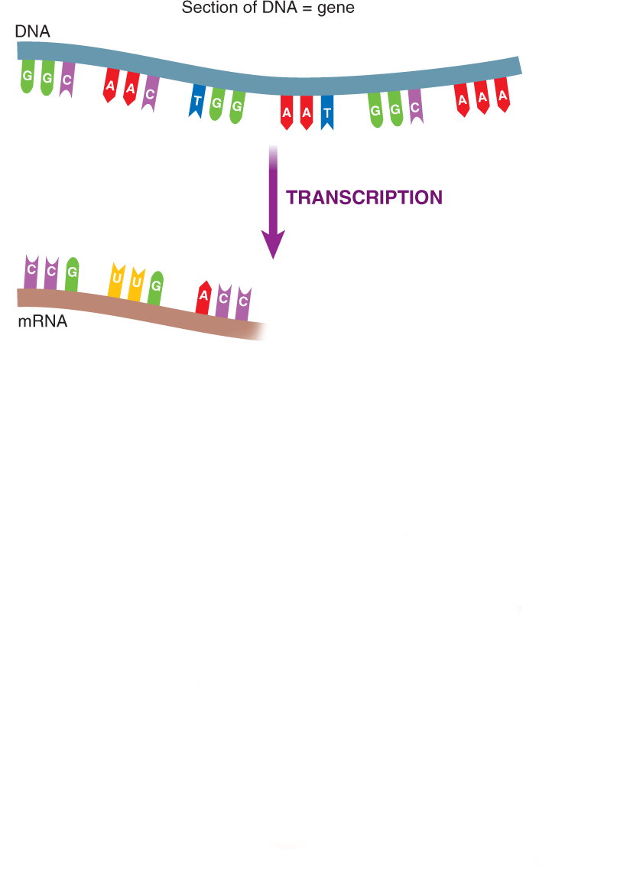
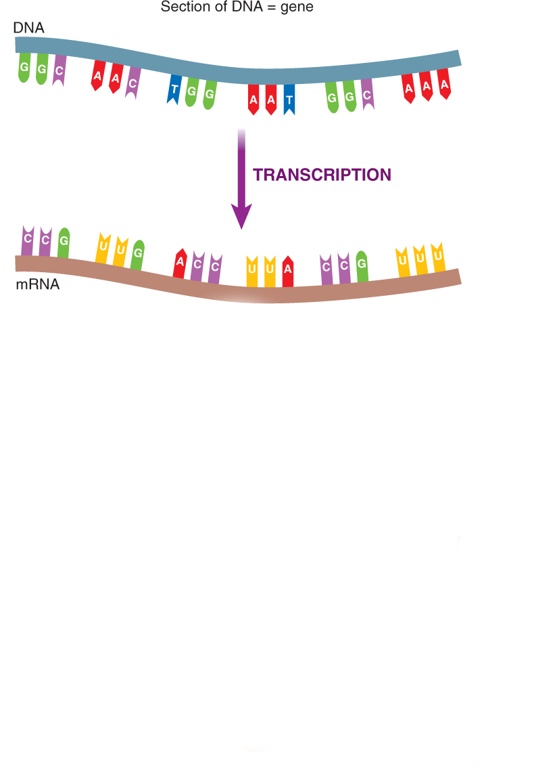
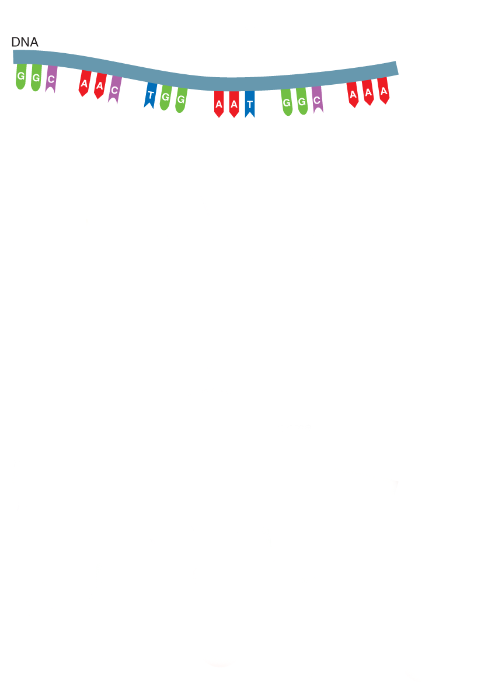
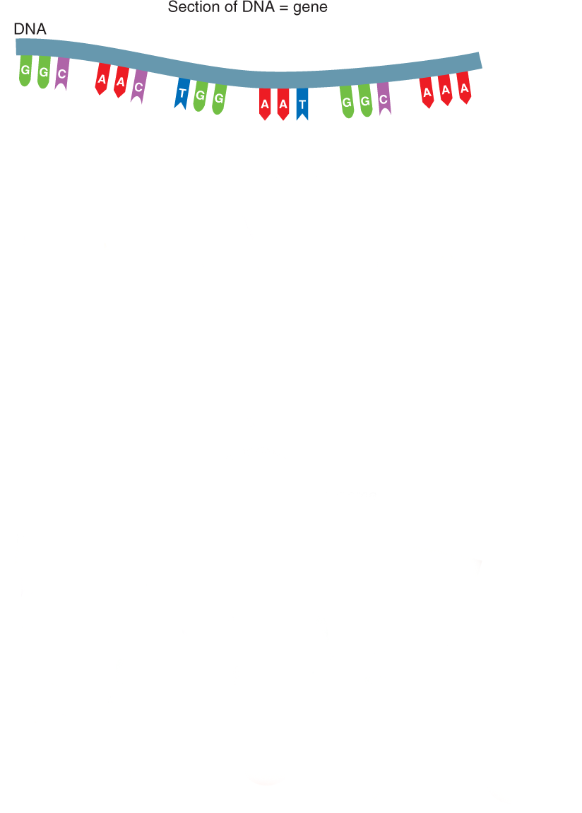
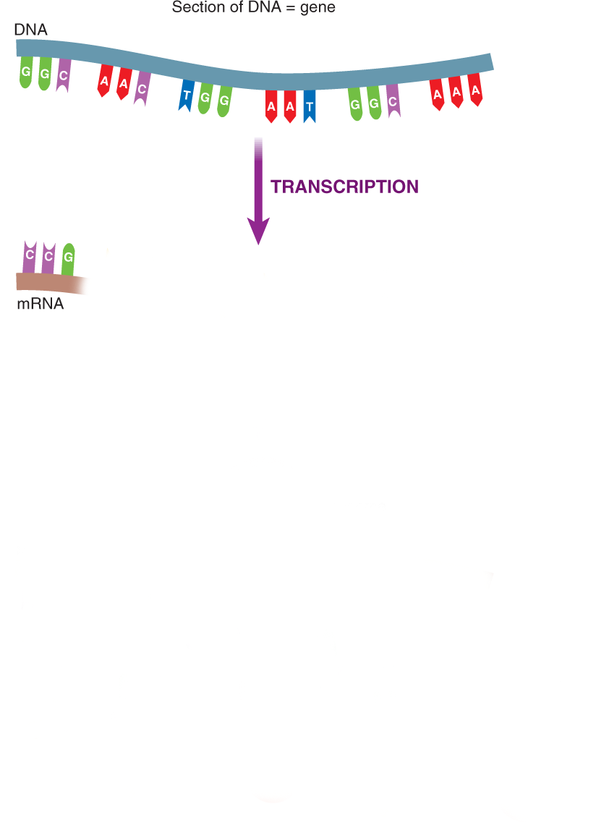
PROTEIN SYNTHESIS

Slide 67
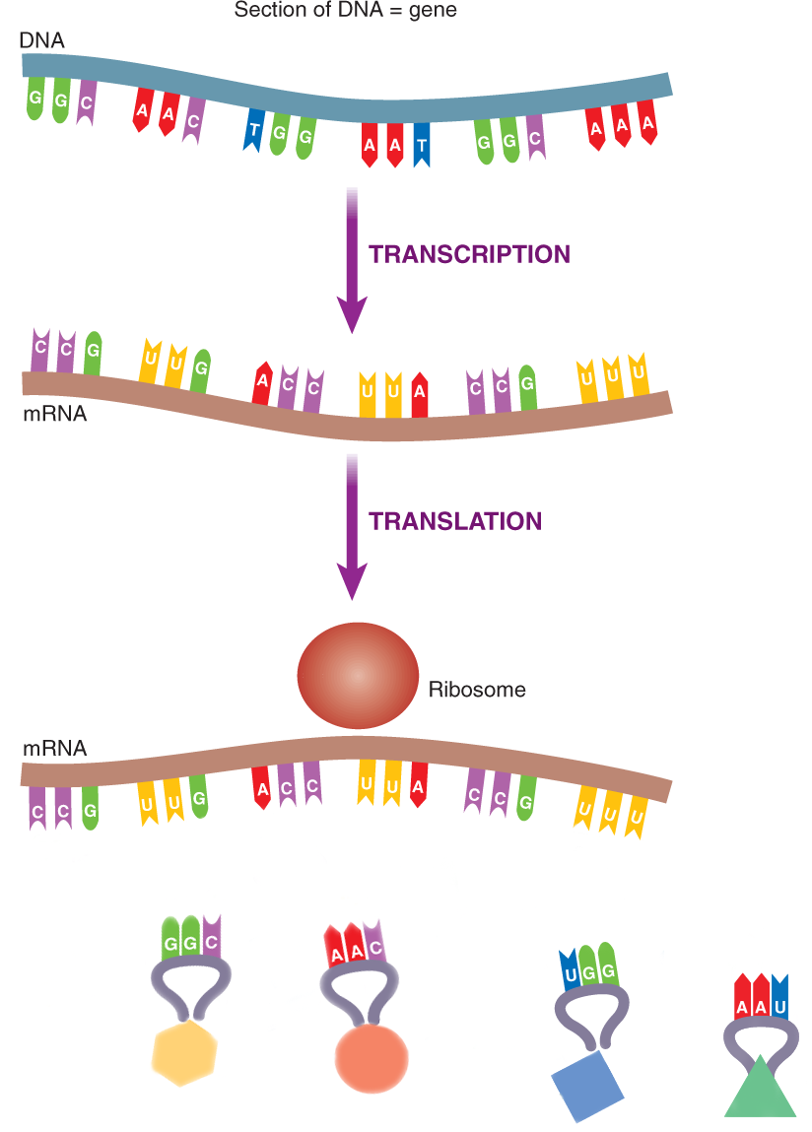
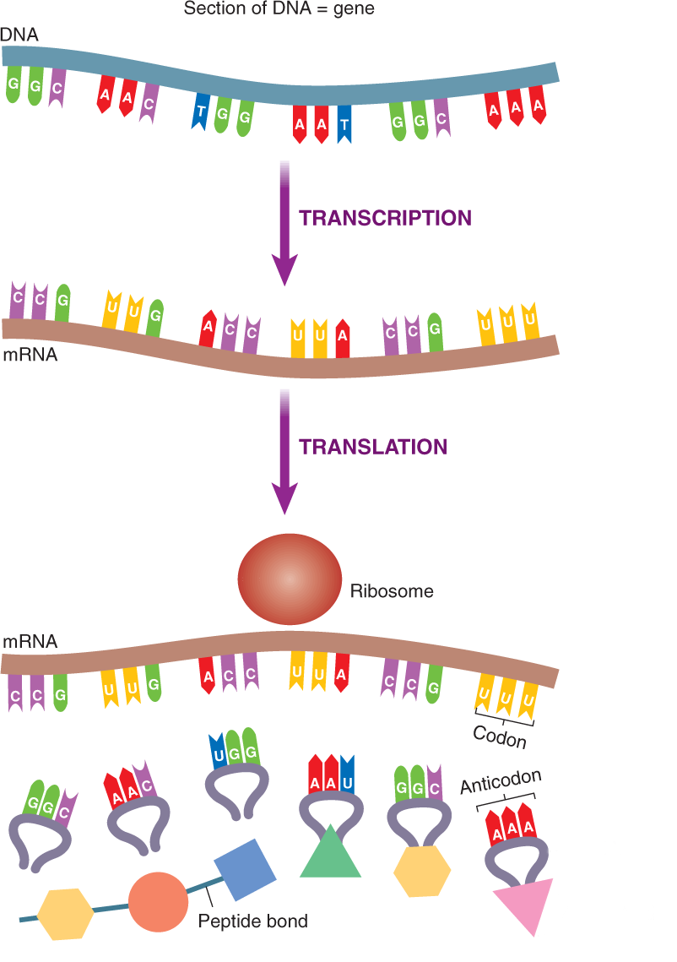
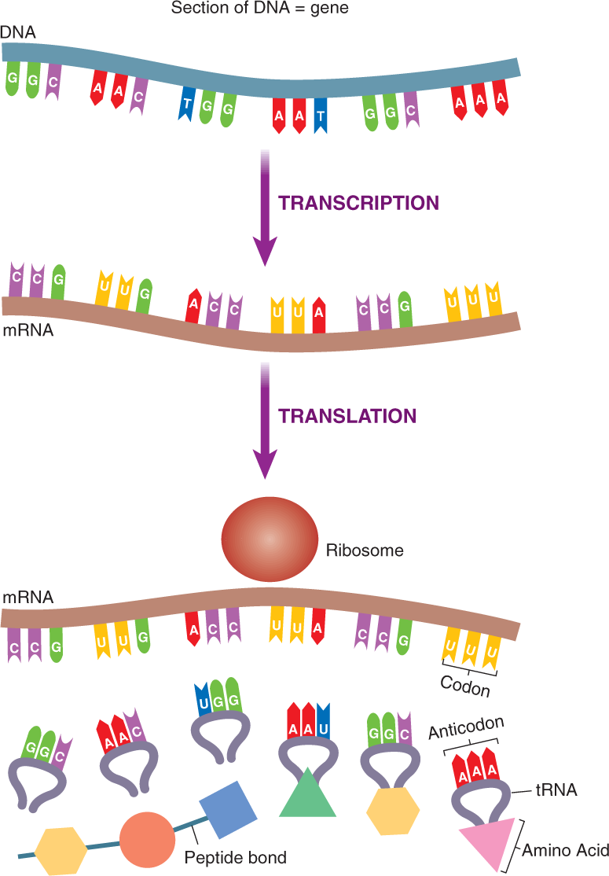
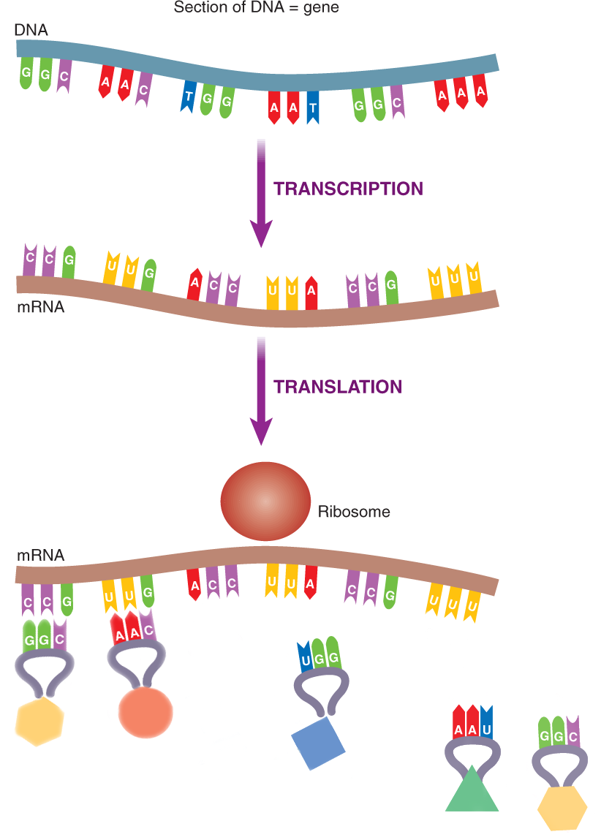
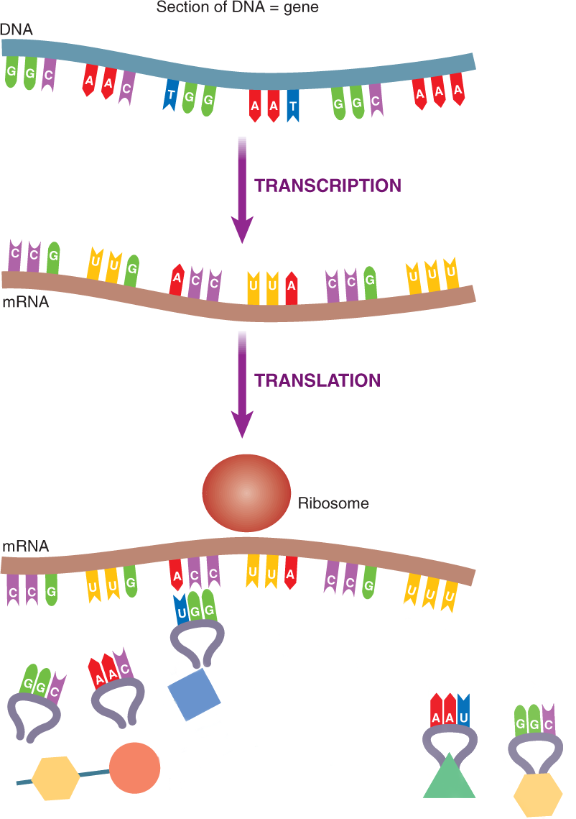
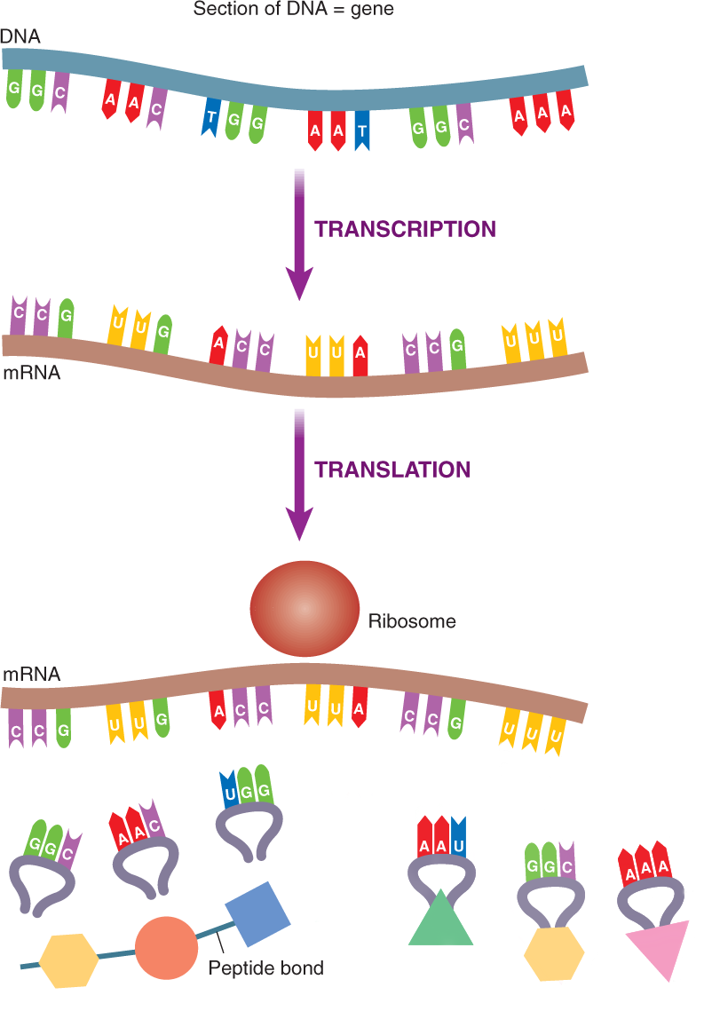
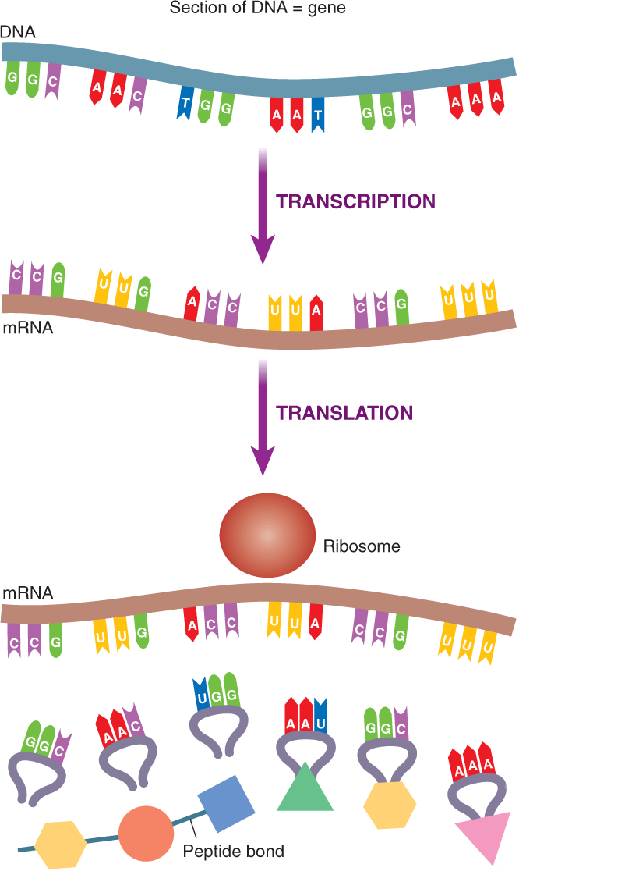

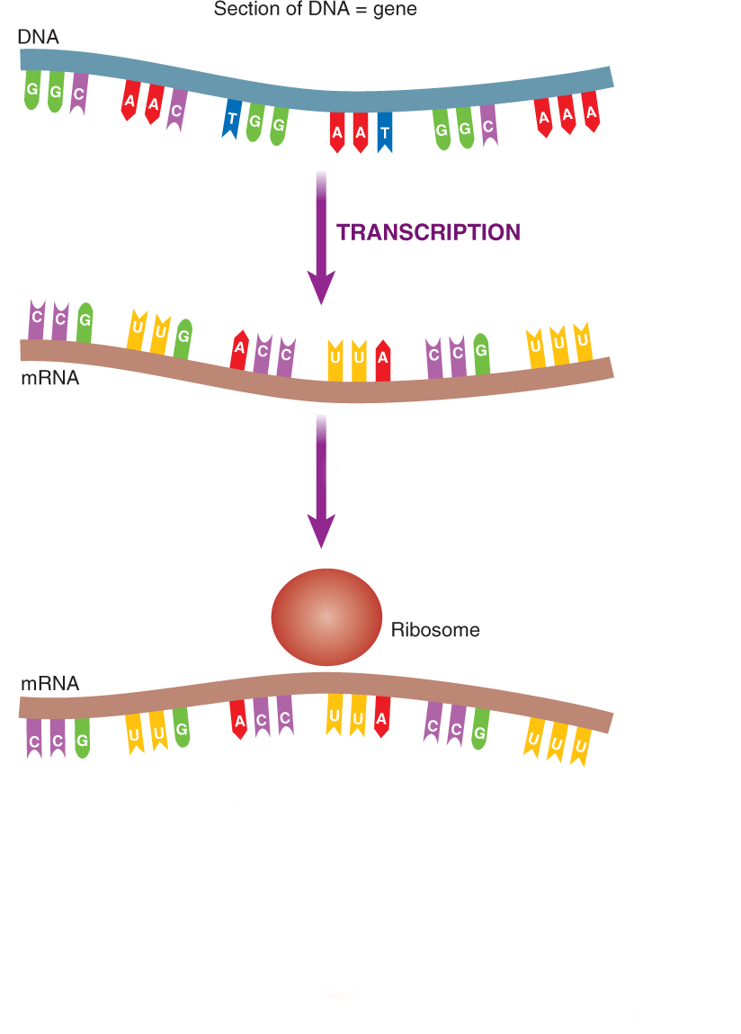
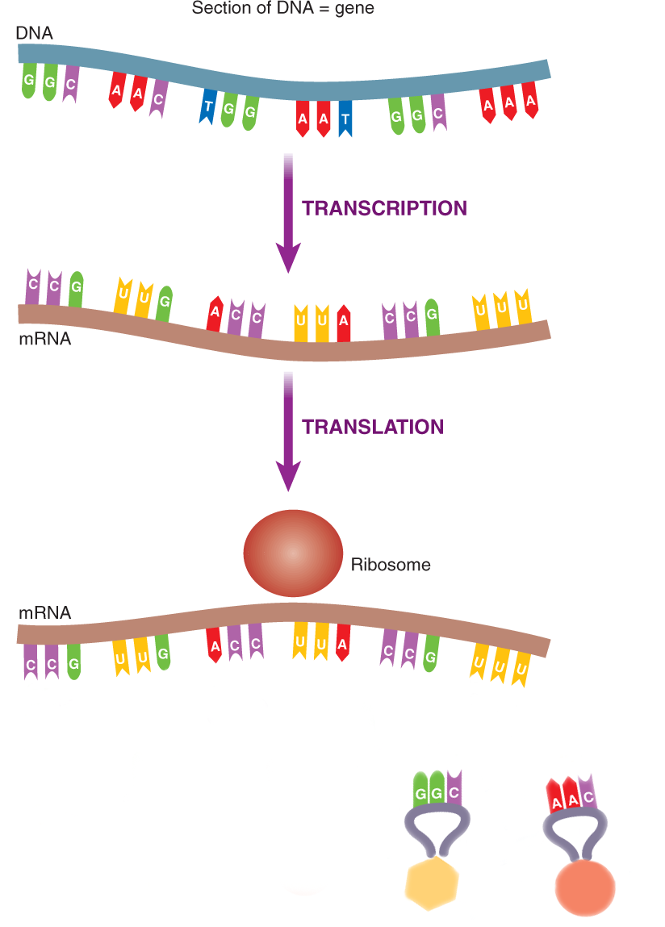

Slide 68
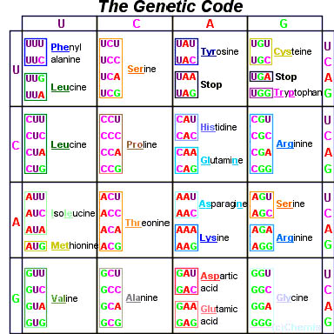

Slide 69
Translation Animation

Slide 70
Types of RNA
Messenger RNA (mRNA) | Consists of RNA nucleotides in the form of a single uncoiled chain. | mRNA carries genetic info from DNA in the nucleus to the cytosol
Transfer RNA (tRNA) | Consists of a single chain of about 80 RNA nucleotides folded into a hairpin shape 45 varieties | binds to a specific amino acid and brings it over to the ribosome
Ribosomal RNA (rRNA) | Most abundant form of RNA Consists of RNA nucleotides in a globular form. | Joins with proteins to form ribosomes – the site of protein synthesis

Slide 71
  This is a molecule of messenger RNA.
  It was made in the nucleus by transcription from a DNA molecule.
codon
A U G G G C U U A A A G C A G U G C A C G U U
mRNA molecule

Slide 72
A ribosome attaches to the mRNA molecule.
ribosome
A U G G G C U U A A A G C A G U G C A C G U U

Slide 73
Amino acid
A transfer RNA molecule arrives
It brings an amino acid to the first three bases (codon) on the mRNA.
The three unpaired bases (anticodon) on the tRNA link up with the codon.
tRNA molecule
anticodon
U A C
A U G G G C U U A A A G C A G U G C A C G U U

Slide 74
Another tRNA molecule comes into place, bringing a second amino acid.
Its anticodon links up with the second codon on the mRNA.
U A C
C C G
A U G G G C U U A A A G C A G U G C A C G U U

Slide 75
Another tRNA molecule brings the next amino acid into place.
C C G
A A U
A U G G G C U U A A A G C A G U G C A C G U U

Slide 76
A peptide bond joins the second and third amino acids to form a polypeptide chain.
C C G
C C G
A U G G G C U U A A A G C A G U G C A C G U U

Slide 77
The process continues.
The polypeptide chain gets longer.
This continues until a termination (stop) codon is reached.
The polypeptide is then complete.
A C G
G U C
A U G G G C U U A A A G C A G U G C A C G U U

Slide 78
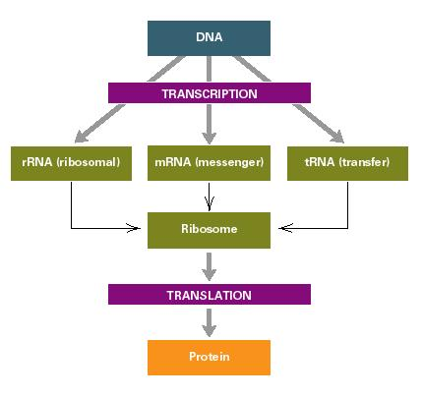

Slide 79
To isolate DNA from onion cells:
grind up onion tissue in a salt/detergent mixture (to clump DNA and break down cell membranes)
filter the mixture (to remove cell parts); proteins and DNA form the filtrate
add protease enzyme to the filtrate (to remove the protein)
add ice-cold ethanol (to precipitate the insoluble DNA)

