Slide 1
Copulation – Sexual intercourse
Sexual arousal
The penis becomes erect
The vagina becomes lubricated
Copulation
The penis is inserted into and moved inside the vagina
Orgasm
Sperm is released from the penis (Ejaculation)
Contraction of vagina and uterus

Slide 2
Insemination
Insemination is the release of sperm into the female
Contractions of uterus and fallopian tubes move the sperm to the fallopian tubes within 5 minutes
If an egg is present it releases chemicals to attract the sperm this is called chemotaxis

Slide 3
Fertilisation
Fertilisation is the fusion of the egg and sperm nuclei to form a diploid zygote.

Slide 4
Fertilisation
Fertilisation usually occurs in the fallopian tube.

Slide 5
Fertilisation
The acrosome releases enzymes to digest the egg membrane.
A number of sperm may reach the egg at the same time. The sperm loses its tail and the head enters the egg.
The sperm and egg nuclei fuse to form a zygote.
A chemical reaction at the membrane prevents other sperm cells entering.
.

Slide 6
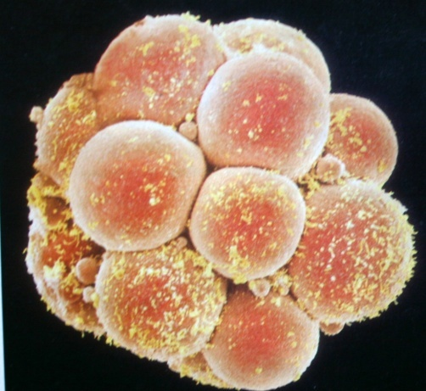
Implantation
Implantation is the embedding of the fertilised egg into the lining of the uterus.
This occurs 6 - 9 days after fertilisation.
By this time the zygote has grown into
an embryo.
During implantation a membrane called the amnion develops around the embryo.
This secretes amniotic fluid which will surround the developing embryo and act as a shock absorber.
After implantation the placenta forms.

Slide 7
Zygote
Implanted embryo
Implantation is the embedding of the fertilised egg into the lining of the uterus

Slide 8
Placenta Formation
After implantation the embryo forms an outer membrane called a chorion
This chorion develops projections (chorionic villi) which, together with the blood vessels of the mother in the endometrium, form the placenta
The placenta allows nutrients, wastes, gases, antibodies and hormones to be exchanged between the blood of the mother and the embryo

Slide 9
Placenta Formation
The blood of the mother and embryo do not mix
This is important as:
- The blood groups of mother and baby might not be compatible.
- The blood pressure of the mothers system may cause damage to the embryo

Slide 10
Placenta Formation
The placenta also makes the hormone progesterone
The umbilical cord connects the placenta with the embryo.
It contains blood vessels which circulate blood between the embryo and the placenta

Slide 11
The Placenta
Chorion
Placenta
Embryo
Mother’s blood
Mother
Nutrients, Oxygen, antibodies
Wastes, Carbon Dioxide, Water
Amnion
Amniotic fluid
Umbilical cord
Embryo’s blood
Embryo

Slide 12
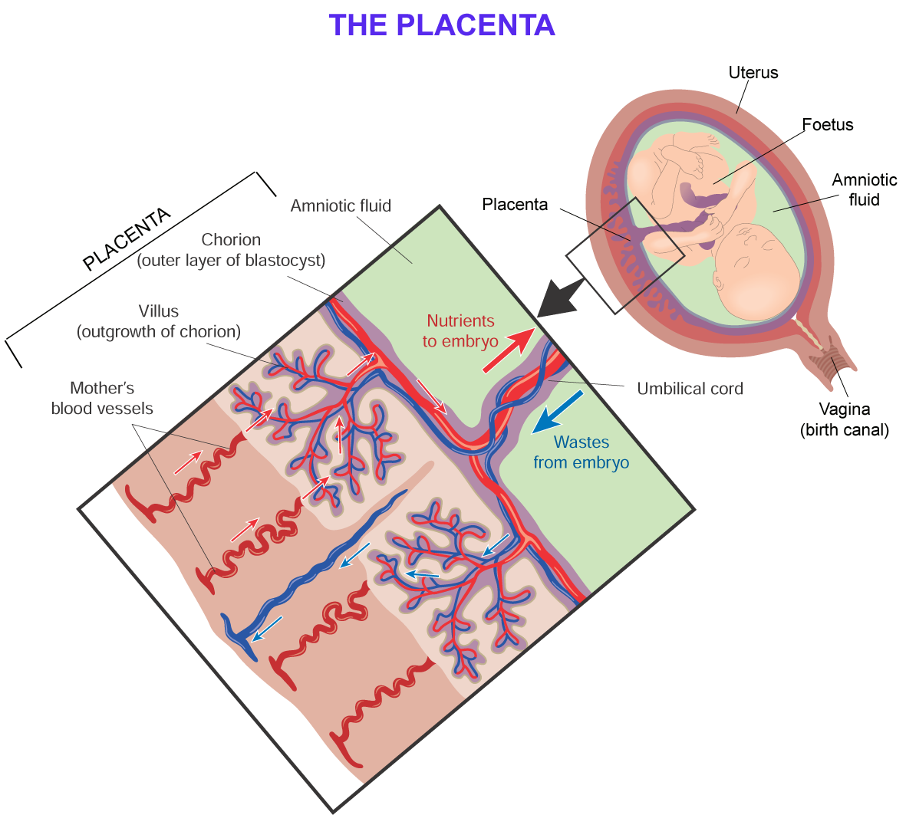

Slide 13
Birth
The hormones oestrogen and progesterone are produced throughout pregnancy firstly by the corpus luteum (3 months) and then by the placenta. The placenta acts as an endocrine gland.
Immediately before birth the placenta stops making progesterone. The walls of the uterus begin to contract as a result.
The pituitary gland releases the hormone called oxytocin. This causes further contractions of the uterus
Labour has now begun

Slide 14
There are three main stages:
Stage 1 - (about 12 hours)
The contraction of the uterus pushes the foetus towards the cervix. This causes the cervix to open (dilate). During this stage the contractions cause the amnion to break releasing the amniotic fluid through the vagina. (The ‘waters break’).

Slide 15
Stage 2 - (20 minutes to 1 hour)
The foetus passes through the cervix and the birth canal head first.

Slide 16
Stage 2 - (20 minutes to 1 hour)
The foetus passes through the cervix and the birth canal head first.

Slide 17
Stage 2 - (20 minutes to 1 hour)
The foetus passes through the cervix and the birth canal head first.

Slide 18
Stage 2 - (20 minutes to 1 hour)
The foetus passes through the cervix and the birth canal head first.

Slide 19
Stage 2 - (20 minutes to 1 hour)
The foetus passes through the cervix and the birth canal head first.

Slide 20
Stage 2 - (20 minutes to 1 hour)
The foetus passes through the cervix and the birth canal head first.
The umbilical cord is tied and cut. This leaves a scar which will eventually become the navel (belly button).

Slide 21
Stage 3 - (10 to 15 minutes)
The baby is now born.
The uterus now contracts again and expels the afterbirth (the umbilical cord and placenta.

Slide 22
Stage 3 - (10 to 15 minutes)
The baby is now born.
The uterus now contracts again and expels the afterbirth (the umbilical cord and placenta.

Slide 23
Stage 3 - (10 to 15 minutes)
The baby is now born.
The uterus now contracts again and expels the afterbirth (the umbilical cord and placenta.

Slide 24
Stage 3 - (10 to 15 minutes)
The baby is now born.
The uterus now contracts again and expels the afterbirth (the umbilical cord and placenta.

Slide 25
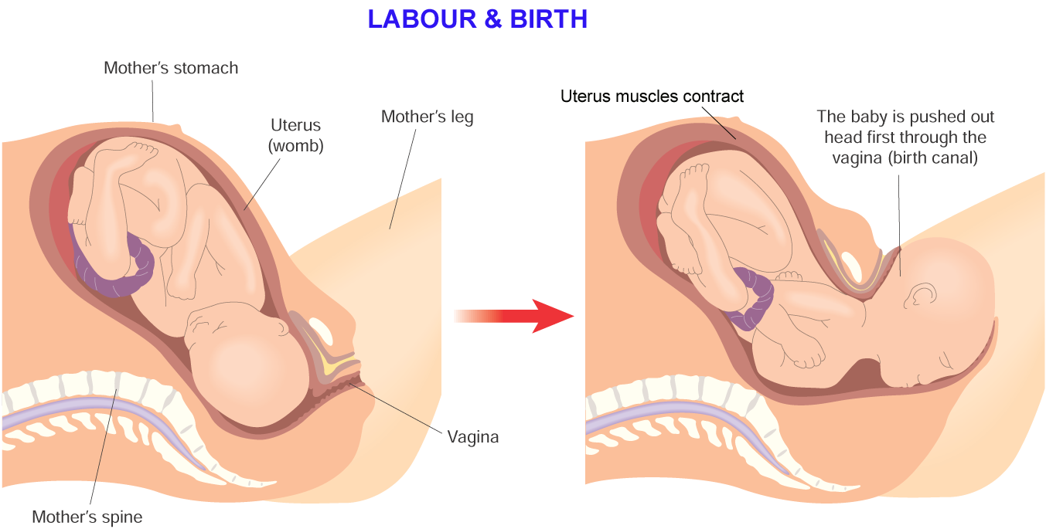

Slide 26
Umbilical cord is cut

Slide 27
Breastfeeding
Lactation
The secretion of milk from the mammary glands
The first days after birth colostrum produced
Milk production triggered by release of prolactin by pituitary

Slide 28
Breastfeeding
Breastfeeding is better than bottle feeding because:
Colostrum and breastmilk provides the baby with essential antibodies protecting it against infection
Ideal balance of nutrients for baby
Has little fat making it is easier to digest than milk

Slide 29
Birth control
Birth control refers to the methods employed to limit the number of children that are born
Removing the possibility of conception is called contraception.
This is achieved by preventing the egg and sperm from meeting
There are a number of methods:

Slide 30
Mechanical contraception -male
The use of condoms
Surgical contraception
Sperm ducts are cut and tied

Slide 31
Mechanical contraception - female
The use of diaphragms

Slide 32
Chemical contraception
Use of ‘the pill’. The pill contains oestrogen and progesterone which prevents ovulation and hence conception.
Use of spermicide

Slide 33
Surgical contraception
The fallopian tubes and sperm ducts can be cut and tied

Slide 34
Natural contraception
Not having sexual intercourse during the fertile period of the menstrual cycle
Natural methods of contraception try to identify the time of ovulation based on:
- monitoring the body temperature.
This rises slightly after ovulation
- mucous secreted in the cervix (which changes its texture after ovulation)

Slide 35
Infertility
Infertility is the inability of a couple to achieve conception.

Slide 36
Male infertility disorders
Low sperm count – Refers to a low number of sperm per ml of seminal fluid.
Low sperm mobility - If movement of the sperm is slow, not in a straight line or both, the sperm may have difficulty passing through the cervical mucous or penetrating the shell of the egg.
Endocrine gland failure – A failure of the testes to produce sperm

Slide 37
Low sperm count
Causes:
The persistent use of drugs such as alcohol, cigarettes and anabolic steroids.
Abnormalities in sperm production or obstruction of the tubes through which sperm travels.
Stress

Slide 38
Low sperm count
Treatment
A change in diet.
A change in lifestyle e.g. stopping alcohol consumption, smoking.
A reduction in stress levels.

Slide 39
Female infertility disorders
Blockage of the Fallopian Tube
Scarring of the fallopian tube can block the passage of the egg to the uterus
Endocrine gland failure
A failure of the ovaries to produce an egg

Slide 40
Blockage of the fallopian tubes
Causes:
Fragments of the uterus lining may spread to the fallopian tube
Inflammation as a result of infection
Treatment
In-vitro fertilisation (I.V.F.)

Slide 41
In-vitro fertilisation (I.V.F.) is a method of treating infertility. It involves removing eggs from an ovary and fertilising them outside the body.

Slide 42
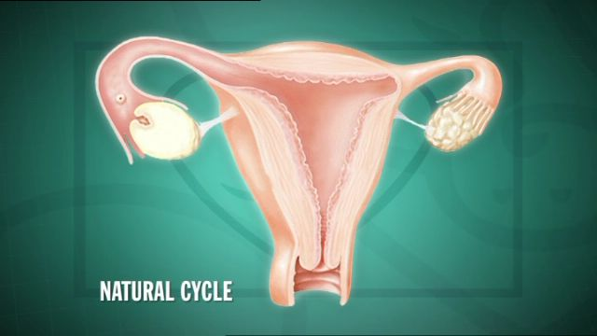
During the natural menstrual cycle an egg is produced by the ovary every month

Slide 43
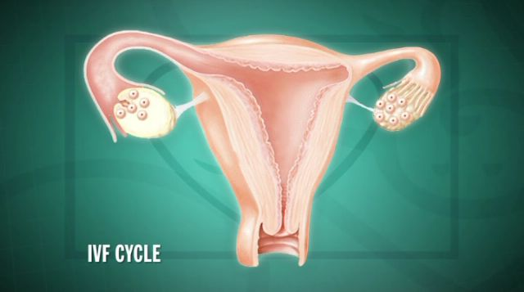
During IVF fertility drugs are given to the female to stimulate the ovaries to produce more than one egg

Slide 44
These eggs are then taken from the females body and into the laboratory

Slide 45
In the meantime a sperm sample is taken from the male

Slide 46
The eggs and sperm are mixed together in the hope that fertilisation will occur

Slide 48
The sample is placed in the most ideal conditions for fertilisation to occur

Slide 49
The main aim of the procedure is to obtain a zygote. If successful the zygotes development will be monitored closely

Slide 50
If successful the zygote develops into a morula, blastocyst and eventually becomes an embryo

Slide 51
The developing embryo can now be placed back into the females body for implantation to take place

Slide 52
Babies born as a result of IVF are often incorrectly called ‘test tube’ babies.
While fertilisation takes place in the laboratory (‘in vitro’ – in glass) the fertilised egg is re-inserted into the mother’s body and develops naturally in the uterus.

Slide 53
If analysis of a couples eggs and sperm suggests that IVF treatment is unsuitable, other methods of assisted fertility treatment are available

Slide 54
Syllabus

Slide 55
Depth of treatment(1/2)
General structure of the reproductive system – male and female
Functions of the main parts
Role of meiosis in the production of sperm cells and egg (ova)
Definition of “secondary sexual characteristics”
Role of oestrogen, progesterone and testosterone
The menstrual cycle: the events and outlined role of oestrogen and progesterone

Slide 56
Depth of treatment(1/2)
Copulation
Location of fertilisation
Implantation, placenta formation and function
Birth – outline of process
Milk production and breastfeeding

Slide 57
Contemporary Issues and Technology
Birth control – natural, mechanical, chemical and surgical methods of contraception
Infertility
One cause of male infertility from the following disorders: low sperm count, low sperm mobility, endocrine gland failure
Availability of corrective measures

Slide 58
Contemporary Issues and Technology
One cause of female infertility from the following disorders: blockage of the Fallopian tube, endocrine gland failure
Availability of corrective measures
In-vitro fertilisation and implantation
Biological benefits of breastfeeding

Slide 59
Explain copulation
Outline infertility
State one cause of male infertility
State the availability of corrective measures for male infertility
State one cause female infertility
State the availability of corrective measures for female infertility

Slide 60
Learning Objectives(3/3)
Explain implantation, placenta formation & function
Outline the birth process
Explain In-vitro fertilisation & implantation
Outline milk production & breastfeeding including biological benefits

