Slide 1
Chapter 9
Factors affecting Human Health

Slide 2
At the end of this unit you should:
Be able to evaluate how Hereditary factors affect human health.
Be able to evaluate how environmental factors & lifestyle affect human health.
Examine the role of microorganisms in human health.

Slide 3
artificially
balanced
calories
carbohydrates
cholesterol
converted
diet
Digestion
environmental
fats
healthy
inherit
joules
lifestyle
micro-organisms
Minerals
natural
nutrients
nutrition
obesity
preservatives
proteins
respiration
vitamins
well-being

Slide 4


Slide 5
What is health?
Health is a state of complete physical, mental & social well-being
Health can be considered as
Physical Health &
Mental Health

Slide 6

Physical Illness
Results from permanent or temporary damage to the body

Slide 7
Physical Illnesses
Notes:
http://psychcentral.com/disorders/

Slide 8

Mental Illness
An illness that affects a persons mind, thoughts, emotions, memory and personal and social behaviour.
May have physical symptoms.
.

Slide 9
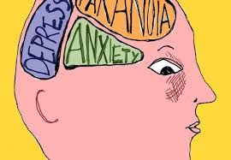
Mental Illnesses
Anxiety & Panic Disorders.
Bipolar Disorder.
Depression.
Feeding & Eating Disorders.
Sleep & wake Disorders
Schizophrenia.
Substance Abuse & Addiction.
Notes:
http://psychcentral.com/disorders/

Slide 10
What Factors affecting our Health?
Inherited factors
Environmental factors
Personal Behaviour

Slide 11
How do Hereditary factors affect our Health?
We know that genes play an important role in determining our physical characteristics.
Cells in human body contain a substance called DNA.
DNA is wrapped together to form structures called chromosomes.
Most cells in human body have 23 pairs of chromosomes, thus making a total of 46.
A child receives half of chromosomes from mother’s egg and the other half from father’s sperm cell.
Genes carried on the chromosomes determine specific human characteristics, such as health conditions, hair color, etc.
Some characteristics come from a single gene, whereas others come from gene combinations.
Notes:
Some diseases like colorblindness,haemophilia
Diabetes etc.transfer from one generation to other Generation, these situations called hereditary-factors.

Slide 12
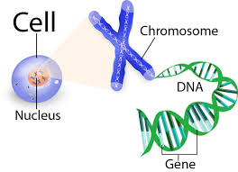

Slide 13
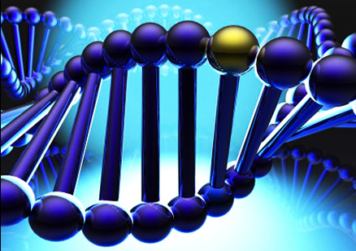
Genetic Disorders
Disorders caused by single gene disorders
Disorders caused by many genes

Slide 14
Disorders caused by single gene disorders
When a certain gene is known to cause a disease, we refer to it as a single gene disorder
Over 10,000 human disorders are caused by a change in a single gene.
In statistics, there is only one person every one million who incur genetic disease.
Examples:
sickle cell disease, coeliac disease, Huntington disease, haemophilia etc.
Notes:
cystic fibrosis,, Fragile X syndrome, muscular dystrophy, or

Slide 15
Disorders caused by many genes
Genetic disorders can be caused by a change in DNA in multiple genes
Some diseases are caused by mutations that are inherited from the parents
Other diseases are caused by acquired mutations in a gene or group of genes that occur during a person's life.
They occur either randomly or due to some environmental exposure (such as cigarette smoke). These include many cancers.

Slide 16
Most genetic disorders, however, are "multifactorial inheritance disorders," meaning they are caused by a combination of inherited mutations in multiple genes, often acting together with environmental factors.
Examples of such diseases include many commonly-occurring diseases, such as heart disease and diabetes, which are present in many people in different populations around the world.

Slide 17
How do Environmental factors affect our Health?
The environment in which a man lives, can also affect his health.
Environmental factors may be further divided into two parts:-
Nutrition
Lifestyle choices

Slide 18
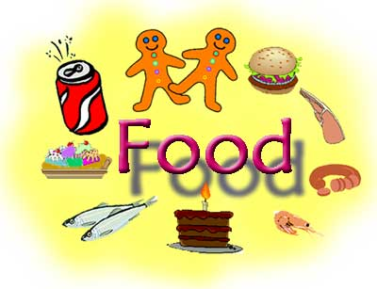

What does your life depend on?
What can make you healthy or ill?
What do over a billion people not have enough of and another billion have too much of?
Do you know what it is?
Yes its……..
Notes:
Slide 1: Introduction to topic
Lesson 1
General introduction to food
Ask class what they think the answer is to question posed by bullet point 1
Ask class what do they think food is necessary for.

Slide 19
What are the effects of Nutrition on our Health?
Nutrition: A process where an organism gets its energy from its surroundings (food).
Food is needed for
Growth and repair of cells
Provides energy
Prevent us from getting diseases

Slide 20
A BALANCED DIET
A balanced diet should include:
A variety of foods from each of the levels of the food pyramid
Foods that are low in fat (especially saturated fats), sugar and salt
At least five portions of fruit and vegetables daily
Plenty of water – approximately 2 litres a day
Failure to eat a balanced diet (malnutrition) can lead to deficiencies.

Slide 21
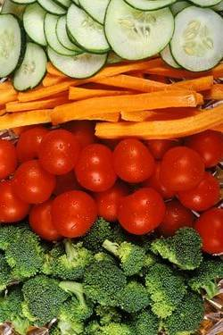
What are the six major constituents of a balanced diet?
Carbohydrates
Fat
Proteins
Vitamins
Minerals
Water

Slide 22

Examples of a healthy lunch
Using the food pyramid we can make ourselves a healthy lunch
  Brown Bread, chicken, lettuce tomato
  Small pot of yoghurt
  Apple & Banana
  Fruit drink, water or milk.
Notes:
Using the example above. Get class to identify which level of the food pyramid the foods come from
Come up with some more healthy lunch ideas and write these up on the whiteboard

Slide 23
1. Carbohydrates
Sources of carbohydrates:
Sugars- fruits, honey, chocolate, soft drinks.
Starch- Bread, potatoes, rice.
Fibre – cereals, brown bread, vegetables.

Slide 24

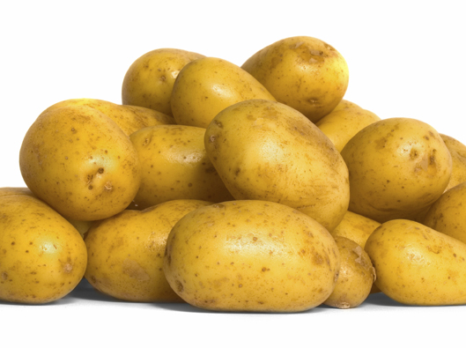
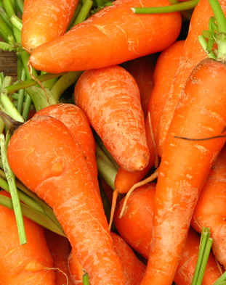
The Function of Carbohydrates is:
carbohydrates
sugar
starch
fibre

Slide 25
The Function of Carbohydrates is:
carbohydrates
For
energy
For
energy
Prevents
constipation
sugar
starch
fibre

Slide 26
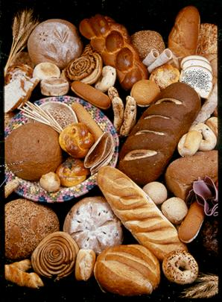
Carbohydrates
Metabolic Function:
Glucose gives energy in respiration.
For each gram of carbohydrate eaten there is a release of 17kJ of energy.

Slide 27
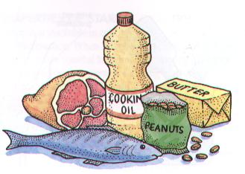
2. Fat
Sources of fat:
Butter
Cream
Milk
Oils
Margarine
Fried foods.

Slide 28
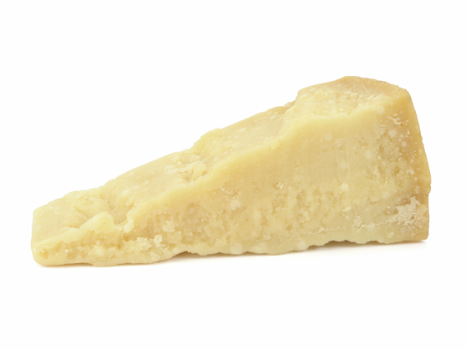
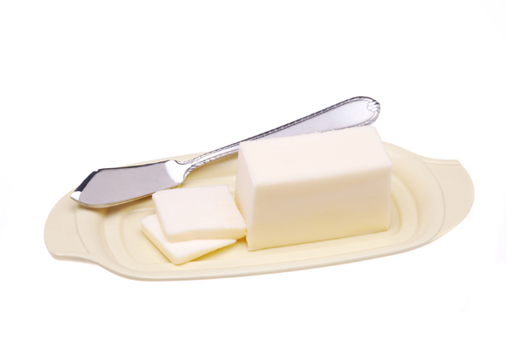
The Function of Fats is:
fats

Slide 29
The Function of Fats is:
fats
For
energy and insulation

Slide 30
Fats
Function of fats:
Provide Energy
Store energy (fats contain twice as much energy as the equivalent weight of carbohydrate or protein but the body only gets energy from fats when there is no carbohydrate present).

Slide 31
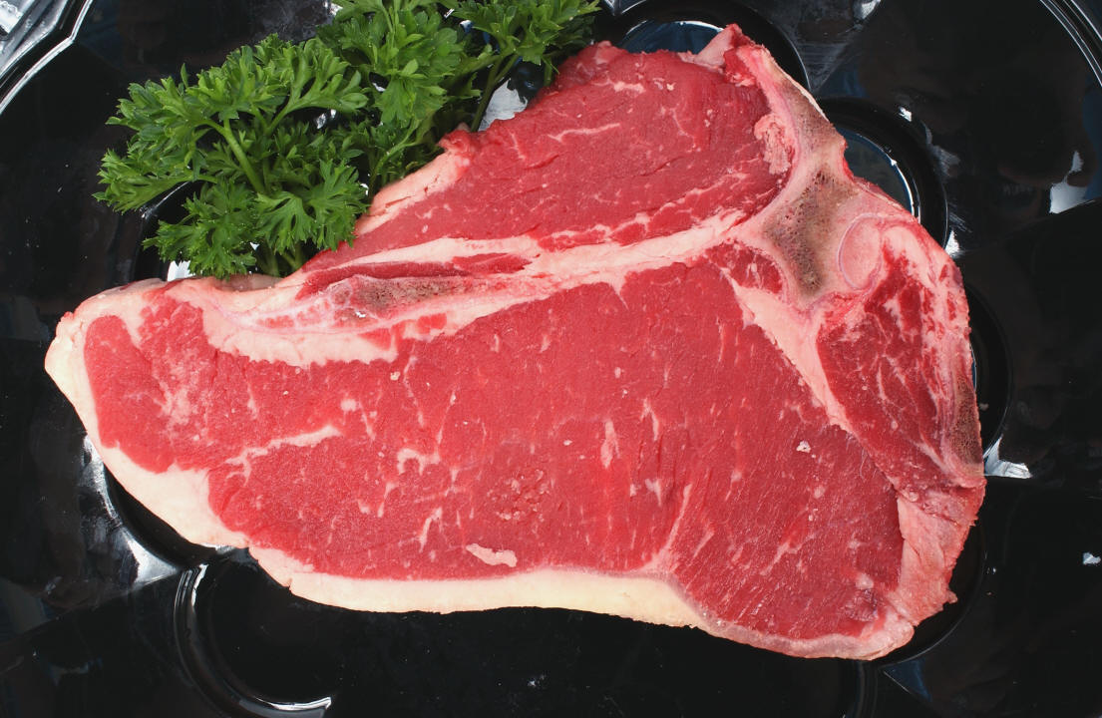
3. Protein
Sources of protein: Name some:
Meat,
Fish,
Eggs,
Peas,
Beans.

Slide 32
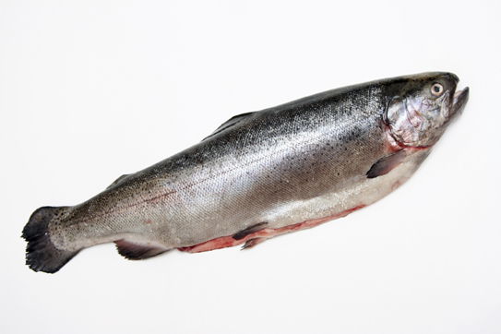
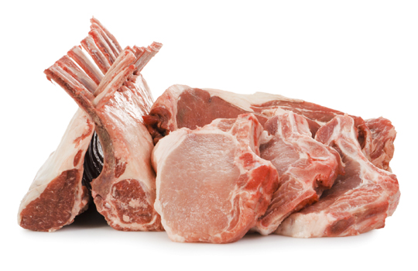
The Function of Proteins is:
proteins

Slide 33
The Function of Proteins is:
proteins
For growth and repair of cells

Slide 34
Protein
Structural Function:
Keratin is found in hair and gives it strength.
Myosin is found in muscles and it enables movement.
Metabolic Function:
Enzymes control all reactions that take place in the body.
Antibodies fight infection.

Slide 35
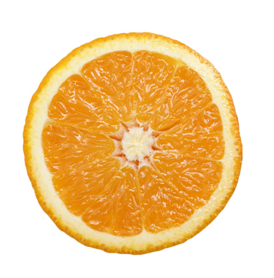
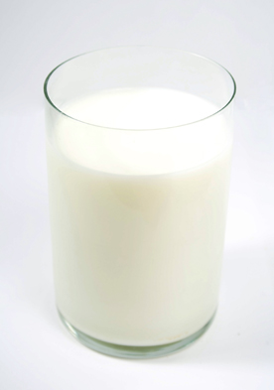
4. Vitamins
A balanced diet contains all the food types in the right amounts to stay healthy.
vitamins
vitamin C
vitamin D

Slide 36
A balanced diet contains all the food types in the right amounts to stay healthy.
vitamins
For healthy skin
and gums
For strong
bones
vitamin C
vitamin D

Slide 37
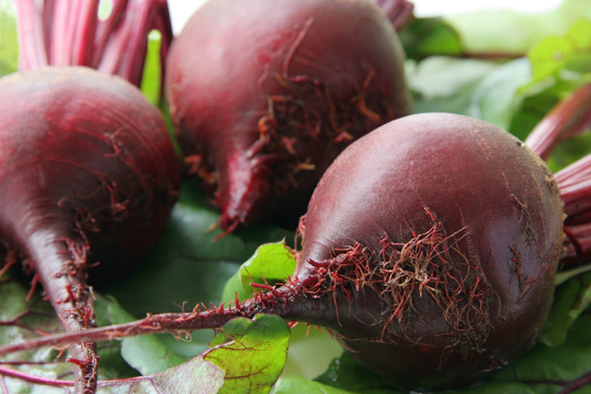
5. Minerals
A balanced diet contains all the food types in the right amounts to stay healthy.
minerals
Iron
Calcium

Slide 38
A balanced diet contains all the food types in the right amounts to stay healthy.
minerals
To make red
blood cells
For strong
bones
Iron
Calcium

Slide 39
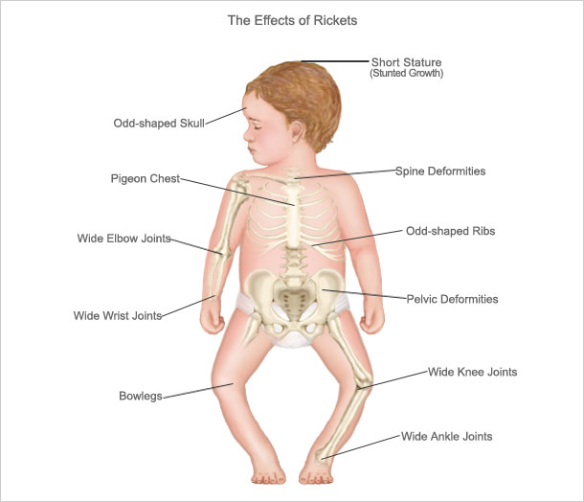
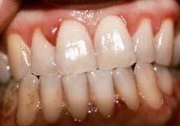
Deficiencies
Scurvy
Rickets

Slide 40
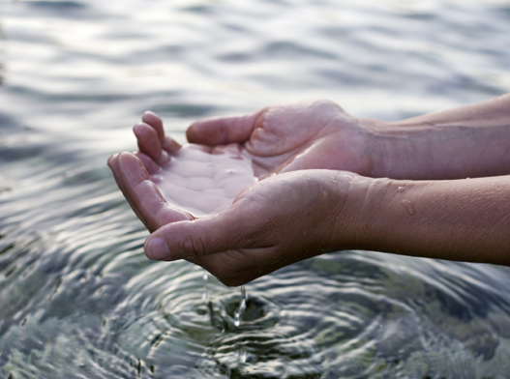
7. Water
A balanced diet contains all the food types in the right amounts to stay healthy.
water

Slide 41
A balanced diet contains all the food types in the right amounts to stay healthy.
water
Water makes up 70% of our body
Drinks & vegetables contain water.
Notes:
Water is used to make blood and to dissolve and transport substances

Slide 42
Food group /Nutrient | Food source(s) | Function | Effect on health if not present in diet | Energy value (if known)
Carbohydrates | Bread, pasta, rice, cereals, sweets, chocolate | Provide energy for the body | Low energy amounts | High amount of energy
Fibre | Fruit and veg, lentils, wholegrain bread or rice | Maintains a healthy digestive system | Constipation | High amount of energy
Fats | Nuts, fish oils, butter, crisps, cakes | Store of energy Insulation/warmth Protects body organs | Cold quicker Poor vitamin uptake | Moderate amount of energy

Slide 43
Food group /Nutrient | Food source(s) | Function | Effect on health if not present in diet | Energy value (if known)
Protein | Meat, eggs, milk, fish, pulses | Growth and repair of body cells Needed to produce antibodies and enzymes | Cells are not replaced Illness as antibodies not produced | Low amount of energy
Vitamins | Green veg, meat, eggs Vegetables, fruit | Keep the body systems functioning | Vit. D = Rickets Vit. C = Scurvy | Low amount of energy

Slide 44
Food group /Nutrient | Food source(s) | Function | Effect on health if not present in diet | Energy value (if known)
Minerals | Red meat, fish, dairy products, some cereals | Keep bones and teeth strong Help to clot blood | Weak bones Anaemia | Low amount of energy
Water | Fruit and vegetables | Hydrate the body | Headaches Feeling of tiredness | Low amount of energy

Slide 45
Summary
The functions of the main food constituents are:
  Carbohydrates give energy.
  Fibre helps to move food through the intestines.
  Fat stores energy and insulates.
  Proteins make and repair body parts.
  Vitamin C keeps skin and gums healthy; Vitamin D helps to form strong bones.
  Minerals such as iron form red blood; calcium forms healthy bones.
  Water allows cells to function properly.

Slide 46
Food Pyramid
A food pyramid is a guideline to the types and amounts of food that should be eaten
This depends on
  Age
  Gender
  Activity levels
  Health
Notes:
Slide 9: Introduction to the food pyramid
Lesson 2
Discussion of the food pyramid-have the class used one before and what do they think it is used for?

Slide 47





What is the Food Pyramid made up of?
Cereals, breads & potatoes
Fruit and vegetable
Dairy products
Meat & fish
Other types of food, eg sweet things
Notes:
Food pyramid is divided up into 5 levels
Each level contains foods as described above
On a blank sheet, get the class to draw a triangle with 5 levels. Get them to draw in where they think each group is located

Slide 48
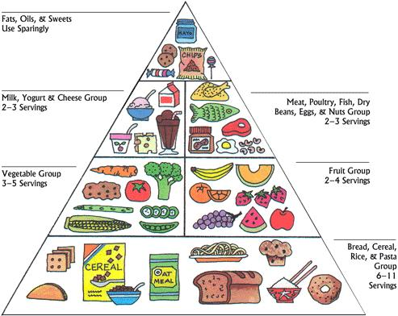
Notes:
Slide 11: What is the food pyramid made up of
Lesson 2
Hand out the food pyramid obtained from the local health board and go through each level, detailing foods and portions as instructed below.
Bottom shelf
Breads, cereals, potatoes, pasta and rice (6 or more servings a day)
These foods are high in energy, but low in fat. It's what you put on bread or the sauce you use with pasta or rice that makes them high in fat. Choose wholegrain and wholemeal varieties of bread, rolls and breakfast cereals. Try leaving the skin on potatoes.
Fruit and vegetables
(4 or more servings a day)
Fruit and vegetables are almost fat-free, packed with vitamins, minerals and fibre. Overcooking vegetables destroys vitamins. Try steaming, microwaving or boiling vegetables in a little water with the saucepan lid on. Frozen vegetables are just as good as fresh. Try the many ways of enjoying fruit - fresh, dried, stewed, tinned in its own juice or as fruit-juice.
Milk, cheese and yoghurt
( 3 servings a day for children and adults and 5 for teenagers or for pregnant or breast-feeding mothers).
These foods are good sources of calcium and vitamin D for strong bones and protein, the building block for all parts of the body. If you are overweight or have high cholesterol, choose low-fat varieties (they have the same amount of calcium as full fat varieties).
Meat, poultry, fish and alternatives
(2 servings a day)These foods are a good source of protein and iron (for healthy blood) - red meat is the richest source of iron. Have oily fish such as sardines, mackerel, trout, herring or salmon at least twice a week. They help thin the blood and prevent clotting.
The top shelf of the Food Pyramid (very small amounts) -Crisps, savoury snacks, biscuits, cakes, sweets and chocolate –
These foods are high in saturated fat. Too much saturated fat in the diet increases cholesterol levels. Many savoury snacks are also high in salt, which may cause high blood pressure. They should not replace meals but you can enjoy them as an occasional treat.
Does your diet add up?
Do the foods you eat every day add up to the Food Pyramid way? J
Get the class to write down everything you had to eat or drink yesterday as homework. Then add up the number of servings for each shelf and compare them with the plate servings on the Pyramid. How did you do? What changes could you make?

Slide 49
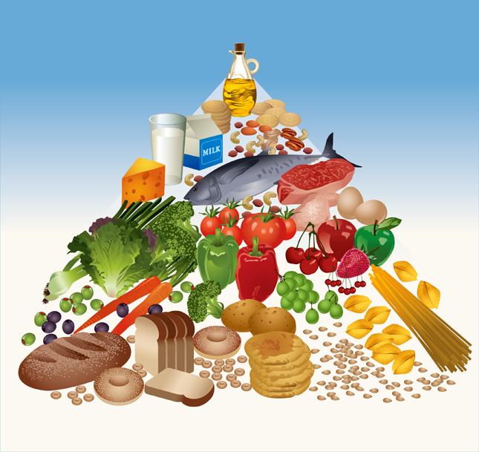
How do we know how much of each food type to eat?
The Food Pyramid suggests the daily number of servings of each of the five food groups.
Oil and Sugar
Milk, Cheese, Yogurt
Meat, Fish, Nuts
Fruit and Vegetables
Bread, Potatoes, Pasta
Notes:
Bottom shelf
Breads, cereals, potatoes, pasta and rice (6 or more servings a day)
These foods are high in energy, but low in fat. It's what you put on bread or the sauce you use with pasta or rice that makes them high in fat. Choose wholegrain and wholemeal varieties of bread, rolls and breakfast cereals. Try leaving the skin on potatoes.
Fruit and vegetables
(4 or more servings a day)
Fruit and vegetables are almost fat-free, packed with vitamins, minerals and fibre. Overcooking vegetables destroys vitamins. Try steaming, microwaving or boiling vegetables in a little water with the saucepan lid on. Frozen vegetables are just as good as fresh. Try the many ways of enjoying fruit - fresh, dried, stewed, tinned in its own juice or as fruit-juice.
Milk, cheese and yoghurt
( 3 servings a day for children and adults and 5 for teenagers or for pregnant or breast-feeding mothers).
These foods are good sources of calcium and vitamin D for strong bones and protein, the building block for all parts of the body. If you are overweight or have high cholesterol, choose low-fat varieties (they have the same amount of calcium as full fat varieties).
Meat, poultry, fish and alternatives
(2 servings a day)These foods are a good source of protein and iron (for healthy blood) - red meat is the richest source of iron. Have oily fish such as sardines, mackerel, trout, herring or salmon at least twice a week. They help thin the blood and prevent clotting.
The top shelf of the Food Pyramid (very small amounts) -Crisps, savoury snacks, biscuits, cakes, sweets and chocolate –
These foods are high in saturated fat. Too much saturated fat in the diet increases cholesterol levels. Many savoury snacks are also high in salt, which may cause high blood pressure. They should not replace meals but you can enjoy them as an occasional treat.
Does your diet add up?
Do the foods you eat every day add up to the Food Pyramid way? J
Get the class to write down everything you had to eat or drink yesterday as homework. Then add up the number of servings for each shelf and compare them with the plate servings on the Pyramid. How did you do? What changes could you make?

Slide 50

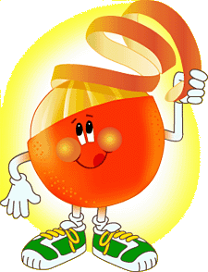

Benefits of a Balanced diet
You feel more energetic
You look better
You feel better about yourself
Notes:
Benefits of a balanced diet
Can the class think of any more?

Slide 51
Quiz
Fruit Group Quiz & Vegetable Group Quiz
http://www.choosemyplate.gov/about

Slide 52
A Food Pyramid
Take The Healthy Eating & Food Quiz – how much do you know?

Slide 53
Questionnaire
This questionnaire is quick and easy to complete and will give you helpful hints on how to eat better for your health.
http://www.enjoyhealthyeating.info/questionnaire

Slide 54
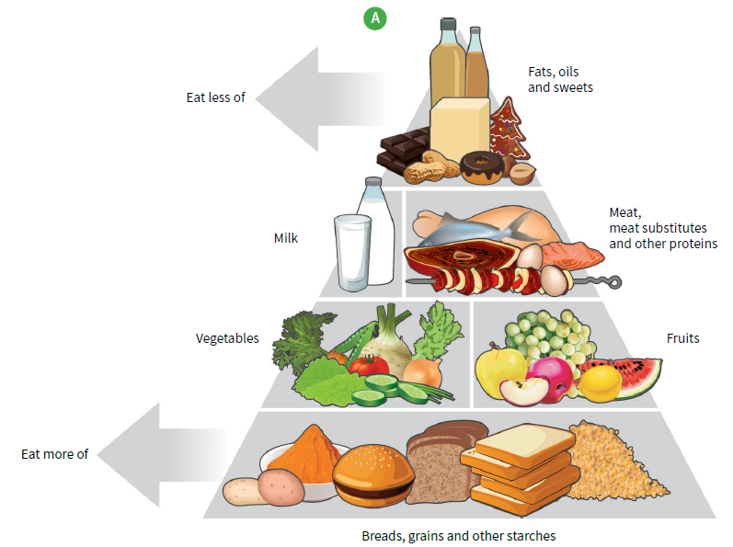
A Food Pyramid

Slide 55
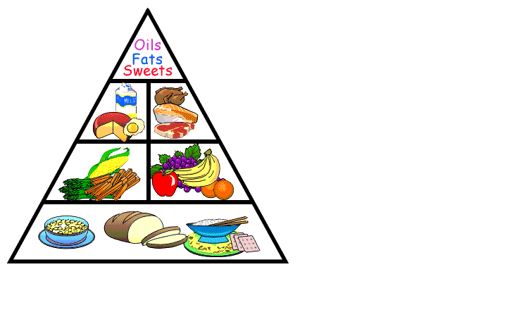
Healthy Eating Pyramid
Carbohydrates: take most food from this group (rice, pasta, bread, potatoes)

Slide 56
Healthy Eating Pyramid
Fruit and vegetables: take 5 portions a day from this group
Carbohydrates: take most food from this group (rice, pasta, bread, potatoes)

Slide 57
Healthy Eating Pyramid
Meat, fish and dairy: take something from this group
Fruit and vegetables: take 5 portions a day from this group
Carbohydrates: take most food from this group (rice, pasta, bread, potatoes)

Slide 58
Healthy Eating Pyramid
Foods high in fats and sugars: take only small amounts from this group
Meat, fish and dairy: take something from this group
Fruit and vegetables: take 5 portions a day from this group
Carbohydrates: take most food from this group (rice, pasta, bread, potatoes)

Slide 59





The Main Food Groups

Slide 60
Fruit and Vegetables
Fruits and vegetables grow on plants: underground, on the ground or in trees.
Every day we should eat at least 5 portions of fruit and vegetables.
(A portion is about a handful.)
Fruit and vegetables give us fibre and vitamins and minerals.
Take
5 a day
everyday!

Slide 61
Grains and Pulses
This food group includes wheat, corn, barley, rice, lentils, beans etc.
These are all from plants and form a staple part of the diet for people all over the world.
Grains and pulses give us carbohydrates and proteins.
Nuts are another source of protein.
What is..?
Rice is the staple food in China and much of the East. What is it in the West (UK, USA)?

Slide 62
Grains and Pulses
This food group includes wheat, corn, barley, rice, lentils, beans etc.
These are all from plants and form a staple part of the diet for people all over the world.
Grains and pulses give us carbohydrates and proteins.
Nuts are another source of protein.
Answer
Wheat. We eat it in bread, pasta, cereals, cakes, biscuits and it’s added to all sorts of foods.

Slide 63
Dairy Products
Dairy foods are made from milk (usually cow’s milk, but can be from other animals like goats or sheep). Dairy foods give us proteins and fats. They are also a good source of calcium which is good for bones and teeth.
These foods include:
Cheese (hard, soft, cottage);
Yogurt;
Food high in milk or milk products.
Weird fact
Our brains are 80% fat.

Slide 64
Meat, Fish and Eggs
The main nutrients derived from meat are proteins, but it also gives us fats and some minerals.
The meat and fish group includes:
Chicken and all poultry;
Fish and shellfish;
Beef, pork and lamb.
Eggs are included in this group too.
Athletes eat lots of protein; they help to build muscles.
Foodie fact
Sushi (raw fish) is now Marks and Spencer’s best-selling lunchtime snack.

Slide 65
Starches, Sugars and Fats
Sometimes foods are classified into starches, sugars and fats. Starches includes foods like potatoes and provide mainly carbohydrates. Carbohydrates give us the energy to carry on with our day-to-day lives.
Foods high in sugars include those naturally occurring as in fruit, and those containing refined/processed sugars such as sweets, chocolates, cakes etc. We need to limit our intake of refined sugars – these are empty calories which give an immediate ‘boost’.
A small amount of fat is important for health, but eating too much fat is unhealthy. It leads to clogged arteries (restricted blood supply), high cholesterol and becoming overweight.

Slide 66

Vitamins and Minerals
Our bodies need all sorts of chemicals (vitamins and minerals) to be healthy. The most common are:
Vitamin A | Helps maintain eyesight | Sweet potatoes, carrots
Vitamin B | Help body make protein | Green leafy vegetables
Vitamin C | Healing skin, preventing colds | Citrus fruit, tomatoes
Vitamin D | Strengthen bones | Milk Sunlight
Vitamin E | Helps strengthen cells | Vegetable oils, nuts
Iron | Healthy blood | Green leafy vegetables

Slide 67
http://www.safefood.eu/Healthy-Eating/What-is-a-balanced-diet/The-Food-Pyramid.aspx

Slide 68
Food and Energy Values
The food types that contain energy are carbohydrates, fats and protein.
Energy is measured in units called joules (J) or kilojoules (kJ).
Carbohydrates and protein contain 17kJ in each gram.
Fats contain 38kJ per gram.
Carbohydrates are mostly used first to supply energy.

Slide 69
Energy Requirements
Age | Sex | Energy per day (kJ)
8 | Male | 9000
8 | Female | 8000
15 | Male | 11400
15 | Female | 9400
40 | Male | 13000
40 | Female | 10000

Slide 70
What is the difference in energy requirements of the following three people:
• A young person sitting exams
• A young sports performer
• A young person who plays video games in the evenings
The person playing video games would have the lowest energy requirements, as they are not as active.
Next would be the person sitting the exams, as they need a moderate level of energy. Sitting exams is actively engaging the brain and recalling information that has been learned and therefore needs energy.
The sports performer would need the highest amount of energy as they are physically engaged, with their muscles requiring a high amount of energy to function.

Slide 71
Reading the Labels on Foods
Food labelling is confusing.
The front of packaging often tells a different story to the back.
Products that claim to be Low in fat on the front, may be loaded with sugar, and sometimes, products saying things like ‘Less than 5% fat’ have more fat than similar products!
Look at example food labels.
Food label
You cannot trust the front of the pack –
you need to read the back!

Slide 72
Food Labelling
Did you know….
It is illegal to make false or misleading claims on food labels
Ingredients are listed in descending order i.e. largest ingredient first
All nutritional information must be given per 100g or per 100ml
Notes:
It is very important that we can all read food labels and understand them
They tell you exactly what you are eating!
Does anyone in the class read food labels? Start collecting some and we will discuss them in class

Slide 73
The Nutrition Panel
This is where you find the information!
Energy is measured in kilocalories (kcals) & kilojoules (kJ).
Other nutrients are shown in grams (g).
Fats & carbohydrates may be broken down
Notes:
The nutritional information is where you find what’s in your food
Some notes below:
It is not obligatory unless a company makes a health claim.
http://www.indi.ie/assets/81/AA381A38-D17C-188B-6431C488B6AB8EB7_document/food_label_factsheet.pdf
2. Fats :saturated & unsaturated
3. Carbohydrate:‘Of which sugars’ indicates the amount of refined carbohydrate compared to complex carbohydrate – this should be less than 10g.
4. Contrary to popular belief, E numbers are additives that have passed EU safety tests.
5. Low Fat / 95 % Fat Free = Less than 5g fat in 100g
Virtually Fat Free = Less than 0.3g fat in 100g
Low Sugar = Less than 5g sugar in 100g
Reduced Sodium (salt) = At least 25% less sodium (salt) than standard product
The terms ‘light’ and ‘lite’ don’t mean anything in relation to food and can be used by anyone
on any product.

Slide 74
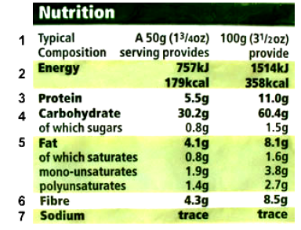
Sample label
Notes:
Using the above label:
What is the classes overall impression of this food stuff?
Name 3 good things that they can see about it
identify the food types on the label that form part of a balanced diet
Ask students to bring in their own food labels & we will discuss them next class
Do you calculate the correct calorie intake for the portion size you eat?
Examine this nutrition panel. If you eat 200g, you take in 4 servings and 4 times the calories and other nutrients i.e. 16.2 g fat and 716 calories compared with 4.1g fat and 179 kcals. This can easily happen with snack food like crisps or nuts.
Examine labels from class

Slide 75
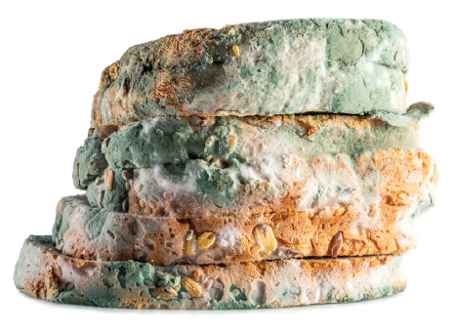
Preservatives:
Artificial additives which prevent food spoilage.

Slide 76
What are food additives?
Food additives are substances that can be both naturally and artificially made and used in a food to help preserve, keep the nutrient value, add flavour, enhance colour and improve the taste or texture of that foodstuff.
Name some natural food additives.
Vinegar, herbs, spices, salt and some sugars.

Slide 77
Now carry out a nutritional analysis on any three foods to determine their nutritional value.
Analyse the foods’ labels, including a bar chart in your
analysis.
Consider carefully what headings to use and how to
present your findings.
Headings: groups, energy value of the food, highest and lowest energy provider, and any additional information deemed suitable.
Two options regarding bar chart: the amount of each main food group provided in that food (‘Food Group analysis per 100 g’), or the total amount of energy provided (‘Total energy provided’).
Note on total energy graph: The function of carbohydrates is to provide energy but that the carbohydrates can be sugar-based and starch-based.

Slide 78
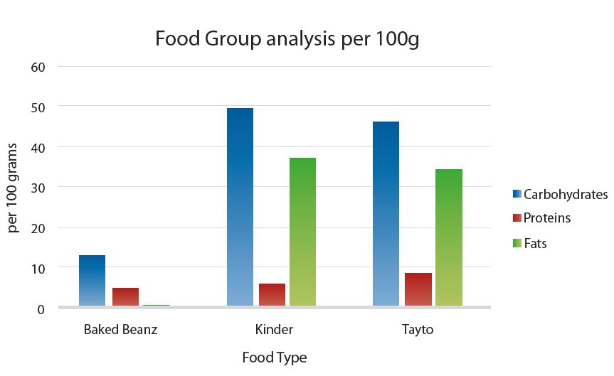

Slide 79
What happens if you eat too much food?
List 5 things.
Eating too much food causes long term negative impacts to overall health, including obesity and increased risk of obesity-related diseases such as diabetes and heart disease, according to the Mayo Clinic. Overeating also leads to weight gain and an increase in body mass index (BMI).

Slide 80
What happens if you eat too little food?
List 5 things.
Eating too little food causes long term negative impacts to overall health and weight loss

Slide 81
Smoking
Your lungs can be very badly affected by smoking.
Coughs, colds, wheezing and asthma are just the start.
Smoking can cause fatal diseases such as pneumonia, emphysema and lung cancer.
Smoking causes 84% of deaths from lung cancer and 83% of deaths from chronic obstructive pulmonary disease (COPD).

Slide 82

Exercise
List 5 benefits
Your heart rate increases with physical activity to supply more oxygenated blood to your muscles.
The fitter you are, the more efficiently your heart can do this, allowing you to work out longer and harder.

Slide 83
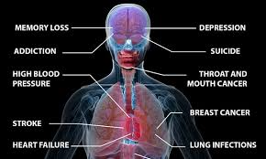
Alcohol
List 5 effects
Brain damage. Binge drinking can cause blackouts, memory loss and anxiety.
Long-term drinking can result in permanent brain damage, serious mental health problems and alcohol dependence or alcoholism.

Slide 84
Drugs
List 5 effects
Drug use can:
Weaken the immune system, increasing susceptibility to infections.
Cause cardiovascular conditions ranging from abnormal heart rate to heart attacks. ...
Cause nausea, vomiting and abdominal pain.
Cause the liver to have to work harder, possibly causing significant damage or liver failure.

Slide 85

Sleep
How many sleep an average do people need?
Sleep plays an important role in your physical health.
For example, sleep is involved in healing and repair of your heart and blood vessels.
Ongoing sleep deficiency is linked to an increased risk of heart disease, kidney disease, high blood pressure, diabetes, and stroke.

Slide 86
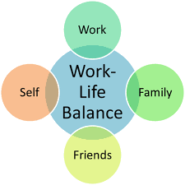
Work–life balance
Work–life balance is a concept including proper prioritizing between "work" (career and ambition) and "lifestyle" (health, pleasure, leisure, family and spiritual development/meditation).
This is related to the idea of lifestyle choice.

Slide 87
What are Microorganisms?
Microorganisms are tiny living things that usually can only be seen using a microscope.
A colony is many microorganisms together (e.g. bread mould).
Microorganisms include:
Viruses
Bacteria
Microscopic fungi
Introduction to Microbes
Notes:
3:12mins

Slide 88
Are all Microorganisms harmful?
Microorganisms range from simple to complex, are found almost everywhere, and are both helpful and harmful.
Majority are beneficial to use.
Can you list 5 benefits?
http://www.mrcjcs.com/micro_organisms.swf

Slide 89
Yogurt--Bacteria is what curdles the yogurt and makes it yogurt.
Cheese--Bacteria curdles the dairy products that make cheese.
Detergents--Tiny microorganisms called diatoms give detergents their cleaning power.
Compost--Microorganisms cause old plants and leaves to rot and decay, which creates fertile soil for planting new plants. Learn about composting here.
Mouth Germs--There are many germs in your mouth that are there to help fight off bad invaders and keep you healthy.
Vitamin K--Some germs help make Vitamin K, which helps stop the bleeding when you get cut.
Vaccines--Some germs are used to make vaccines, which help keep you from getting sick. Check out the bad microorganisms page to learn more about vaccines.
Digestion--Some bacteria help you digest your food.

Slide 90
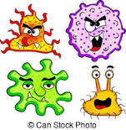
What is the role of Microorganisms in Human Health?
Pathogens are microorganisms that cause disease.

Slide 91
What disease do Microorganisms cause?
Viruses are the smallest microorganism
Viruses are dependent on a host cell.
They are parasites, so they cannot grow or reproduce outside another cell.
A virus causes damage to cells when it hijacks a cell’s DNA and other cell contents to use them for its own purpose.
Human diseases caused by viruses include cold, flu, Ebola, AIDS and chicken pox.
Viruses are not affected by antibiotics.

Slide 92
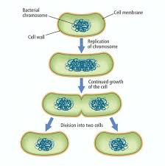
Bacteria
The four main requirements bacteria need to multiply are Food, Moisture, Warmth and Time.
They reproduce asexually – one cell splits into two
The Multiplication Song

Slide 93
Bacteria
The four main requirements bacteria need to multiply are Food, Moisture, Warmth and Time.
They reproduce asexually – one cell splits into two
Diseases caused by bacteria include:
Cholera
Tetanus
Tuberculosis
Food poisoning

Slide 94
Useful Bacteria
Bacteria called decomposers break down dead organic matter.
They help recycle carbon and nitrogen in the carbon cycle and
the nitrogen cycle.
Bacteria are used to make some antibiotics.
Bacteria are found in the human gut and play a vital role in human health:
They help digest some foods.
They produce vitamin B and vitamin K.
Bacteria help boost our immune system by keeping populations of harmful bacteria under control.

Slide 95
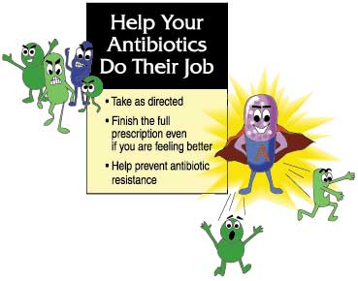
Antibiotics

Slide 96
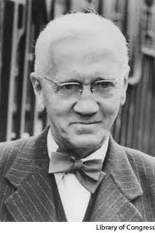
The first antibiotic Penicillin isolated from a fungus by Sir Alexander Fleming
Now antibiotics are mostly produced by genetically engineered bacteria
video on alexander-fleming
Notes:
Alexander Fleming (6th August 1881 - 11th March 1955) was a Scottish biologist and pharmacologist. Fleming published many articles on bacteriology, immunology and chemotherapy. His best-known achievements are the discovery of the enzyme lysozyme in 1923 and the antibiotic substance penicillin from the fungus Penicillium notatum in 1928, for which he shared the Nobel Prize in Physiology or Medicine in 1945 with Howard Walter Florey and Ernst Boris Chain. Fleming's discovery and isolation of penicillin in September 1928 marks the start of modern antibiotics. In 1955, Fleming died at his home in London of a heart attack. He was cremated and his ashes interred in St Paul's Cathedral a week later. Fleming was knighted in 1944. Fleming received the Nobel Prize in Medicine in 1945. 7mins.

Slide 97
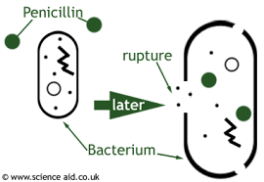
Antibiotics
Edward Jenner Story

Slide 98
Antibiotics are a group of medicines that are used to treat infections caused by germs (bacteria and certain parasites).
They do not work against infections that are caused by viruses - for example, the common cold or flu.
Antibiotics are normally only prescribed for more serious bacterial infections - for example, pneumonia.
When prescribed, it is important to take the entire course of antibiotics which helps to prevent resistance developing to that antibiotic.
Most side-effects of antibiotics are not serious - for example, diarrhoea, or mild stomach upset such as feeling sick (nausea). Although some people develop a serious allergy to some antibiotics, this is rare.

Slide 99
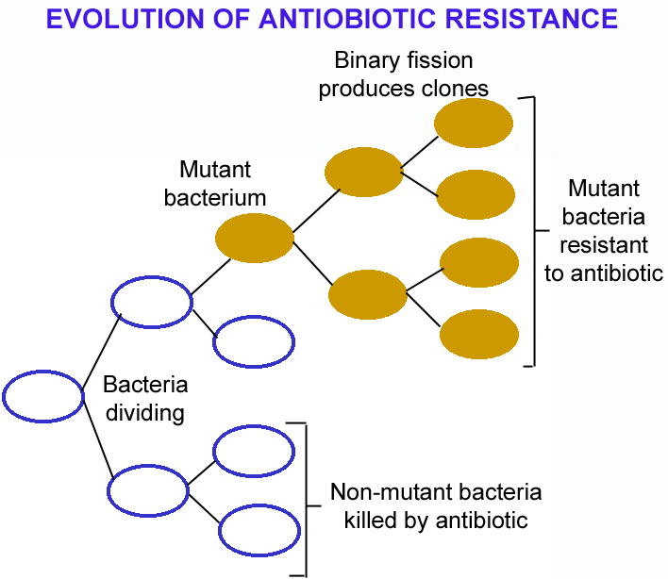

Slide 100
Mutations in bacterial genes can allow bacteria to develop antibiotic resistance.
Antibiotics will then kill ‘sensitive’ bacteria and favour resistant bacteria.
Bacterial strains have emerged which are resistant to almost all known antibiotics (multi-resistant). As a result present day antibiotics become ineffective. MRSA is one example.
Methicillin-resistant Staphylococcus aureus (MRSA) is a bacterium responsible for several difficult-to-treat infections in humans.

Slide 101
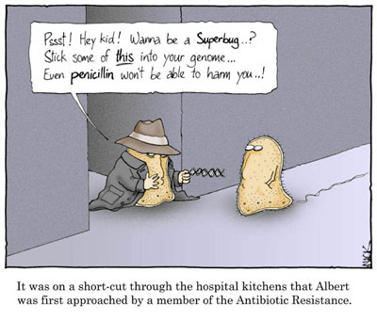
Misuse & Overuse of antibiotics
This results in the increased growth of antibiotic resistant bacteria
Failure of some patients to complete a course of antibiotics prescribed to them by a doctor allows the bacteria to survive and re-grow

Slide 102
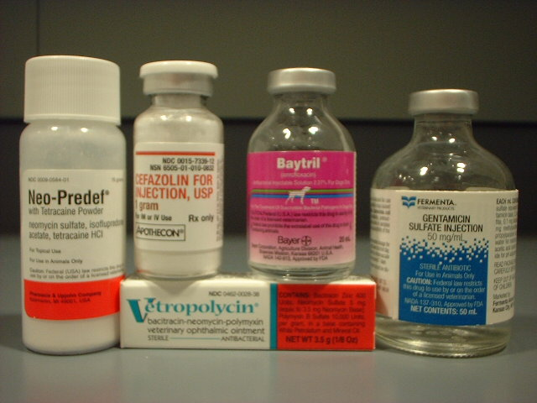
Antibiotics
Antibiotics

Slide 103
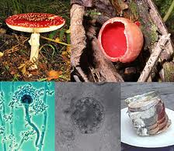

Slide 104
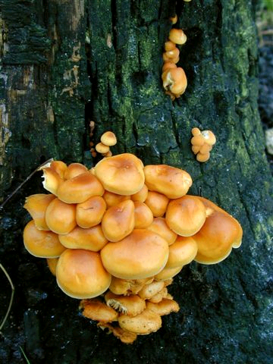
Nutrition
All fungi lack chlorophyll & are heterotrophs i.e. they take in food made by other organisms
Fungi are either:
Saprophytic
Parasitic

Slide 105
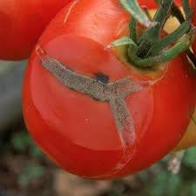
1. Saprophytic fungi
Most fungi are saprophytic - obtain nutrients from dead material
As they digest it minerals are released and recycled
Play a vital role in the environment as they are responsible for decay
E.g. mushrooms and moulds

Slide 106
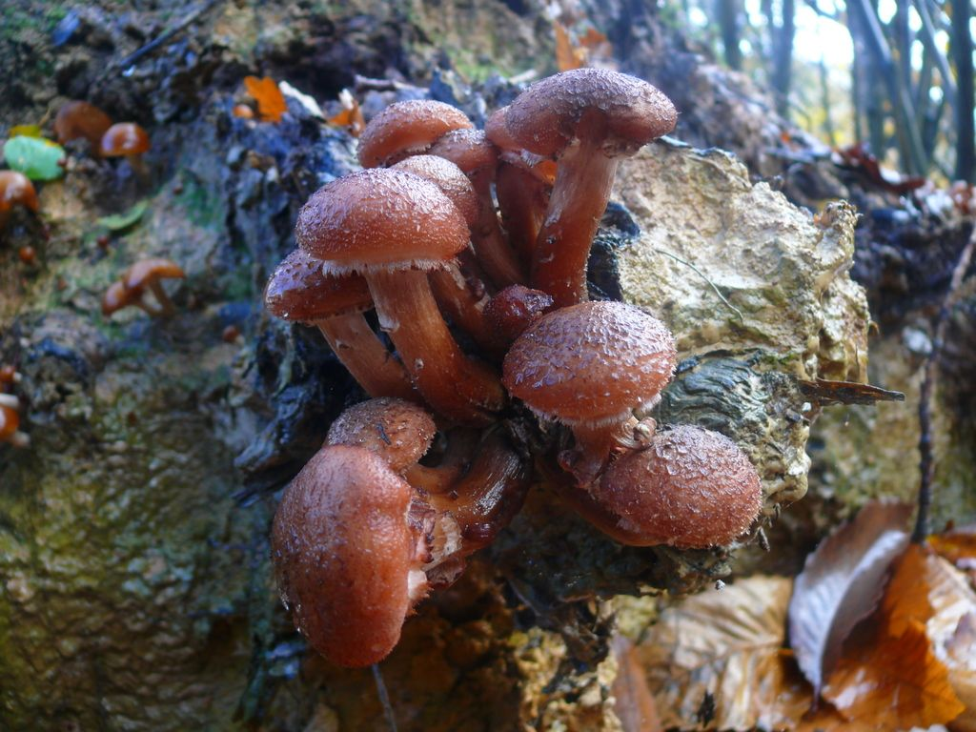
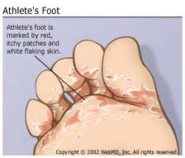
2. Parasitic Fungi
Absorb their food from live hosts – plants, animals e.g. athlete’s foot

Slide 107
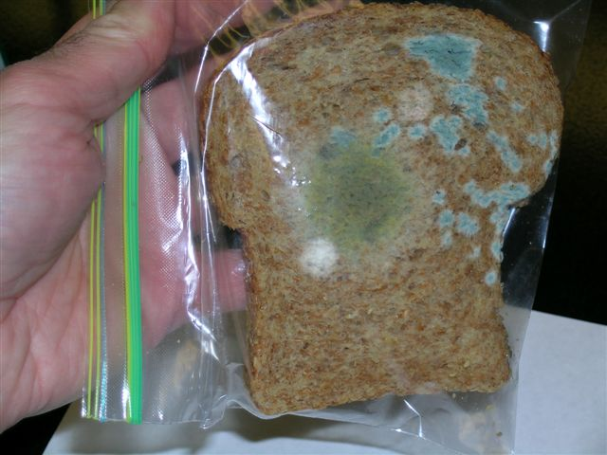
Rhizopus
Bread mould

Slide 108
Fungi
Fungi are decomposers that break down dead matter to substances such as carbon and nitrogen compounds.
Some fungi can cause minor health problems (e.g. athlete’s foot and ringworm). These are treated with antifungal medicine.
Overall, fungi are very important to human health.
Fungi provide important medicines. Medicine to control cholesterol, and penicillin and other antibiotics are all based on chemicals produced by fungi.

Slide 109
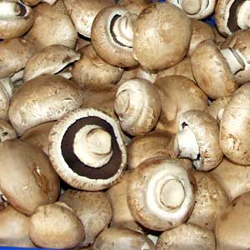
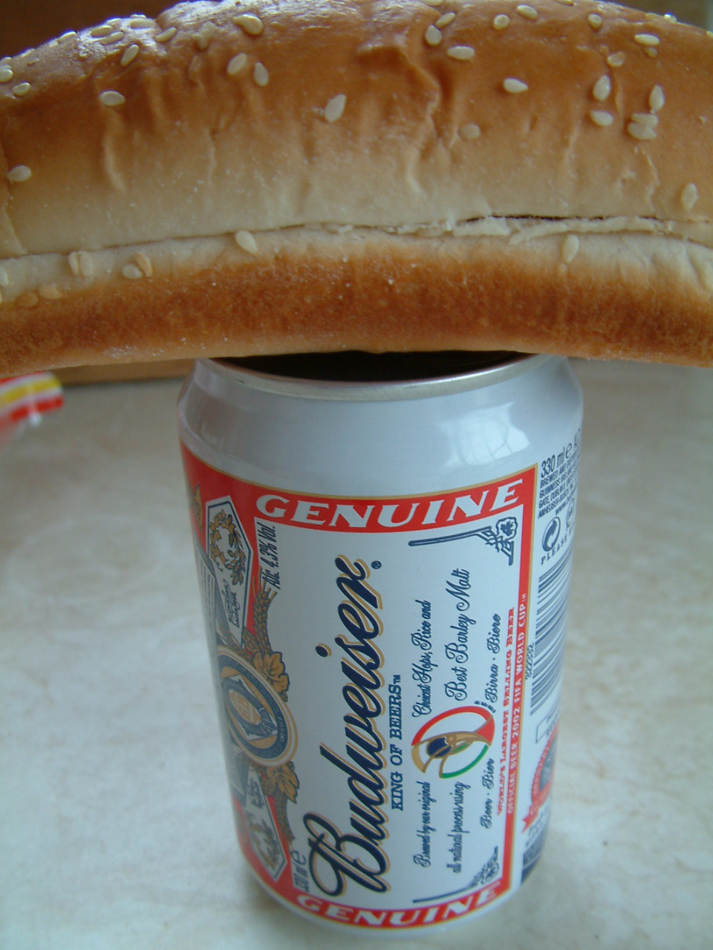
Economic importance of fungi
Beneficial fungi
Yeasts can be used to make bread and alcohols such as wine and beer
Fungi can be used as a source of food e.g. mushroom
Brewing Beer

Slide 110
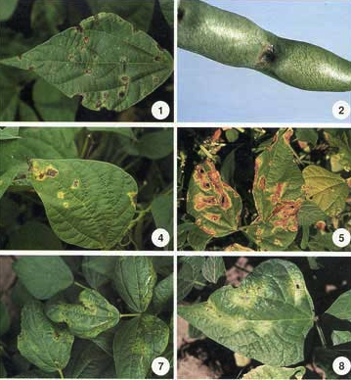
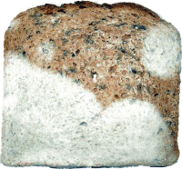
Harmful Fungi
Fungi can attack crops e.g. corn and wheat and cause major financial losses as a result.
Fungi such as athletes foot and ringworm can infect animals
Fungi can spoil food e.g. rhizopus grows on bread.

Slide 111
How do we reduce the risk of infection?
Wash your hands. This is especially important before and after preparing food, before eating, and after using the toilet.
Get vaccinated.
Prepare food safely.
Eat a balanced diet, exercise & get plenty of sleep.

Slide 112

Vaccination
Vaccination is humankind’s greatest weapon against viral infections.
Vaccination is when a harmless version of a disease is introduced into a person in order to stimulate the production of antibodies and white blood cells against the disease.

Slide 113
Review Question
What is the function of each food type in the table? Write out the table and complete.
Carbohydrates(i) Sugar
(ii) Starch
(iii) Fibre
Protein
Fat
Vitamins (i) Vitamin C
(ii) Vitamin D
Minerals (i) Calcium
(ii) Iron
Water
For energy
For energy
Prevents constipation
For growth and repair of cells
For energy and insulation
For healthy skin/gums
For strong bones
For strong bones
To make red blood cells
To dissolve and transport substances

Slide 114
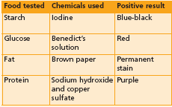
FOOD TESTS

Slide 115
TESTING FOR STARCH USING IODINE

Slide 116
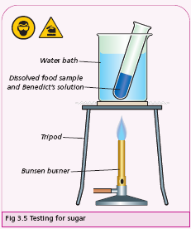
TESTING FOR SUGAR USING BENEDICTS

Slide 117

TESTING FOR FAT USING BROWN PAPER

Slide 118
TESTING FOR PROTEIN USING BIURET

Slide 119

To investigate the conversion of chemical energy in food to heat energy
  METHOD:
  A burning cream cracker
  is placed under a test tube
  of water.
  RESULT:
  The temperature of the water rises.
  CONCLUSION:
  The chemical energy in food has
  been converted to heat energy
  in the water.

Slide 121
Think, Pair and Share!!!
Think on your own first (3mins)
  Jot down ideas in copy
Teams of 2
  Yellows + Reds
Discuss ideas with your Team Partner (3mins)
Then Share with the Class!! (10mins)

Slide 122
Revision
What is a balanced diet- List some examples
Nutrients
Describe the food pyramid
Food tests
Conversion of chemical energy to heat energy
Understanding food labels
Notes:
Slide 25: Revision
Lesson 6
Revise the chapter using the handout given in the previous class
Answer any questions
Assignment is given in the next class

Slide 123
Links for further study
http://www.bbc.co.uk/northernireland/schools/4_11/uptoyou/
http://www.lifebytes.gov.uk/teachers/lb_teachers-eat.htm
Healthy eating and wired for health sites by the government – links to appropriate ages:
http://www.wiredforhealth.gov.uk/cat.php?catid=886&docid=7219
Food Standards Agency, 5 a day the Bash Street Way aimed at 7-11:
http://www.food.gov.uk/interactivetools/educational/bashstreetdiet/
http://www.eatwell.gov.uk/foodlabels/
http://kidshealth.org/kid/stay_healthy/food/vitamin.html
http://www.dole5aday.com/MusicAndPlay/M_Games.jsp?topmenu=6
Flash game ‘identify the fruit’, interactive, suitable whiteboard, aimed at year 2:
http://www.elllo.org/yeartwo/jan17th/vivian/fruit.htm
Back to Introduction

