Slide 1
Chapter 34
The Senses

Slide 2
3.5.3 Responses in the Human Nervous System
Objectives – What you will need to know from this section
The sense organs contain receptors, with the brain as an interpreting centre for received information.
Knowledge of the five senses and related organs.
Study the eye and the ear – recognition and function of the main parts.
Corrective measures for long and short sight or for a hearing defect.

Slide 3
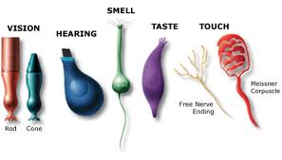
Sense Organs
A sense organ consists of receptors cells.

Slide 4
The five traditional senses are:
smell
taste
touch
hearing
sight

Slide 5
Sense
Sense
Sense
Organ
Organ
Stimulus detected
Sight
Sight
Sight
Eye
Eye
light [by rods and cones in the retina]
Hearing
Hearing
Hearing
Ear
Ear
sound [receptors in cochlea]
Touch
Touch
Touch
Skin
Skin
touch, pressure, temperature and pain [receptors spread throughout body]
Taste
Taste
Taste
Tongue
Tongue
chemicals [taste buds detect sweet, sour, salt and bitter].
Smell
Smell
Smell
Nose
Nose
chemicals [receptors in the nasal cavity detect vapours]

Slide 6
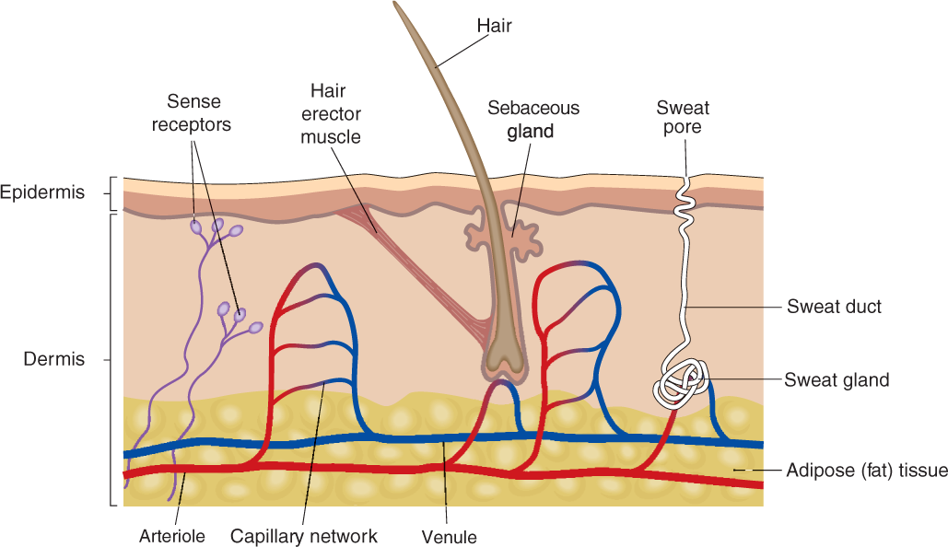
The Skin

Slide 7
1. Touch
The skin is the organ of touch and temperature.
The sense of touch is distributed throughout the body. Nerve endings in the skin and other parts of the body transmit sensations to the brain.
Some parts of the body have a larger number of nerve endings and, therefore, are more sensitive.

Slide 8
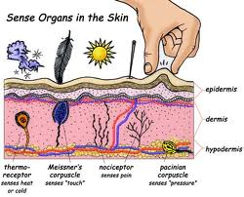
The skin contains receptors for
Temperature
touch and
pain.

Slide 9
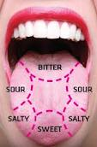
Taste
The tongue is the organ of taste. Taste buds in the tongue can detect the following tastes:
sweet
sour
bitter
salty

Slide 10

Many flavors are recognized through the sense of smell. If you hold your nose while eating chocolate, for example, you will have trouble identifying the chocolate flavor, even though you can distinguish the food’s sweetness or bitterness.
This is because the familiar flavor of chocolate is sensed largely by odor.
This is why a person who wishes to fully savor a delicious flavor (e.g., an expert chef testing his own creation) will exhale through his nose after each swallow.

Slide 11
3. Smell
The nose is the organ of smell.
Olfactory neurons in the nose detect many smells.

Slide 12
How do smell and taste work?
Smell and taste belong to our chemical sensing system (chemosensation).
The process of smelling and tasting begins when molecules released by the substances around us stimulate special nerve cells in the nose, mouth, or throat.
These cells transmit messages to the brain, where specific smells or tastes are identified.

Slide 13
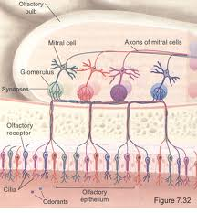
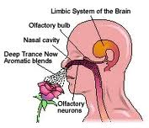
Olfactory (smell nerve) cells are stimulated by the odors around us—the fragrance from a rose, the smell of bread baking.
These nerve cells are found in a tiny patch of tissue high up in the nose, and they connect directly to the brain.

Slide 14
4. Sight
The eye is the organ of sight.

Slide 15
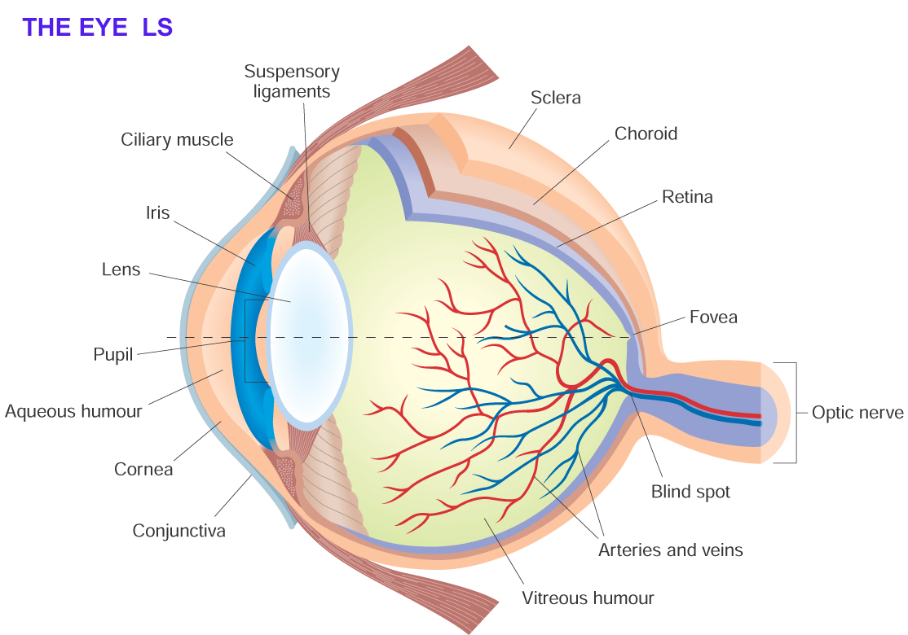

Slide 16
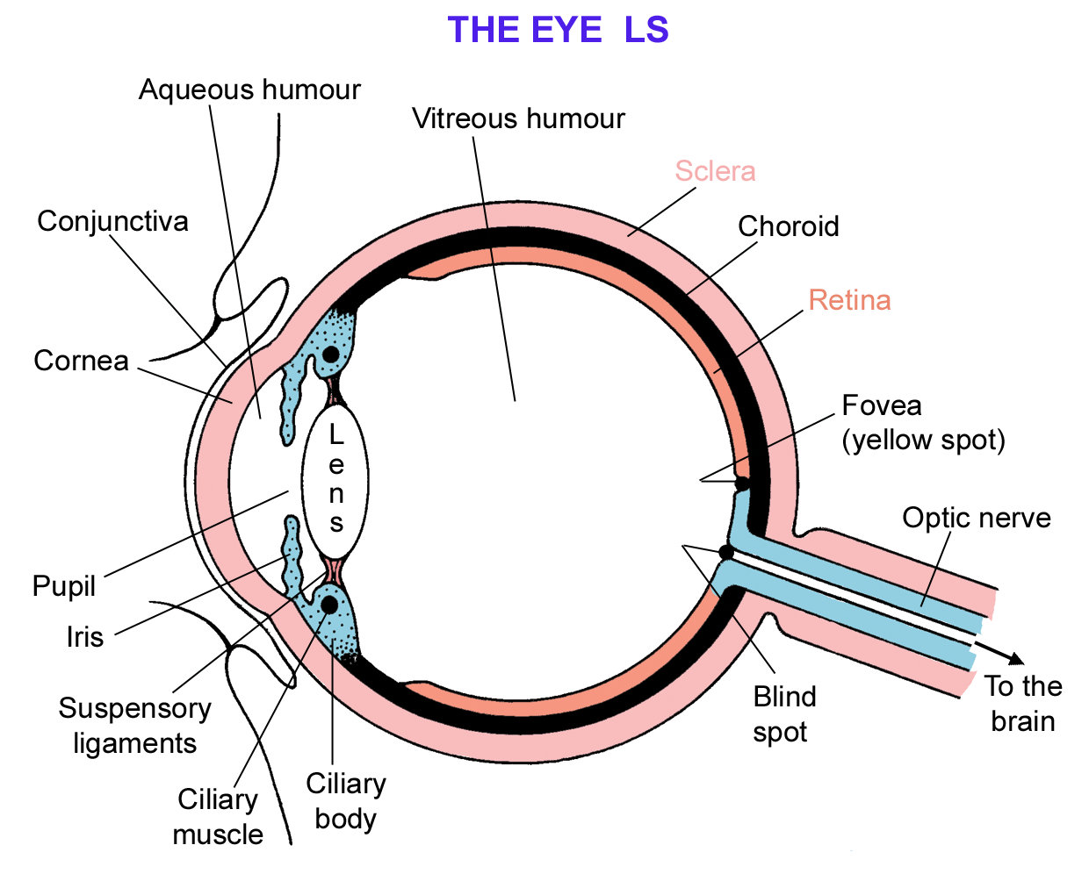
Conjunctiva – protective transparent membrane around the eye
Sclera - is a tough, white coat that holds the eye in shape
Conjunctiva
Cornea

Slide 17
Cornea – transparent part of the sclera at the front. It allows light into the eye and bends it to help focus it on the retina.
Choroid – dark coloured layer. Contains blood vessels to nourish the eye and the black pigment prevents internal reflection of light.

Slide 18
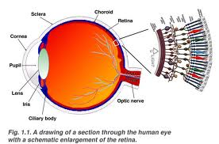
Retina - contains light receptor cells, rods (for black and white vision, work in dim light) and cones (for colour vision, work in bright light).
When light rays focus on the retina, these receptor cells are stimulated and impulses are carried by the optic nerve to the brain.
Fovea – contains only cones, where most images are focused.

Slide 19
The blind spot is where the optic nerve leaves the retina. It has no rods or cones.

Slide 20
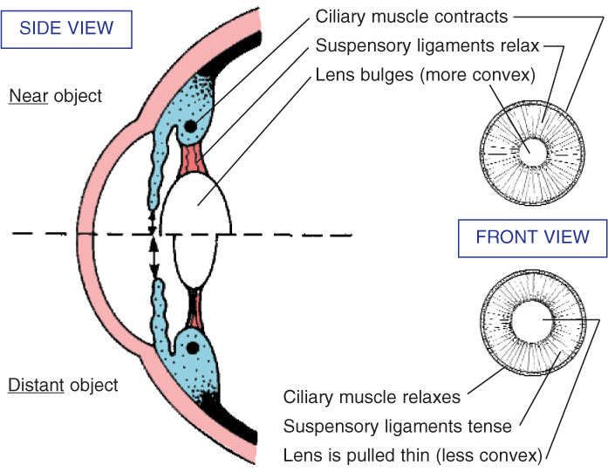
The optic nerve carries electrical impulses to the brain.
The lens focuses light on the retina.
The ciliary muscles changes the shape of the lens, reflex action - accomodation
Suspensory ligaments
Lens

Slide 21
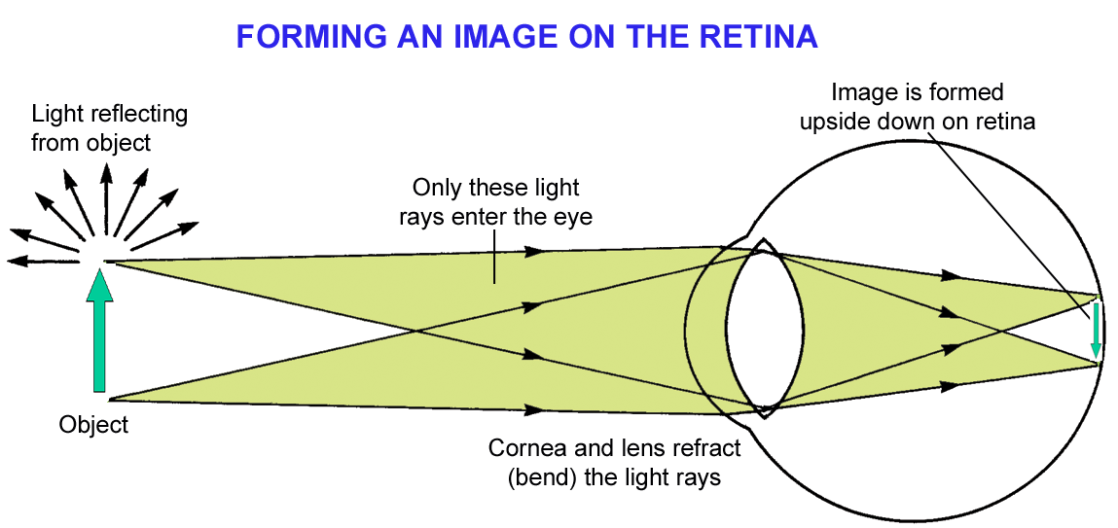
Accommodation is the changing of the shape of the lens to focus light onto the retina.

Slide 22
Iris – Coloured part of the eye, controls the amount of light entering the eye, by altering the size of the pupil.
The aqueous and vitreous humours keep the eye in shape.

Slide 23
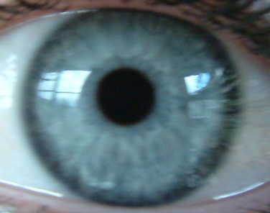
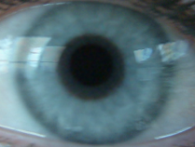
The pupil
The pupil is the black circle at the front of the eye. It lets light into the eye.
In bright light,
pupil constricts.
In dim light,
the pupil dilates.
How we see

Slide 24
For close vision:
the Ciliary muscle contracts,
the suspensory ligaments relax,
the lens becomes thicker.

Slide 25
For Distant Vision:
the Ciliary muscle relaxes
the suspensory ligaments contract,
pulling the lens thinner.

Slide 27
LEARNING CHECK
Name the 5 senses and the organs involved.
Name the 3 main layers of the eye and the function of each.
What is the function of the
[a] iris, [b] lens, [c] cornea, [d] fovea
What is accommodation?

Slide 28
Reflex Action and Antagonistic Muscle Actio
Circular muscles contract
Radial muscles relax
Pupils constricted
Radial muscles contract
Circular muscles relax
Pupils dilated

Slide 29
Seeing things at different distances
For distant objects, the ciliary muscle relaxes and so the suspensory ligaments pull tight, pulling the lens thinner – the light doesn’t bend as much.
For close objects the ciliary muscle contracts, allowing the lens to go fat, thus bending the light more.

Slide 30
Eye Defects
There are 2 Eye Defects:
long-sighted, eyeball is too short.
The image is focused behind the retina.
2. Short - sighted, eyeball is too long.
The image is focused infront of the retina.

Slide 31
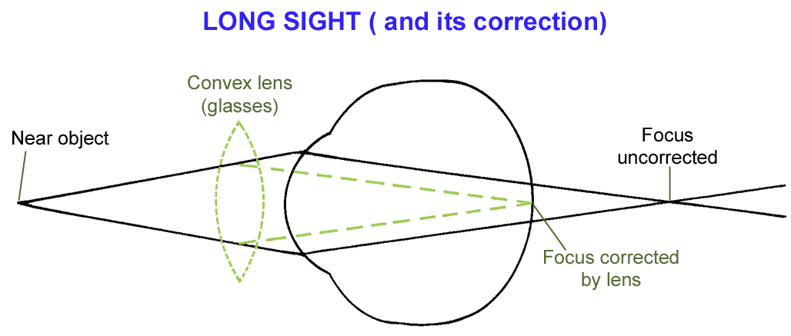
You are long-sighted if you can clearly see objects a long way off, but you cannot see things close by.
Convex lenses are used to correct the problem. They bend the light before it enters the eye.

Slide 32
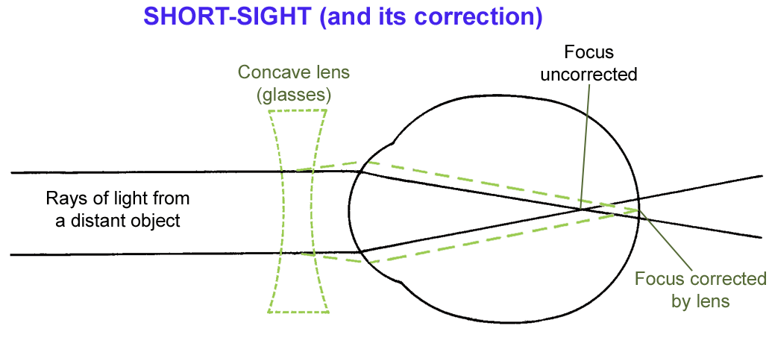
You are short-sighted if you can clearly see objects close to you, but you cannot see things in the distance.
Concave lenses are used to correct the problem. They diverge the light before it enters the eye

Slide 33
LEARNING CHECK
Explain how the ciliary body and suspensory ligaments alter the lens.
What is the function of the
[a] humours, [b] optic nerve?
If you are longsighted, what does it mean?
What could be a possible cause?
What type of lens can rectify it?

Slide 34
5. Hearing
The Ear has 2 separate functions:
Hearing
Balance

Slide 35
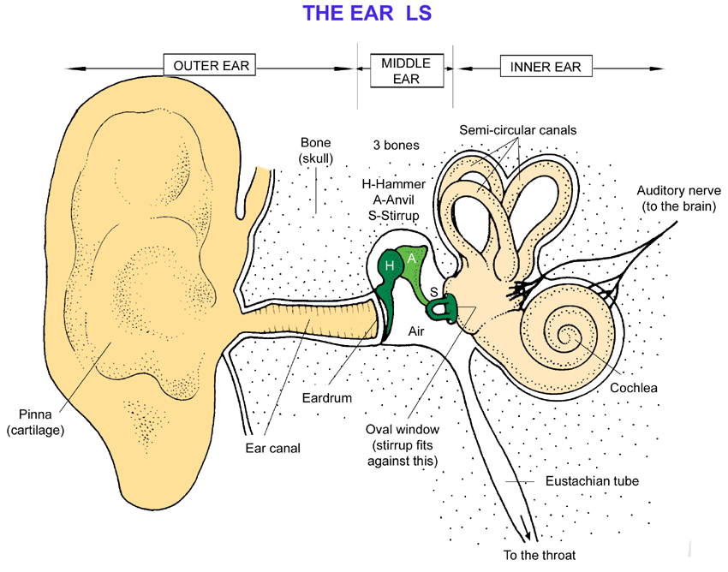

Slide 36
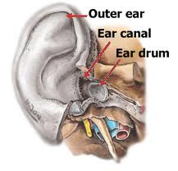
The Outer Ear
Is filled with air.
It consists of the
Pinna
Ear canal &
Eardrum

Slide 37
Pinna – funnels vibrations into the ear canal.
Ear canal –carries vibrations to the eardrum. It has hairs and wax glands to trap dirt and germs.
Eardrum – a membrane of skin that carries the vibrations to the middle ear.
Eardrum
Pinna
Ear Canal

Slide 38
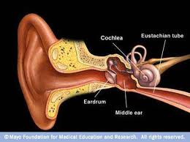
The Middle ear
Is filled with air.
It consists of the
Eustachian tube
three small bones [ossicles] &
the oval window

Slide 39
Eustachian tube – connects the middle ear with the pharynx and equalises pressure between the middle and outer ear.
Ossicles - hammer, anvil and stirrup, that amplify(increase) the vibrations & pass them on to the oval window.
Middle Ear
Ossicles
Eustachian tube

Slide 40
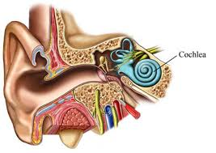
3. Oval window –
the stirrup vibrates against it, causing fluid in the cochlea of the inner ear to move
Middle Ear

Slide 41
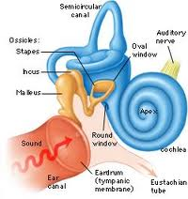
The Inner ear
It is filled with fluid.
It consists of the
cochlea and
semi-circular canals.

Slide 42
Cochlea – a coiled tube that is responsible for hearing. It converts vibrations into electrical impulses that are sent to the brain along the auditory nerve.
Semi-circular canals –
3 fluid filled tubes responsible for keeping our balance.
Inner Ear
Semi-circular canals
Cochlea

Slide 43
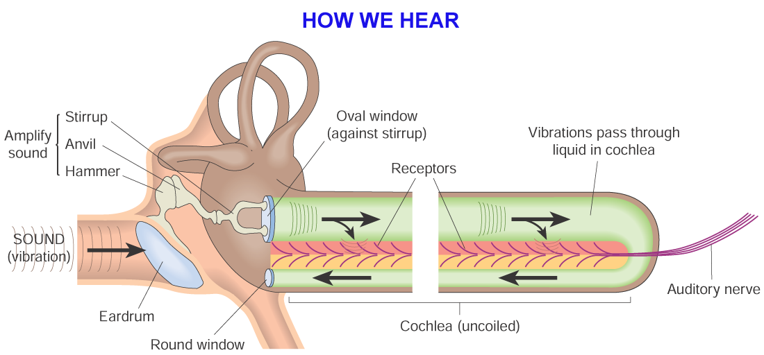
The pinna (ear lobe) channels the sound (vibrations in the air) towards the eardrum, which then vibrates.
In turn, this vibrates the hammer, anvil and stirrup bones, which amplify the sound.

Slide 44
The stirrup pushes on the oval window of the cochlea, moving the liquid inside.
Special hairs on 30,000 receptor cells detect the movement and send signals to the brain along the auditory nerve.
The brain interprets these as sounds, and we ‘hear’.

Slide 45
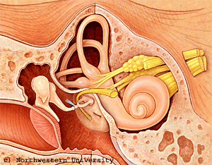

Slide 46
Ear Defects - Deafness
Deafness can be caused by long exposure to a high level of noise, drugs, or ear infections.
Damage to the eardrum, ossicles [bones], and cochlea, which can be caused by loud sounds, produces incurable deafness.
Workers exposed to prolonged sounds of over 90 decibels [dB] are obliged by law to wear ear protection.
Any exposure to 140 dB causes immediate damage to hearing.

Slide 47


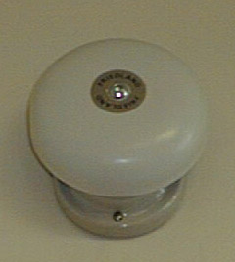

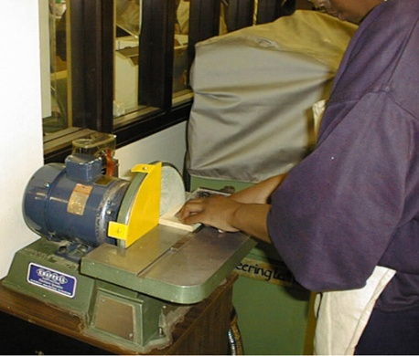

Sound : How loud are sounds?
Aircraft overhead
150
140
120
100
80
60
40
20
10
0
Personal stereo
Permanent ear damage
Loud bell
A circular saw at 2m
Quiet countryside
Pin being dropped
Can just be heard

Slide 48
Sound : How loud are sounds?
Aircraft overhead
150
140
120
100
80
60
40
20
10
0
Personal stereo
Permanent ear damage
Loud bell
A circular saw at 2m
Quiet countryside
Pin being dropped
Can just be heard

Slide 49
The following list illustrates some hearing FREQUENCY ranges.
The average human can hear frequencies from about 20 Hz to 20,000 Hz.
Humans | 20 - 20,000 Hz
Cats | 60 - 65,000 Hz
Dog | 15 - 50,000 Hz
Robin | 250 - 21,000 Hz
Bat | 1000 - 120,000 Hz
Moth | 3000 - 150,000 Hz

Slide 50
Loudness Levels:
Jet taking off 30m | 140 dB
Pain threshold | 120 dB
Disco speaker 2m | 120 dB
Pneumatic Drill road 10m | 100 dB
Busy Street Traffic | 70 dB
Ordinary Conversation | 60 dB
Quiet TV or Radio | 40 dB
Average Whisper | 20 dB
Rustling of leaves | 10 dB
Threshold of hearing | 0 dB
Above 150dB Eardrums BURST

Slide 51
Hearing problems
Our hearing range can be damaged by several things:
Too much ear wax!
Damage to the auditory nerve
Illness or infections
Old age

Slide 52
Glue ear
is:
a hearing disorder
caused by too much sticky fluid in the middle ear
corrected by decongestants or grommets

Slide 53
LEARNING CHECK
What is the function of the
[a] pinna, [b] 3 ossicles, [c] cochlea, [d] semi-circular canals, [e] Eustachian tube?
Outline how vibrations in the air are eventually “heard” by our brain.
Name a common ear defect.
Give some possible causes & treatments.
How might you reduce your risks of this defect?

