Slide 1
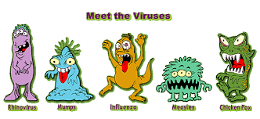
Chapter 38
Viruses

Slide 2
3.5.4 VIRUSES
Objectives – What you will need to know from this section
Identify the problem of definition ‑ living or non‑living?
State that there is a variety of shapes.
Outline the basic structure of viruses.
Explain the process of viral replication -- only within living cells-- therefore can be called obligate parasites
Economic and medical importance of viruses to humans, plants, animals:
Include 2 harmful, 1 beneficial example of viruses.

Slide 3
What is a virus? How do viruses work?
Notes:
What is a virus and how do they work? In the first video in the series, WinchPharma Science & Health look at viruses, how they infect cells and reproduce, as well as some of the practical uses they have. 4:30mins

Slide 4
Viruses
Consist of a
protein coat – a capsid,
and nucleic acid - either DNA or RNA.

Slide 5
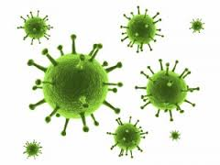
Is a Virus a Living Organism?
Chapter 1 – Properties of life
  Cellular Respiration
  Reproduction
  Metabolism
  Homeostasis
  Heredity
  Responsiveness
  Growth and development

Slide 6
Viruses are on the borderline between living or non-living
Non-living Features
Non-cellular.
Do not have cell organelles e.g. ribosomes, mitochondria etc.
Do not carry out any metabolic processes on their own.
Can’t reproduce by themselves or outside their host.
Have only one type of nucleic acid (Living things have both DNA & RNA).

Slide 7
Living Features
Viruses do
  Infect cells, cause disease and use the cell to make more viruses in many organisms
  Posses Genetic material - DNA or RNA
  Posses a protein coat or Capsid
  Contain some enzymes.
  Can replicate (inside a cell).

Slide 8
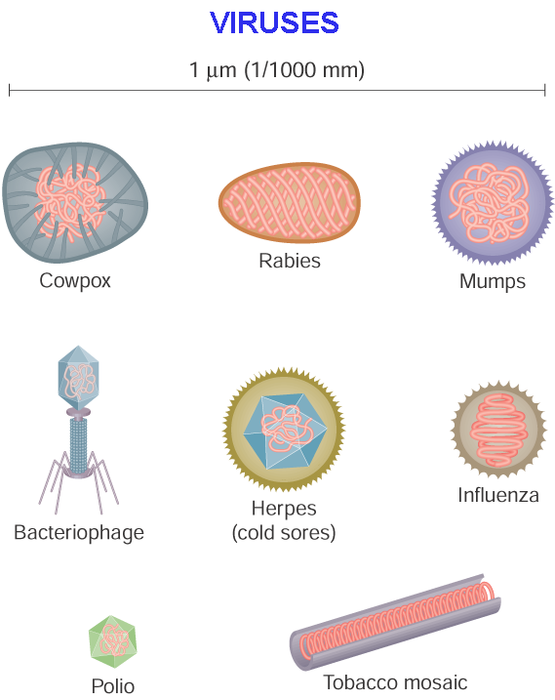
Viruses have 3 different shapes:
Rod
Spherical
Complex

Slide 9
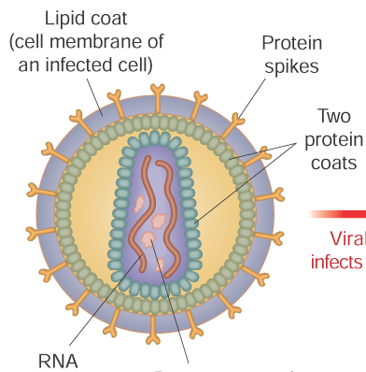
RNA or DNA?
Viruses with RNA
  Human immunodeficiency virus (HIV)
  Influenza viruses
  Rabies
Viruses with DNA
  Warts
  Chickenpox

Slide 10
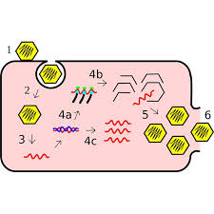
How do viruses replicate?

Slide 11
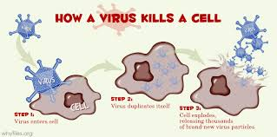
Reproduce V’s Replicate
Viruses are not cells, hence do not reproduce only replicate.
A virus replicates by sending its nucleic acid into a live host cell and using the host and its energy & structures to produce new viruses.
Hence viruses are called obligate parasites.

Slide 12
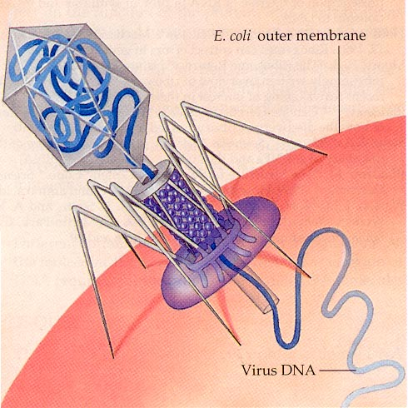
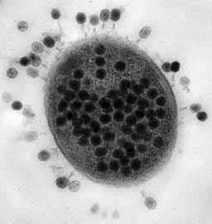
A Bacteriophage
A Bacteriophage / Phage is a viruses that infects bacterial cells by injecting its DNA into them & then uses its parts to replicate itself.
Notes:
Viruses are host cell specific.Most viruses are restricted to certain kinds of cells (those that infect plants cannot infect animal cells).

Slide 13
2 methods of replication
Lytic Cycle – the virus enters the cell, replicates itself hundreds of times, and then bursts out of the cell, destroying it.
Lysogenic Cycle – the virus DNA integrates with the host DNA and the host’s cell helps create more virus DNA. An environmental change may cause the virus to enter the Lytic Cycle.

Slide 14
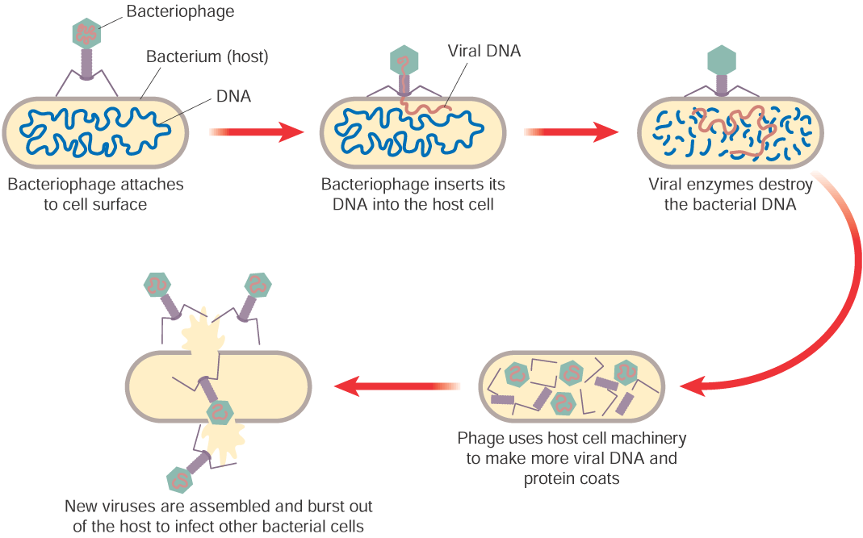
Viral Replication
The virus attaches to a host cell
It forms a hole in the host cell
It inserts its nucleic acid

Slide 15
It uses the host cell's organelles to make viral nucleic acid & proteins
They assembles themselves
They burst out of the host cell - Lysis
They infect further cells.

Slide 16
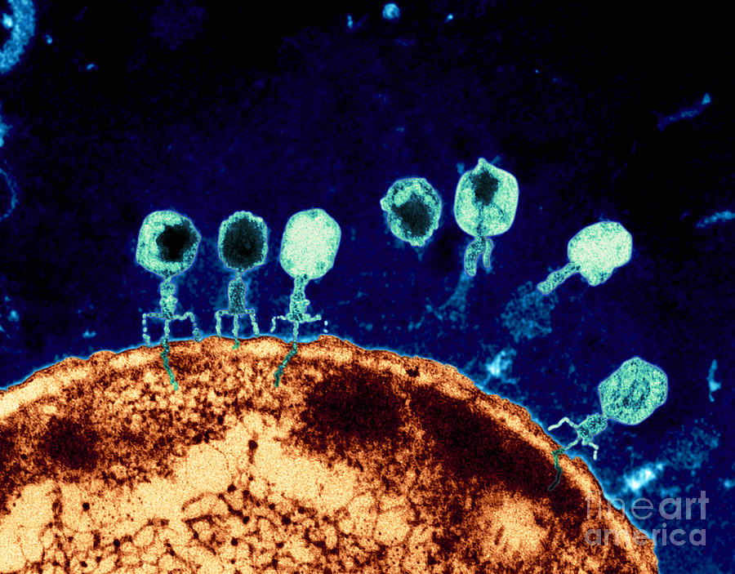
The whole Lytic cycle takes about 30 mins.

Slide 17
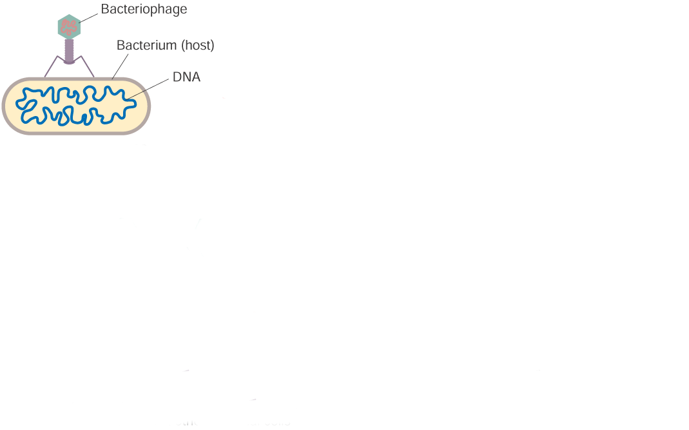
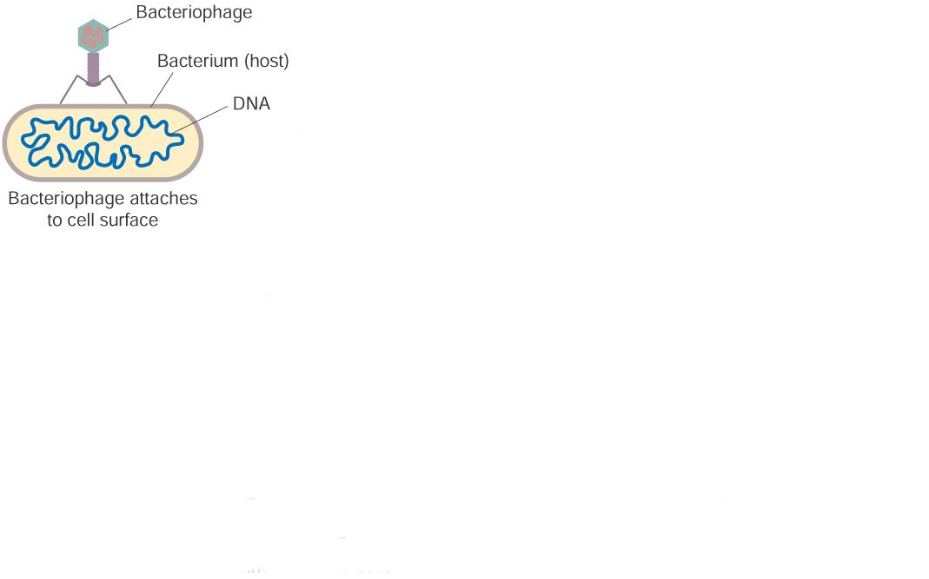
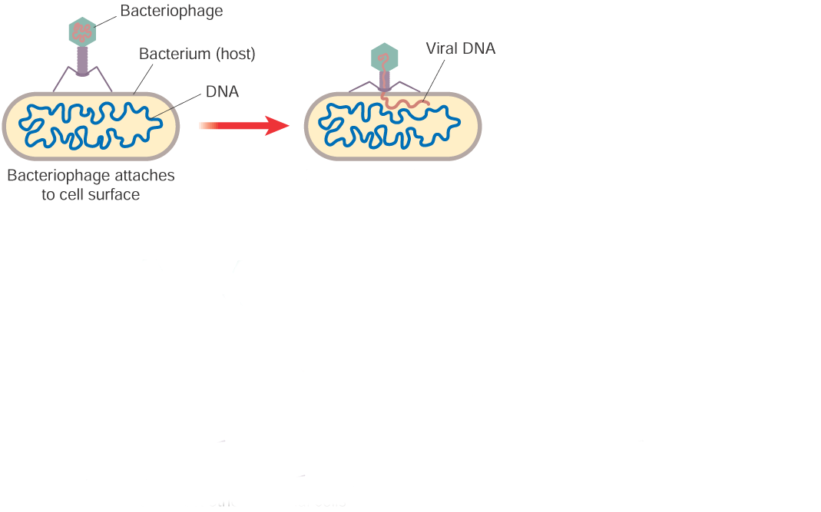
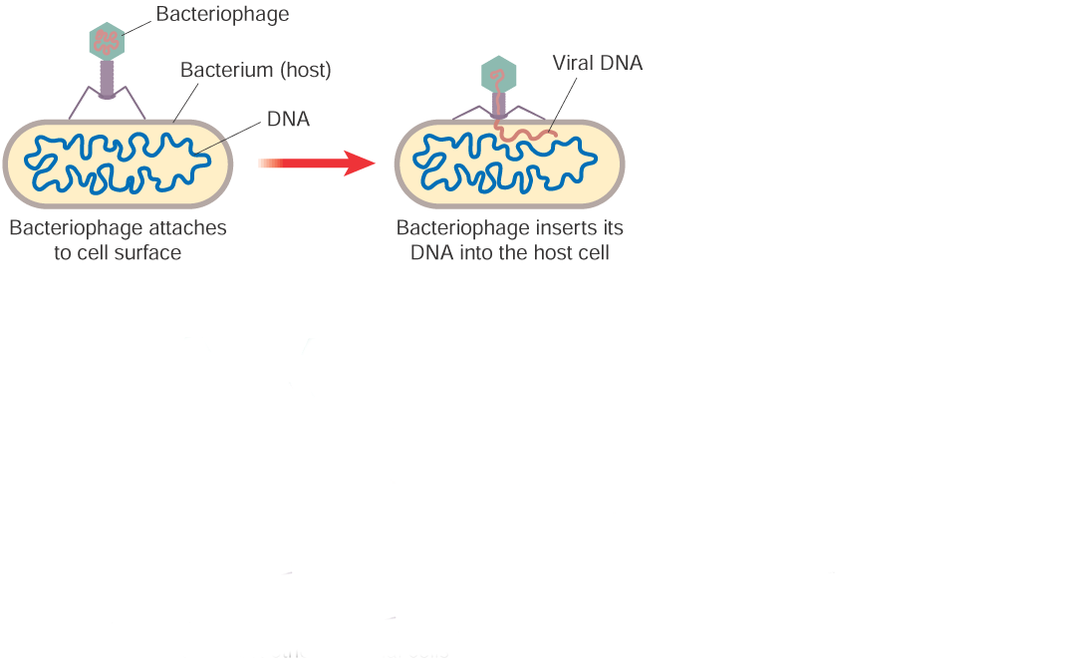
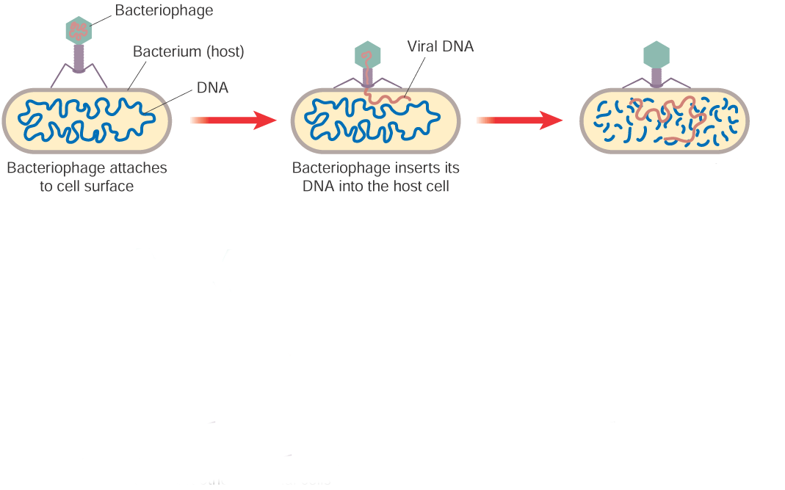
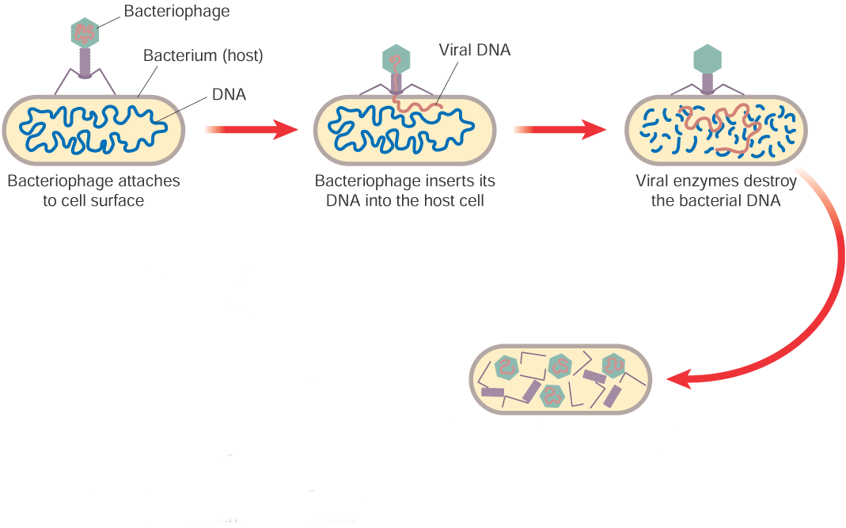
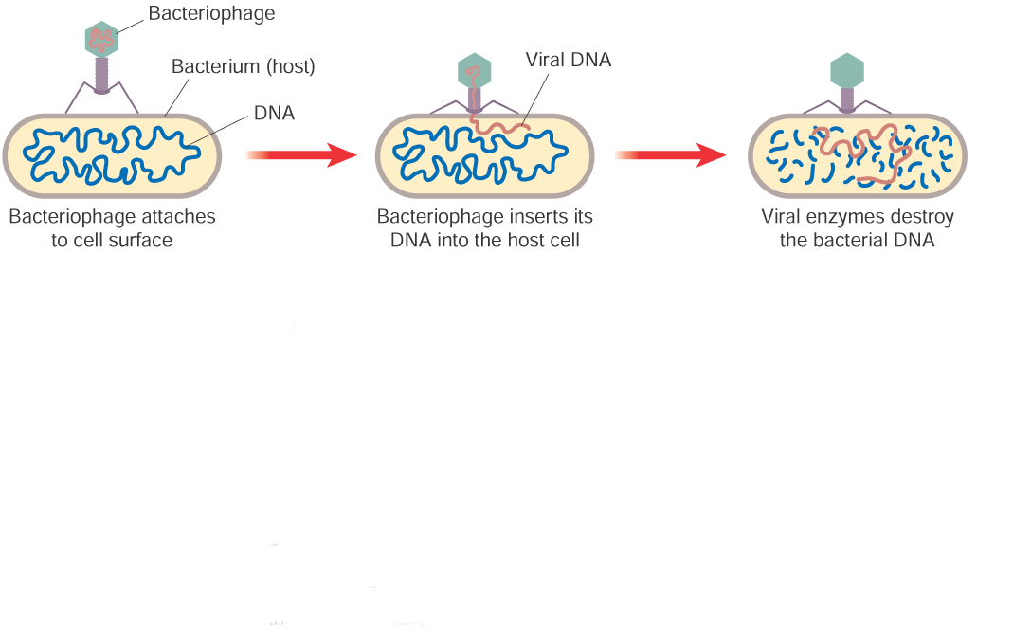
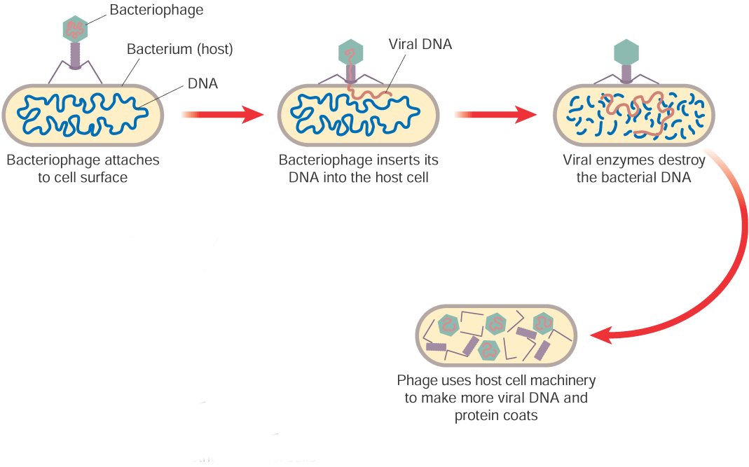
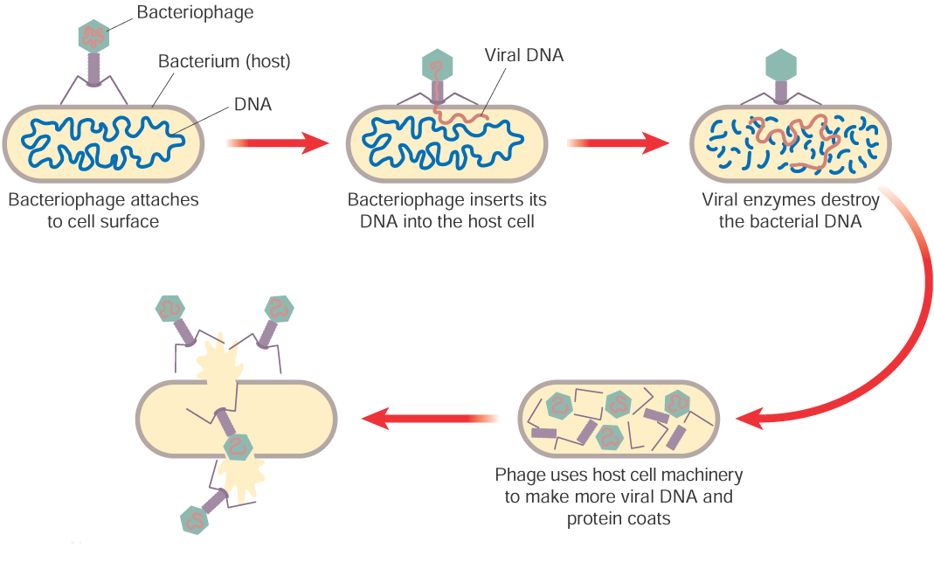
VIRUS REPLICATION

Slide 18
Viruses: Virus Replication and The Mysterious Common Cold
Notes:
explain virus structure, the lytic cycle, and the lysogenic cycle! 7:21mins

Slide 19
LEARNING CHECK
What is a virus?
What do virus consist off?
How many different shapes do Viruses have? Name them.
What are the 7 Properties of life?
What are the Non-living Features of viruses?
What are the living Features of viruses?
Name the 2 ways in which viruses replicate?
Outline the 4 steps.

Slide 20
Medical & Economic
Importance of Viruses

Slide 21
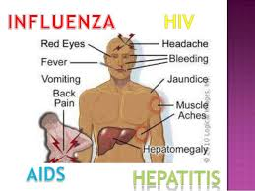
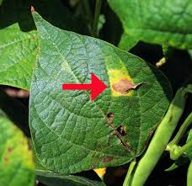
Harmful effects of Viruses
They cause:
Human diseases e.g. AIDS, colds, influenza, measles, etc.
Plant diseases e.g. Tobacco, potato & tomato mosaic disease
Animal diseases e.g. Foot and mouth, Rabies, Myxomatosis
Notes:
The disadvantages of viruses are that they cause:
human diseases
plant diseases
animal diseases
The advantages of viruses are that they:
transfer genes from one organism to another
can be used to control bacterial infections.

Slide 22
Myxomatosis is a disease which affects rabbits.
It is caused by the Myxoma virus.
It was deliberately introduced into Australia in 1950 in an attempt to control rabbit infestation and population there.

Slide 23
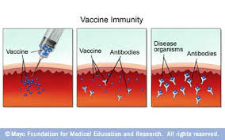
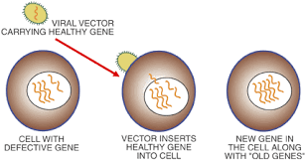
Beneficial effects of Viruses
Genetic Engineering: viruses are used to transfer genes from one organism to another - vectors.
Control infections: To form vaccines

Slide 24
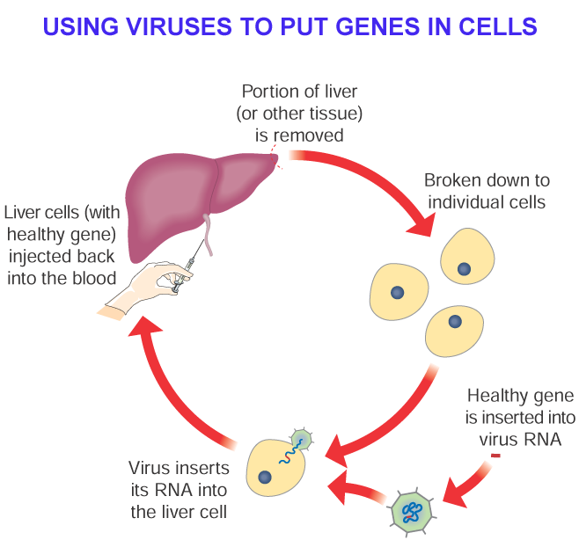
Genetic Engineering
Isolation of the genes of interest
Insertion of the genes into a transfer vector e.g. a virus
Transfer of the virus to the organism to be modified
Transformation of the cells of the organism

Slide 25
Defence against Viruses
Viruses may be controlled by:
the general body defences e.g. skin, mucus etc.
the specific defence system e.g. production of antibodies to disable viruses
Vaccination - Vaccines are available for most viruses.
Injection of antibodies
Antiviral drugs
Viruses do not have a cellular structures with organelles to damage so antibiotics do not work against them.

Slide 26
LEARNING CHECK
Give 2 Harmful effects of Viruses.
Give 2 Beneficial effects.
Explain the term vector.

Slide 27
I'm a Virus! (Mr. W's Virus Rap)

Slide 28
Introduction to Viruses
Notes:
This HD dramatic video choreographed to powerful music introduces the viewer/student to the "Virus". It is designed as a "trailer" to be shown by Biology teachers in middle and high school and college as a visual introduction to this amazing non-living but deadly substance, and how it has affected life on Earth.
5:46mins Abit slow

