Slide 1
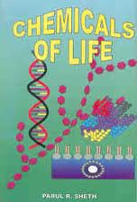
Chapter 3
Food

Slide 2
Syllabus
Appreciate all living things are made of chemicals
Name the chemical elements present in food
Reasons for requiring food
Name the chemical elements present in, the structure, source & functions of carbohydrates, proteins & fats

Slide 3
Distinguish between reducing & non – reducing sugars, fats & oils
The role of vitamins.
Example of a water soluble vitamin & a fat soluble vitamin.
Describe 2 minerals used in plants & animals
The role of water.
Lab. Test for reducing sugar, starch, proteins & fats.

Slide 4
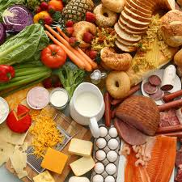
Food is needed for:
Energy
Growth of new cells
Repair of existing cells, tissues, organs, etc.
Defence and
Reproduction.

Slide 5
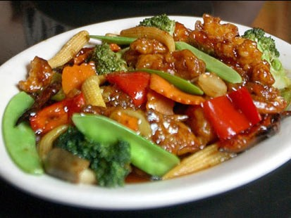
1.3.2 Chemical Elements
Elements in Food

Slide 6
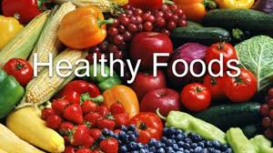
What is Food made up of?
Food is made up of:
Six chemical elements C, H, O, N, P, S
Salts of Na, Mg, Cl, K, Ca
Three trace elements Fe, Cu, Zn

Slide 7
Chemical Elements and their Symbols
Calcium | Ca | Nitrogen | N
Carbon | C | Oxygen | O
Chlorine | Cl | Phosphorus | P
Copper | Cu | Potassium | K
Hydrogen | H | Sodium | Na
Iron | Fe | Sulphur | S
Magnesium | Mg | Zinc | Zn

Slide 8
What is the difference between an inorganic and organic compound?
Organic compounds are contain carbon
Inorganic compounds are produced by non-living natural processes or by human intervention in the laboratory.
Inorganic compounds can form salts e.g. NaCl.

Slide 9
Biomolecules
are chemicals made inside living things.
The biomolecules in food
are carbohydrates,
lipids,
proteins
and vitamins.

Slide 10
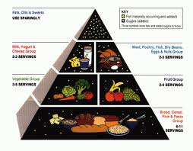
Types of Food
Food is made up of six different components
Carbohydrates
Lipids
Proteins
Vitamins
Minerals
Water

Slide 11
Learning check
What are the six different food components?
Water Proteins
Lipids Carbohydrates
Vitamins Minerals

Slide 12
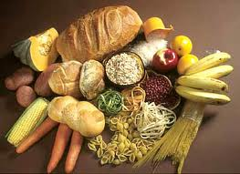
Carbohydrates
Carbohydrates contain the elements
Carbon, Hydrogen, Oxygen
The general formula for a carbohydrate is
C_{x}(H₂O)_{y OR} (CH₂O)
There are twice as many hydrogen molecules as oxygen molecules.

Slide 13
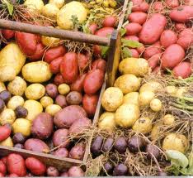
3 Types of Carbohydrate
Monosaccharides
Disaccharides
Polysaccharides

Slide 14
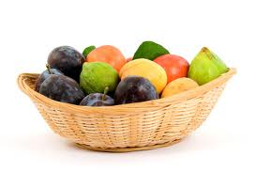
Monosaccharides
A single sugar unit
Examples: glucose, fructose
Found in fruit, honey and jam.
Notes:
Pentoses: C₅H₁₀O₅ Deoxyribose of DNA and Ribose of RNA
soluble in water
sweet to taste
smallest carbohydrate unit
Hexoses: C₆H₁₂O₆ Glucose, Fructose, Galactose — use for respiration

Slide 15
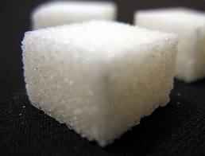
Disaccharides
two monosaccharide sugar units joined together
Examples: sucrose, lactose, maltose
Found in fruit, table sugar
Notes:
Maltose: glucose + glucose — intermediate between glucose and starch
Sucrose: glucose + fructose — food transported in the phloem of plants is a sucrose solution
Lactose: glucose + galactose — the sugar present in milk
known as double sugar molecules
soluble in water
sweet to taste

Slide 16
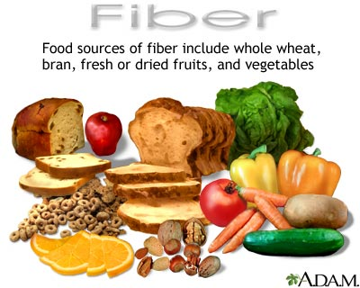
Polysaccharides
Many monosaccharide sugar units joined together
Example: starch, cellulose, glycogen
Found in bread, rice, pasta, potatoes, seeds, fruit, vegetables, wholegrain cereals, nuts.
Notes:
Starch: plant glucose reserve
Glycogen: glucose reserve of animals and fungi. Glycogen stored in skeletal muscle and liver
Cellulose: plant cells walls and fibre in our diet
Not soluble in water
Do not taste sweet

Slide 17
What does the ‘Structural Role of Biomolecules’ mean?
Structure = the way in which something is built e.g. steel structure
Role = function/job or position
Biomolecules = carbohydrates, fats, proteins
Structural Role of Biomolecules:
the function/job of carbohydrates, fats, proteins in making various parts of living things

Slide 18
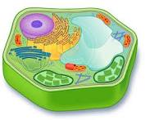
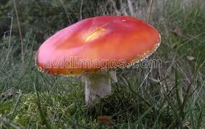
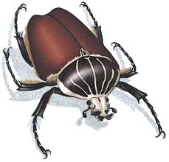
Structural role of Carbohydrate
Cellulose (polysaccharide) found in plant cell walls
Chitin (polysaccharide) found in fungal cell walls and insect exoskeletons.

Slide 19
Learning check
Give examples and sources of:
 | Examples | Sources
Monosaccharides
Disaccharides
Polysaccharides
Glucose
Fructose
fruit
Sucrose
Lactose
Table sugar
Milk
Starch
Cellulose
Bread, Pasta,
Cereals

Slide 20
What does the ‘Metabolic Role of Biomolecules’ mean?
Metabolic / metabolism = all the chemical reactions in a cell
Role = function/job or position/involvement
Biomolecules = carbohydrates, fats, proteins
Metabolic Role of Biomolecules = the function of carbohydrates, fats, proteins in the chemical reactions in cells making various substances for living things.

Slide 21
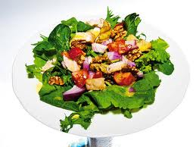
Metabolic Role of Carbohydrates
(i) glucose is made in photosynthesis
(ii) glucose releases energy in respiration
Notes:
Respiration – energy is released when glucose is broken down to form carbon dioxide and water – catabolism
Photosynthesis – glucose molecules are made from carbon dioxide and water using the sun’s energy – anabolism

Slide 22
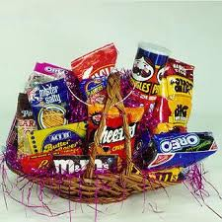
Lipids include
fats (solid at room temp.)
oils (liquid at room temp.)
steroids which include cholesterol and some of the sex hormones
waxes which cover insect bodies and plant leaves.

Slide 23
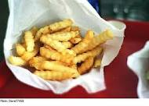
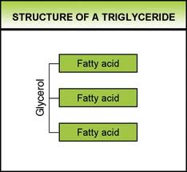
Structure of Lipids
They are made up of the elements:
Carbon, hydrogen & oxygen
Composed of three fatty acids linked to the glycerol.

Slide 25
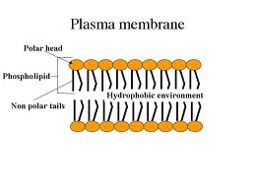
Types of Lipid
There are two main types of lipids
Triglycerides
Phospholipids

Slide 26
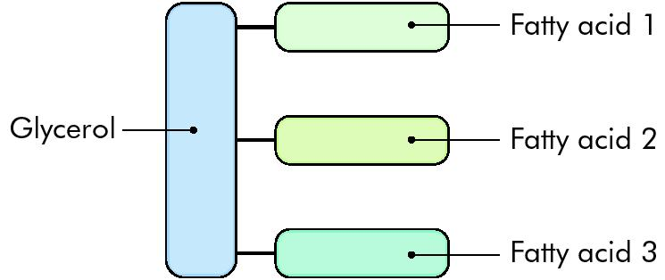
Triglyceride
It is made up of 3 fatty acid and 1 glycerol molecule
Notes:
This is the smallest lipid.

Slide 27
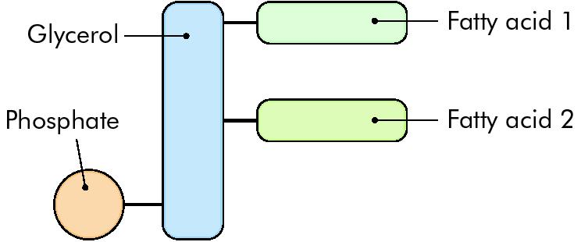
Phospholipids
If one fatty acid of a lipid molecule is replaced by a phosphate group then a phospholipid is formed

Slide 28
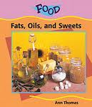
Sources of Lipids
Fat – in and on meat
Butter (80% fat)
Cooking oils
Milk,
cheese,
plant oils,
margarine.

Slide 29
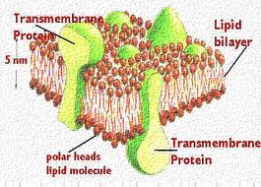
Structural role of Lipids
store energy
Insulate
form membranes
Notes:
Heat insulation – e.g. under the skin
Waterproof the body
Protection around body organs e.g. kidney, heart
Phospholipids and lipoproteins are major components in cell membranes
Myelin helps transmit messages in nerve cells
The protective wax cuticle on the outside of leaves.

Slide 30
Metabolic Role of Lipids
release energy in respiration
Notes:
Energy storage: more than twice the energy of carbohydrate or protein.
Energy source: released during respiration.
Storage of fat-soluble vitamins.
Some lipids function as hormones

Slide 31
Learning check
The two main types of molecules that make up lipids are:
Fatty acids and
Glycerol
The two main types of lipids are:
Triglycerides
Phospholipids

Slide 32
Proteins
Proteins contain the elements
Carbon Hydrogen
Oxygen Nitrogen
Some may also contain sulphur, phosphorous or iron

Slide 33
Dietary Sources of Proteins
Proteins are found in
meat,
fish,
pulses,
soya and
eggs

Slide 34
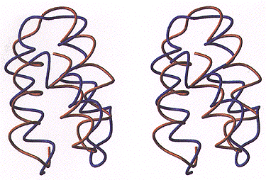
Structure of Proteins
Proteins are made up of long chains of amino acids joined together by peptide bonds in chains, folds and branches
There are 20 different amino acids — each different sequence of amino acids produces a different protein.

Slide 35
Learning check
Proteins contain the elements
Carbon Hydrogen
Oxygen Nitrogen
Sometimes they contain
sulphur, phosphorous or iron
Proteins are made up of long chains of
amino acids

Slide 36
Structural Role of Proteins
They combine with phospholipids to form cell membranes
Keratin is the structural protein in skin, hair and nails
Myosin: major protein in skeletal and cardiac muscle.
Notes:
form structures such as skin, hair, nails, muscle

Slide 37
Metabolic Role of Proteins
function as
enzymes.
hormones.
antibodies
Notes:
enzymes
(ii) some hormones
(iii) antibodies
Proteins synthesis takes place at the ribosomes.

Slide 38
Learning check
What is the metabolic role of protein?
Each protein has a specific functional shape.
Many proteins function as enzymes.
Some proteins function as hormones.
Proteins synthesis takes place at the ribosomes.

Slide 39
Vitamins
A vitamin is
an organic compound
needed in small quantities in the diet for health.
cannot be produced in the body

Slide 40
Water-soluble Vitamin:
Vitamin C (ascorbic acid)
Found in fresh fruit and vegetables.
Forms connective tissue, bones and teeth, helps healing and immune system
and the absorption of iron by the gut.
Long term deficiency of vitamin C causes a disease called scurvy (poor skin, bleeding, bad teeth and gums)
Notes:
Chemical name: ascorbic acid
Solubility:water soluble
Function: for building connective tissue i.e. tissue used for attaching organs together or for protection, e.g. skin, blood vessels, bone, tendons, cartilage, ligaments and the absorption of iron by the gut.
Source: Citrus Fruits, Green vegetables

Slide 41
Fat-soluble Vitamin: Vitamin D
Found in milk, eggs, liver, fish liver oils and produced in skin exposed to UV light.
helps absorb calcium for bones and teeth It is needed for bone and tooth formation, bone maintenance and the absorption of calcium from the gut.
Deficiency: rickets in children, osteomalacia in adults (weak, deformed, brittle bones)
Notes:
Chemical name: calciferol
Solubility:fat soluble
Function: needed to absorb calcium from food. Calcium needed for healthy teeth and bone formation and their maintenance
Source: Dairy products, fish liver oils, egg yolk, made by skin in sunlight
Vitamin D (calciferol):
fat soluble
sources: liver, fish oils, milk, made in skin (UV rays)
metabolic role: It is needed for bone and tooth formation, bone maintenance and the absorption of calcium from the gut.
deficiency:
If, for any reason, there is a
shortage of minerals, especially of
calcium, the reinforcement
becomes inadequate. Bones will
soften and may bend under the
body weight. This occurs in rickets
in children and osteomalacia in
adults, usually because calcium is
not being absorbed properly from
the intestine because of a
deficiency of vitamin D

Slide 42
Sources of Vitamins
Vitamin | Source
A | Green leafy vegetables, Eggs, Cheese, Carrots
B | Lean Meat, Cereals, Nuts
C | Citrus Fruits, Green vegetables, Turnips
D | Milk and Milk products, Sunlight
E | Vegetable oils, fish, nuts
K | Green leafy vegetables

Slide 43
Learning check
What is a vitamin?
A vitamin is an essential organic catalyst of metabolism
What vitamins dissolve in water?
B & C
What vitamins are fat-soluble?
A, D, E and K

Slide 44
Learning check
For the vitamins C & D give the following
The chemical name -
Solubility -
Function -
Source in the diet -
Vit C
Vit D
Ascorbic acid
Calciferol
Water soluble
Fat soluble
Connective tissue formation
Absorb calcium
One source
One source

Slide 45
Minerals
soluble inorganic salts that contain elements essential for metabolism.
only needed in small quantities
Animals get most of their minerals in the food they eat; some from the ‘water’ they drink.
Notes:
What are minerals?
They are salts formed from the earth’s rocks.
These mineral salts then dissolve in water and are absorbed by plants.
Animals get their minerals by eating plants or other animals that contain them.
NB Minerals are required by organisms in very small amounts.

Slide 46
Minerals and Plants
Plants absorb minerals from e.g. soil water, freshwater and seawater.
They use:
Calcium (Ca) to make cell walls
Magnesium (Mg) to make the pigment chlorophyll
Nitrates (N) to make proteins
Phosphates (P) to make ATP, DNA
Notes:
Calcium: for the middle lamella that ‘glues’ neighbouring plant cell walls.
Magnesium: for the production of chlorophyll so vital for photosynthesis.

Slide 47
Minerals and Animals
Animals get most of their minerals in the food they eat; some from the ‘water’ they drink.
They use
calcium (in milk and cheese) for bones and teeth,
and iron (in liver and green vegetables) for haemoglobin
Notes:
Calcium (Ca) to make bones and teeth
Iron (Fe) to make the pigment haemoglobin
Sodium (Na) for the regulation of the osmotic balance (water content) of cells and the blood

Slide 48
Learning check
How do plants get their minerals?
_________________________________
Plants use:
Calcium (Ca) to make ________
Magnesium (Mg) to make _________
_________
Nitrates (N) to make ______
Phosphates (P) to make _________
Plants absorb minerals through their roots
cell walls
the pigment
chlorophyll
proteins
ATP, DNA

Slide 49
Learning check
How do animals get their minerals?
________________
Animals use:
Calcium (Ca) to make ____________
Iron (Fe) to make the pigment __________
Sodium (Na) for the regulation of the _____________ (___________) of cells and the blood.
In the food they eat
bones and teeth
haemoglobin
osmotic balance
water content

Slide 50
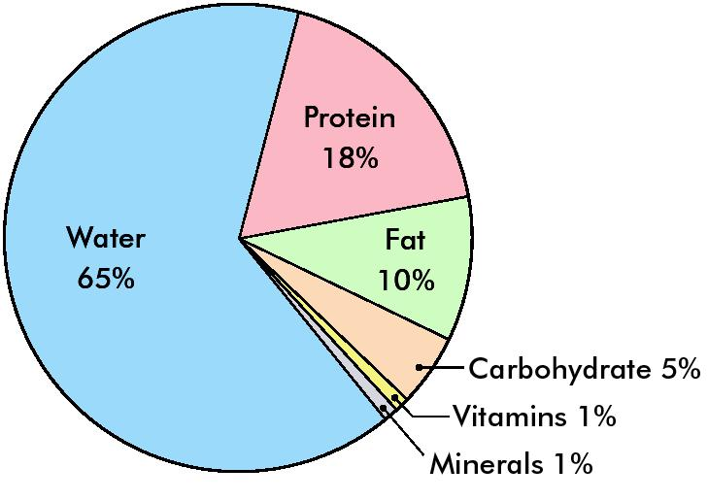
Humans are mainly made up of Water!

Slide 51
Importance of Water for Organisms
Fluid Component:
90% of cell cytoplasm,
92% of blood plasma,
97% of tissue fluid and lymph.
is a good solvent which allows
(i) cell reactions and
(ii) transport

Slide 52
Takes Part in Metabolic Reactions
Photosynthesis: water is a raw material in the light stage.
Respiration: aerobic respiration produces water.
Notes:
It is slow to heat up and cool down – kept at a fairly steady temperature – helps to keep a constant rate of metabolism.
A good absorber of energy. It absorbs a lot of heat as it evaporates, so sweating and transpiration cools animals and plants. This helps to keep temperature steady.
Participates in the movement of material in and out of cells.
Controls cell shape.

Slide 53
Control Cell Shape
moves in and out of cells, giving them the correct shape
Notes:
It is a universal solvent for transporting substances in blood or in plants
The medium for metabolism i.e. chemical reactions take place in it within cells
It is a reactant/product in chemical reactions e.g. photosynthesis, respiration and digestion

Slide 54
Good Absorber of Heat Energy
maintains its temperature despite temperature changes around it which provides stable temperatures for living things and their reactions

Slide 55
(ii) starch – iodine

Slide 56
test:
(i) reducing sugars – Benedict’s or Fehling’s solution

Slide 57
test: biuret

